Slide 1
TRANSPORTATION PLANNING AND ENGINEERING TE-501
Transportation Demand Analysis
Lecture # 3
Engr. Hina Saleemi
Assistant Professor
Department of Transportation Engineering & Management
University of Engineering & Technology, Lahore

Slide 2
Lecture Outline
Aggregate vs. Disaggregate Analysis
Surveys
Transportation Demand Analysis
Four-Step Transportation Modeling System
Step1: Trip Generation

Slide 3
Survey Data
Origin-Destination (O-D) surveys
Ask questions about each trip made on a specific day Where the trip begins and ends
Purpose of the trip
Time of day trip is made
Mode used to make the trip (vehicle, transit)
Characteristics of person (gender, age, income, vehicle owner, etc.

Slide 4
Travel Diary
Summarize the number of trips by mode, by purpose, by time of day, etc.
To do so, for each trip record the following information:
Start and end time
Start and end location of each trip,
Primary mode (drive alone, car driver with passenger, car pooling, bus, walk, bike, other)
Purpose (to work, return home, work related business, shopping, family/personal business, school, medical/dental, vacation, visit friends or relatives, social recreational, other)

Slide 5
Travel Diary
Break into groups and assess the travel diary data.
What factors most strongly influence trip-making?
What model best predicts trip-making behavior?

Slide 6
Survey Procedures
External Surveys:
Provide information on trips that either pass through the zone or have one trip end outside the zone
Internal Surveys:
Provide information on trips made by residents of an area

Slide 7
External Surveys
Cordon Surveys
Roadside interviews
License plate surveys
Postcard/mail-back surveys
Study area
Entire urbanized area
Transportation study area
City
CBD
An industrial area

Slide 8
External Surveys
Cordons should;
Define the study area/area of interest.
Define area useful for planning purposes.

Slide 9
Internal Surveys
Dwelling-unit interviews.
Vehicle owner mail questionnaires.
Interviews at workplaces and special generators.
Transit route passenger questionnaires.
Truck and taxi surveys.

Slide 10
Transportation Demand Analysis
User Costs
Cost of Automobile
Operating and Maintenance Cost
Tolls
Value of Time (time spent in travel)
Monetary Value of Time
Travelers’ willingness to pay for reduced travel time
Purpose of trip
Time saved

Slide 11
Transportation Demand Analysis
Trip-Making Characteristics
Trip Purpose
Time of day
Origin and destination of the trip
Mode of travel
Route
Frequency

Slide 12
Aggregate Vs Disaggregate Analysis
Zonal-Based (Aggregate models)
Zone as the smallest entity of interest for trip making Zonal characteristics (Population, Average income, Average vehicle ownership)
Household-Based (Disaggregate models)
Disaggregate each zone into smaller units

Slide 13
Travel Demand Forecasting
Travel demand- number of persons or vehicles per unit time expected to travel on a given route under a set of conditions:
Land use
Socio-economic
Environmental

Slide 14
What Travel Decisions can be Modeled
Forecasts should be based on some understanding of traveler decisions.
There are four distinct, but interrelated, decisions regarding trips:
The choice and reason to travel
The destination of travel
The mode by which to travel
The route on which to travel

Slide 15
Four Step Travel Demand Model
These four decisions are the basis of the traditional four-step travel demand model
Sequential demand model
Outputs of each step become inputs to the following step
Originally developed in the 1950’s and 1960’s when planning major highway facilities

Slide 16
Four Step Travel Demand Model
TRIP GENERATION
How many trips will be generated by a given location and when will these trips occur?
2. TRIP DISTRIBUTION
What are the origins and destinations of these trips?
3. MODE CHOICE
Which mode of transportation will be used to make the trip?
4. TRAFFIC ASSIGNMENT
Which route on the transportation network will be used when making the trip?

Slide 17
Four Step Travel Demand Model (FSTDM)
Demographic Data
Step 1: Trip Generation
Transportation Network
Step 2: Trip Distribution
Step 3: Mode Choice
Step 4: Trip/ Traffic Assignment

Slide 18
Trip Generation Questions
How much do people use the transport system?
Why do people use the transport system?
Where can different types of activities be satisfied?

Slide 19
Trip Distribution Questions
Given a location, where do people go to satisfy demand for an activity type?

Slide 20
Mode choice Questions
How do people use the transport system?
What modes do they choose?
How do they react to varying transport service quality?

Slide 21
Trip / Traffic Assignment Questions
How do people use the transport system?
Given a mode, which route do they choose?
Do they satisfy multiple activities in one tour?
Which parts of the transport system do they use?
How do they react to varying transport service quality?

Slide 22
Demographic Data
Autos per household
Income level
Household size

Slide 23
Network Data
Highway network
Transit network

Slide 24
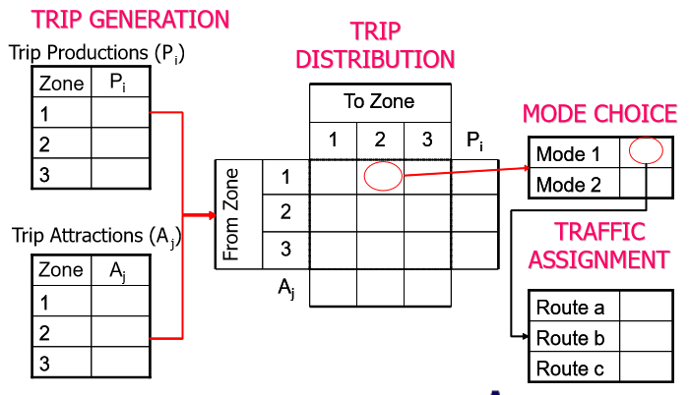
Example of Four Step Model

Slide 25
What Factors Influence Travel Demand
Location and intensity of land use
(Residential, Industrial, Commercial, Office, Institutional/Civic, Parks/Open Space, Extent, cost and quality of available transportation services)
Socioeconomic characteristics of study area
Population Forecasts
Economic Forecasts
Land Use Forecasts

Slide 26
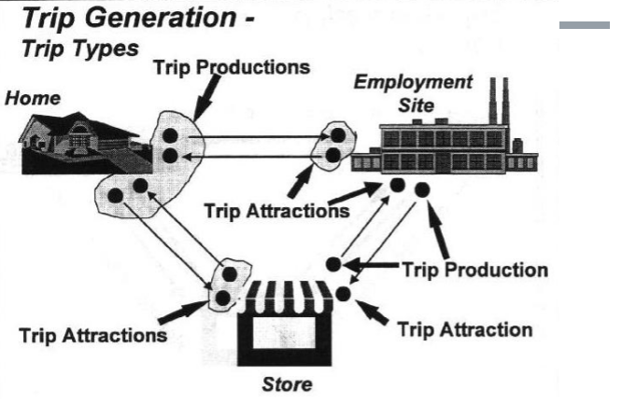
STEP 1 : Trip Generation

Slide 27
Trip Generation
Process of determining the number of trips that will begin or end in each traffic zone within a study area Each trip has two ends.
Described in terms of trip purpose or whether the trips are either produced by a zone or attracted to a zone

Slide 28
Trip Generation
Trip Purposes
Home-Based Work (HBW, H2W, W2H)
Trips between home and work
Home-Based Other (HBO, H20, O2H)
Trips between home and other places such as shopping or recreation
Non-Home Based (NHB, W2O, O2W, O2O)
Trips that do not involve the home

Slide 29
Trip Generation
Purpose is to establish relationships between variables that predict the amount of traffic a part of land will produce or attract
Data may be aggregated at zonal level or at household level
Based on characteristics of the trip-makers
Age, gender, income, auto ownership, etc

Slide 30
Trip Generation
Trip generation is the process of determining the number of trips that will begin or end in each TAZ within a study area.
It is the first step of the four-step modelling procedure and is very important since it sets up:
The framework for the following tasks, and also
The controlling values such as the total number of trips generated in the study area by location and trip purpose.
Notes:
The commonly used units for trip generation analysis usually include a household, a ‘dwelling unit’ (DU), and a business establishment. However, the results of a trip generation analysis for a study area are aggregated based on larger areas known as ‘traffic zones’

Slide 31
Trip Generation (contd.)
Trip?
A trip, for the purpose of analysis, is defined as a one-way movement from an origin to a destination.
Each trip has two ends, and these are described in terms of trip purpose, or whether the trips are either produced by a traffic zone or attracted to a traffic zone.
For example, a home-to-work trip would be considered to have a trip end produced in the home zone and attracted to the work zone.
Origin
Destination
Notes:
Since the trips are determined without regard to destination, they are referred to as trip ends.
Typically, a trip is defined as movement which has ‘origin’ destination’ and a purpose. Based on its O-D, trips are classified as home-based, non-home based trips. Whereas, based on the purpose, a trip generation is classified as trip production or attractoion.

Slide 32
Trip Generation Analysis
Two types of trip generation analysis are carried out, and these are referred to as,
Trip production analysis, and
Trip attraction analysis
Notes:
The social and economic character of the users attributes like average family income, education, and car ownership.

Slide 33
Trip Generation Analysis (contd.)
The term trip production refers to the trips generated by residential zones, where these trips may have trip origins or trip destination.
The term trip attraction is used to describe trips generated by activities at the non-home end of trips.
Notes:
One end is home in trip production, and non home-end trips are trip attractions.

Slide 34
Trip Classification
Urban travel demands are made up of a number of different trip types that have specific spatial and temporal characteristics.
The first level of trip classification, used normally, is a broad grouping into,
Home based trips; trips that have one trip end at a household
Non-home based trips; e.g. trips b/w work place and shopping area, business trips b/w two activity centres, etc.
Notes:
Both trips are analysed separately i.e. separate models should be developed b/c types of variables and/or extent of their influence on trip-making may vary for both the types.

Slide 35
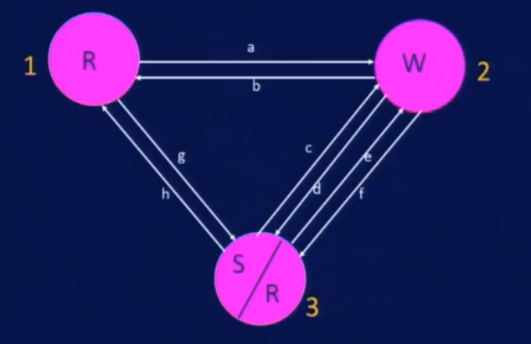
Trip Classification
Total Trips = 8
4 trip ends are produced at zone 1
6 trip ends are attracted to zone 2
2 trip ends are produced at and 4 trip ends are attracted to zone 3.
Notes:
Home-based trips are used for trip production analysis. Likewise, non-home based trips will be used for trip attraction analysis.

Slide 36
Trip Generation Analysis
Simply, trip generation analysis has two functions:
The goal of trip generation models for internal passenger trips is to estimate total number of ‘trip ends’ for each purpose generated in each traffic zone based on socio-economic and/or land use data for the respective zones.
To use the relationship to estimate the number of trips generated at some future date under a new set of land use conditions.
Notes:
To develop a relationship between trip end production (or attraction) and land use, and

Slide 37
Trip Generation Analysis (contd.)
This task can be accomplished with either aggregate or disaggregate models.
For aggregate models the total number of trips (trip ends) generated in a zone is used as the dependent variable.
For disaggregate models trips made by a household (or a business establishment) is used as the dependent variable. When using disaggregate models the trip ends generated by households, and/or any other trip generating units such as business establishments, in a zone are combined to produce the zonal (total) value.
Notes:
The difference between the aggregate and disaggregate techniques is mainly in the data efficiency.
The disaggregate approach is based on large samples of household types and travel behaviours and uses data directly. There are savings in the amount of data required and some of the data can be transferred to other applications. The disaggregate approach expresses non-linear relationships and is more easily understood.

Slide 38
Trip Generation Analysis (contd.)
Cross-Classification
Rate Based Analysis
Multiple Regression Analysis – aggregated model
- household generated trips comprise a major portion of all trips in an urban area (more than 80%).
disaggregate models
Notes:
The development of aggregate models usually requires a full-scale O-D survey.
One advantage of disaggregate models is that for developing these models a full-scale O-D survey is not needed.
WHY?
Recall, that the movements could be internal-internal, internal-external, and through movement. However, the main focus is on internal-internal movement here.
Household generated trips comprise a major portion of all trips in an urban area. Actually more than 80% of trips in an urban area are generated by the residents of households in the area. Trips by non-residents and a variety of other vehicles including commercial vehicles such as taxis and trucks, and public utility and public service vehicles comprise the remaining portion of total travel.

Slide 39
LAB WORK 4
System Descriptive Model
Traffic Counts at Closed Loop
(Real Time Problem)

Slide 40
Traffic count at 4 Intersection
Garhi Shahi Intersection
Butt Sweets Intersection
Queen Marry Intersection
Cakes and Bakes Intersection

Slide 41
Any Questions

