Slide 1

TRANSPORTATION PLANNING AND ENGINEERING
TE-501
Transportation Problems and Models in Transportation
Lecture # 2
Engr. Hina Saleemi
Assistant Professor
Department of Transportation Engineering & Management
University of Engineering & Technology, Lahore

Slide 2
Lecture Outline
Transportation Problems
Transportation Goals and Objectives
Time Horizon
Travel Demand Forecast
Study Area
Traffic analysis Zone
Data Collection
Transportation Inventories
Highway Planning Study
Travel Decisions
System Descriptive Model

Slide 3
Transportation Problems
Service Related
Congestion
Inadequate Capacity
Higher user costs
Safety Issues
Right-of-way and relocation issues
Air Pollution
Noise
Other Factors Affecting Transportation
Population growth and dispersion
Increased automobile ownership

Slide 4
Transportation Goals and Objectives
Goals related to transportation service, impact and affecting factors are:
Increased access
Efficiency and Economy
Conservation of natural resources
Performance measures
Travel times
Constraints and Standards
Budget

Slide 5
Transportation Planning-Time Horizons
Short term transportation planning :
Intended for projects implemented in 1 to 3 years to provide better management of existing facilities e.g Traffic signal retiming, transit improvements.
Long term transportation planning
Considers projects to be constructed over a 20 year period .Adding new highway elements, adding bus lines or freeway lanes, etc.

Slide 6
Travel Demand Forecasting
Used to establish vehicular volumes on future or modified transportation system alternatives .
Urban transportation forecasting process includes the following elements:
Define the study area
Data collection or inventories
Analysis of existing conditions and calibration of forecasting techniques
Forecast of future travel demand
Analysis of results

Slide 7
Transport Survey Design
This series of lectures is designed to cover important aspects related to Transport Surveys including
  Information needed
  Study area definition
  Zoning
  Types of movement
  Types of surveys
  Survey design
  Sampling methods and size
  Data processing and analysis

Slide 8
Information-needed
Typical information required from the data collection can be grouped into four categories, enumerated as below.
Socio-economic data: Information regarding the socio-economic characteristics of the study area. Important ones include income, vehicle ownership, family size, etc. This information is essential in building trip generation and modal split models.
Travel surveys: Origin-destination travel survey at households and traffic data from cordon lines and screen lines. Former data include the number of trips made by each member of the household, the direction of travel, destination, the cost of the travel, etc. The latter include the traffic flow, speed, and travel time measurements. These data will be used primarily for the calibration of the models, especially the trip distribution models.

Slide 9
Information-needed
Land use inventory: This includes data on the housing density at residential zones, establishments at commercial and industrial zones. This data is especially useful for trip generation models.
Network data: This includes data on the transport network and existing inventories. Transport network data includes road network, traffic signals, junctions etc. The service inventories include data on public and private transport networks. These particulars are useful for the model calibration, especially for the assignment models.

Slide 10
THE STUDY AREA
Once the nature of the study is identified, the study area can be defined to encompass the area of expected policy impact. The study area need not be confirmed by political boundaries, but bounded by the area influenced by the transportation systems. The boundary of the study area is defined by what is called as external cordon or simply the cordon line.

Slide 11
Definition of The Study Area
The study area for which transportation facilities are being planned is first of all defined.
For planning at the urban level, the study area should embrace the whole contribution containing the existing and potential continuously built up areas of the city.
Interactions with the area outside the cordon are defined via external stations which effectively serve as doorways to trips, into, out of, and through the study area.
Notes:
iii. What is potential of growth towards Thokar Niaz Baig?
Transportation planning can be at the national level, the regional level, or at the urban level.

Slide 12
Definition of The Study Area
The imaginary line representing the boundary of the study area is termed as the ‘‘ external cordon line’’
The area inside the external cordon line determines the travel pattern to a large extent, and as such, it is surveyed in great detail.
The land-use pattern and the economic activities are studies intensively and detailed surveys (such as the home-interview) are conducted in the area to determine the travel characteristics.
On the other hand, the area outside the cordon line is not studied in such details.
Notes:
Outside are trips may influence trip pattern of inside area as there could be internal to external trips or vice versa.

Slide 13
Definition of the Study Area
In short, study area should be defined such that
  majority of trips have their origin and destination in the study area, and
  should be bigger than the area-of-interest covering the transportation project.
Notes:
Outside trips may influence trip pattern of inside area as there could be internal to external trips or vice versa.

Slide 14
Selection of External Cordon Line
The selection of the external cordon line for urban transportation planning should be done carefully with due consideration to the following factors:
    i. The external cordon line should circumscribe all areas, which are considered likely to be developed during the planning period.
    ii. The external cordon line should contain all areas of systematic daily life of the people oriented towards the city centre and should in effect be the commuter shed.
Notes:
ii. For example, people might be commuting from a suburban area to the city daily, in that case cordon line must include that suburban pocket too. For example, in case of Lahore, Shahdra can be a suburban pocket which needs to be inside the cordon line as people commute daily from there.

Slide 15
Selection of External Cordon Line
  iii. The external cordon line should be continuous and uniform in its course so that movements cross it only once. The line should intersect roads where it is safe and convenient for carrying out traffic survey.
  iv. The external cordon line should be compatible with the previous studies of the area or studies planned for the future.
Notes:
iv. Significance of fourth point is that the previous studies could be related to census, which are done at district, municipal and more sub-levels. In that way, information can be integrated and can be projected at a national level. Therefore, external cordon line should preferably match the revenue border line.
Secondly, data available for those studies can be used for comaprison, cross check.

Slide 16
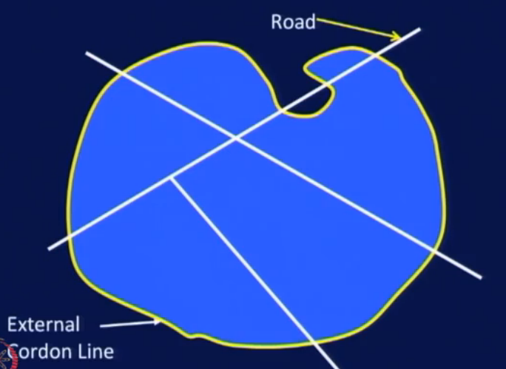
Notes:
A sample of the zoning of a study area is shown.
Radiating roads crossing external cordon line at one point.
? What is wrong here, identify, and what can be done to rectify it?

Slide 17
Zoning for Transportation Planning
The defined study area is sub-divided into smaller areas called zones or traffic zones.
The purpose of such a sub division is to facilitate the spatial quantification of land use and economic factors, which influence travel pattern.
Sub division into zones further helps in geographically associating the origins and destinations of travel.
Notes:
Purpose of Zoning:
First: Spatial quantification of an area (i.. Socio-economic characteristics) so that it can be taken as an attractive force or trip producing force.
Significance, spatial quantification cannot be done, unless you divide the Study area into this kind of zones.
Spatial analysis or spatial statistics includes any of the formal techniques which study entities using their topological, geometric, orgeographic properties.
Secondly, these economic factors will influence travel pattern.

Slide 18
Zoning
Zones within the study area are called internal zones and those outside the study area are called external zones.
In large study projects, it is convenient to divide the study area into sectors, which are sub divided into zones.
Zones can themselves be sub divided into sub-zones depending upon the type of land use.

Slide 19
Zoning
A convenient system of coding of the zones will be useful for the study. One such system is to divide the study area into 9 sectors.
The central sector (CBD) is designated 0, and the remaining eight are designated from 1 to 8 in a clockwise manner.
The prefix 9 is reserved for the external zones.
Each sector is sub divided into 10 zones bearing numbers 0 to 9.
If necessary, each zone can be divided into 10 sub-zones bearing numbers from 0 to 9.
Notes:
This kind of coding will help you to understand database much more better, and would help you to perceive location of a particular zone or sub-zone.

Slide 20
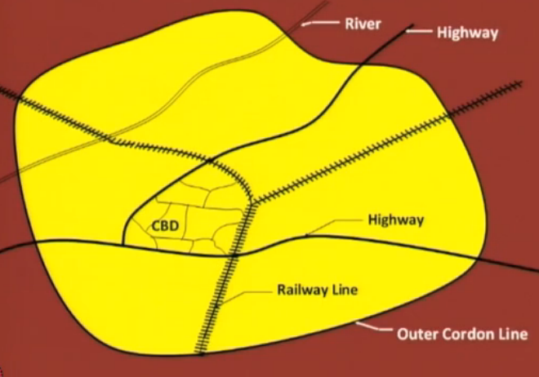
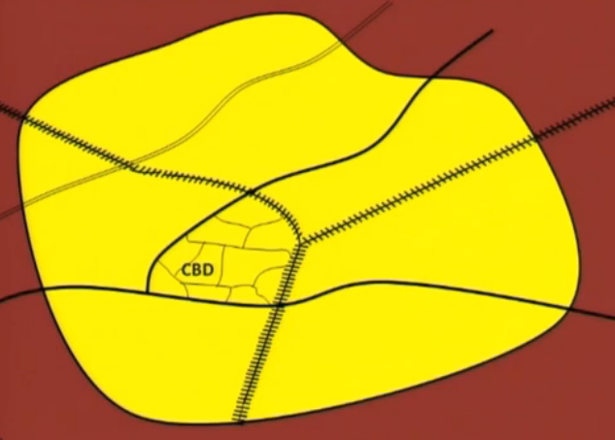
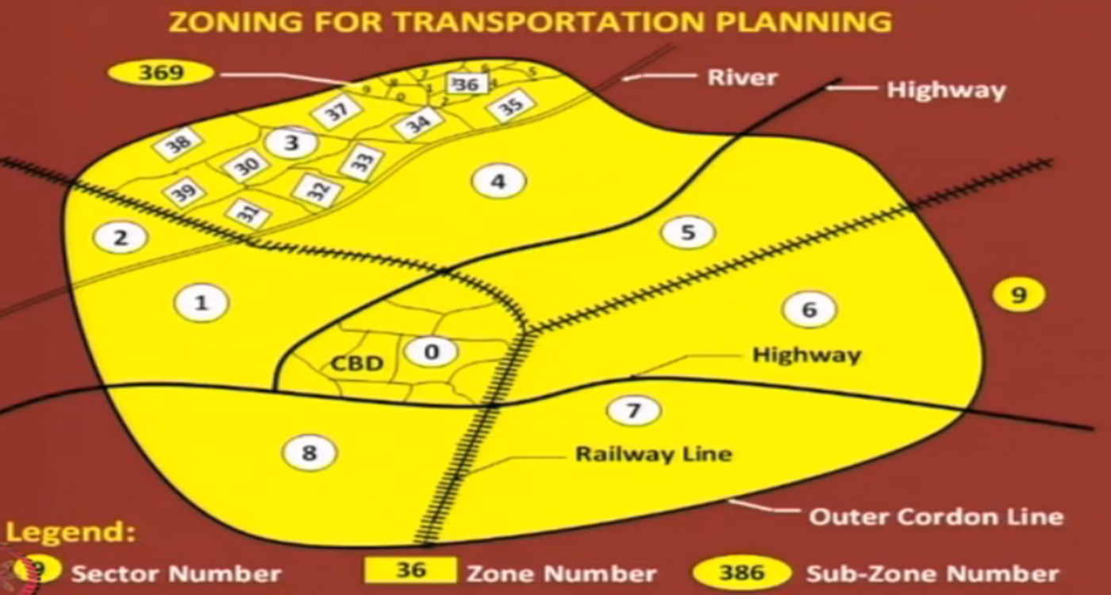
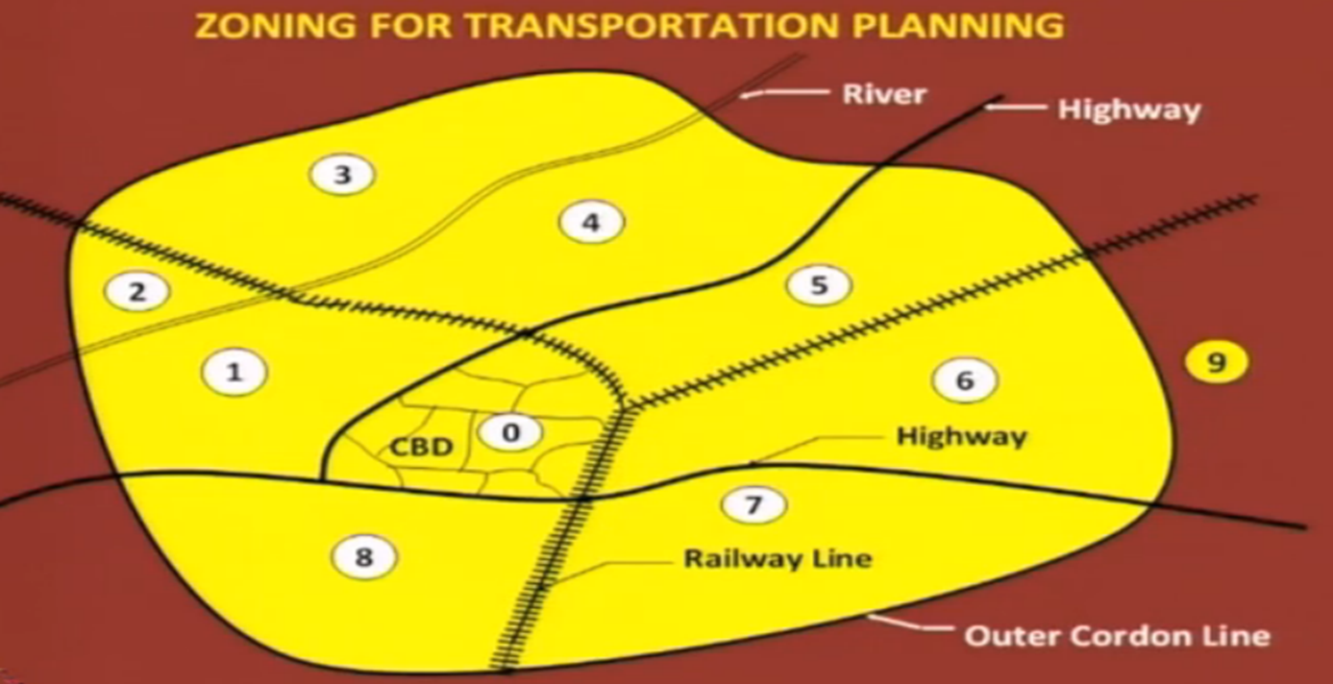
Zoning

Slide 21
Zoning
It would be helpful, if the following points are kept in view when dividing the area into zones:
The zones should have a homogeneous land use so as to reflect accurately the associated trip making behaviour.
Anticipated changes in land use should be considered when sub-dividing the study area into zones.
It would be advantageous, if the sub division follows closely that adopted by other bodies (e.g. census department) for data collection. This will facilitate correlation of data.
Notes:
ii. There could be a residential area which is rapidly transferring into a commercial area e.g. Food Street. Or there can be a less developed residential zone with agriculture or vacant land in b/w. so you should take it take whole area as a single zone.
Such changes need to be foreseen. A transport planner must have an idea about histroy of development of Study Aea.
Discuss Lahore example and its administrative classification, or overall classification at national level

Slide 22
Zoning
iv. The zones should not be too large to cause considerable errors in data. At the same time, they should not be too small either to cause difficulty in handling and analysing the data.
As a general guide, a population of 1000-3000 may be the optimum for a small area; and a population of 5000-10000 may be the optimum for large urban areas.
In residential areas, the zones may accommodate roughly 1000 households.

Slide 23
Zoning
v. The zones should preferably have regular geometric form for easily determining the centroid, which represents the origin and destination of travel.
vi. The sectors should represent the catchment of trips generated on a primary route.
vii. Zones should be compatible with screen lines and cordon lines.

Slide 24
Zoning
viii. Zone boundaries should preferably be watersheds of trip making.
ix. Natural or physical barriers such as canals, rivers etc. can form convenient zone boundaries.
Notes:
Earlier in catchment area of trips we talked about commuter sheds. Now watersheds mean that zone boundary should preferable be a road or a railway line so that it can collect a trip just like watershed.

Slide 25
Points to Consider
In addition to the external cordon lines, there may be a number of internal cordon lines arranged as concentric rings to check the accuracy of survey data.
Screen lines running through the study area are also established to check the accuracy of data collected from home-interview survey.
Screen lines can be conveniently located along physical or natural barriers having a few crossing points.
  Examples of such barriers are rivers, railway lines, canals, etc.

Slide 26
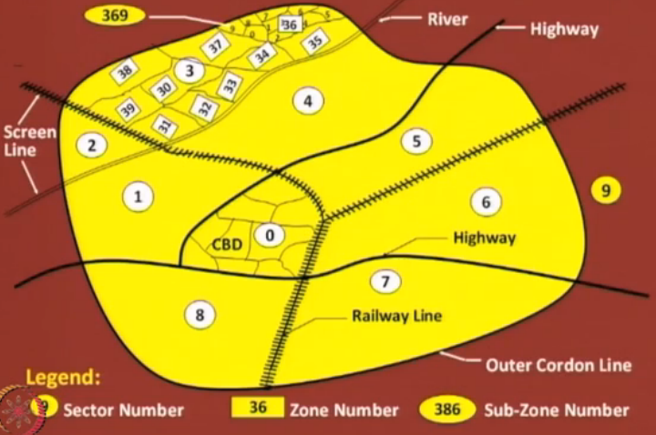
Zoning
Notes:
Screen lines act as barriers for traffic.

Slide 27
Types of movement
The basic movements for which survey data required are:
    Internal to internal
    External to external
    Internal to external
    External to internal
Notes:
After completing the zoning process, the next stage is data collection. We need to think about type of survey which can collect information.

Slide 28

Types of movement

Slide 29
Defining the Study Area
Define the study area boundaries.
Further subdivide the area into traffic analysis zones (TAZ).

Slide 30
Traffic Analysis Zone-TAZ
Defined as:
“a special area defined by state and/or local transportation officials for tabulating traffic-related data”
Usually consists of one or more census blocks or block groups.

Slide 31
Traffic Analysis Zone-TAZ
Guidelines for establishing TAZ :
Socioeconomic characteristics should be homogeneous.
Intra-zonal trips should be minimized.
Zones should not be created within other zones.
The zone system should generate and attract approximately equal trips, households, population or area.
Zones should be approximately equal in size (smaller in downtown areas and larger on the periphery).

Slide 32
Traffic Analysis Zone-TAZ
Other Guidelines :
Boundaries are major roadways or physical barriers such as railways or rivers.
Political and historical boundaries should be used where ever possible.
Zones should use census tract boundaries where possible.

Slide 33
Data Collection
This phase provides information about the city and its people. Serves as the basis for developing travel demand estimates
Includes information about:
Economic activity (employment, sales volume, income, etc.)
Land use (type, intensity)
Travel characteristics (trip and traveler profile)
Transportation facilities (capacity, travel speed, etc.)
Data may be collected using surveys or can be based on previously collected data

Slide 34
Data Collection
The data can be collected
    At home,
    During the trip, and
    At the destination of the trip
Most details of internal to internal travel can be obtained by home interview survey.
The details of internal-external, external-internal, and external-external travels can be studied by cordon surveys.

Slide 35
Data Collection
When collected at home, the data can be wide ranging and can cover all the trips made during a given period.
The data collected during the trip is necessarily of limited scope since the procedure yields data only on the particular trip intercepted.
At the destination end, the direct interview types of surveys provide data on demand for parking facilities and or the trip ends at major traffic attraction centres such as factories, offices and commercial establishments.

Slide 36
Types of Surveys
Home-interview survey
Commercial vehicle survey
Intermediate public transport survey
Public transport surveys
Road-side-interview surveys
Post-card-questionnaire surveys
Registration-number surveys
Tag-on-vehicle surveys
Notes:
The following are the surveys that are usually carried out:

Slide 37
Transportation Inventories
Involve:
Description of the existing transportation services
Available facilities and their condition
Location of transit routes and schedules
Maintenance and operating costs
System capacity and existing traffic volumes, speed and delay
Property and equipment
Type of data collected depends on the project

Slide 38
Highway Planning Study
Data needs:
Functional classification of roadways in system
Freeways, arterials, collectors and local roads
Physical roadway features
Number of lanes, pavement width, traffic signals, traffic control devices
Street and highway capacity for segments and intersections
Travel times along the arterials

Slide 39
Highway Planning Study
Computerized network of existing roadway system is then produced
Network consists of a series of links, nodes and centroids
Link: portion of the highway system that can be described by its capacity, lane width and speed
Node: end point of a link and represents an intersection
Centroid: location within a zone where trips are considered to begin and end

Slide 40
Traveler Decisions
Forecasts should be predicated on some understanding of traveler decision.
The various decisions will ultimately determine the: Quantity,
Spatial distribution (by route), and
Temporal distribution of vehicles on a highway network

Slide 41
What is a Model
Modeling is the process of constructing a mathematical object whose behavior or properties correspond in some way to a particular real world system.
A mathematical object could be a system of equations, an algorithm, a geometric or algebraic structure, or even just a set of parameters.

Slide 42
System Descriptive Model
“A system descriptive model describes logical relationships, such as the system’s whole part relationship that defines its part tree, the interconnection between its parts, the functions that its components perform, or the test cases that are used to verify the system requirements.”

Slide 43
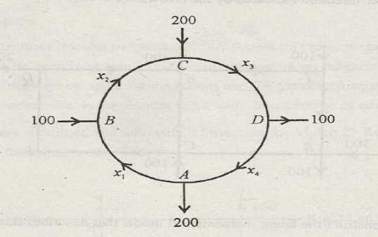
System Descriptive Model
- Develop the system equations.
- Solve the system when x4 = 300

Slide 44
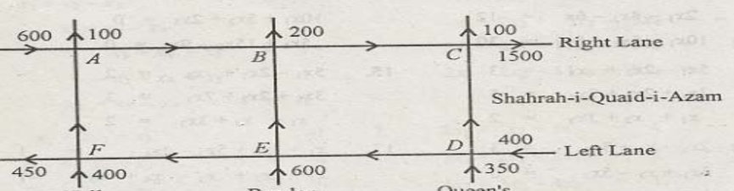
System Descriptive Model
-Develop mathematical model
Calculate traffic flow on missing lanes when traffic form E to F is at least 50 vehicles
Calculate flow on missing lanes when flow from D to E is zero.

Slide 45
LAB WORK 2
System Descriptive Model
(Real Time Problem)

Slide 46
Garhi Shahu Intersection
Visit Garhi Shahu Intersection near UET Lahore
Traffic count for one complete hour
Share the data

Slide 47
LAB WORK 3
System Descriptive Model
(Real Time Problem)

Slide 48
Garhi Shahu Intersection
Traffic volume study for a complete network including two intersections
Develop system descriptive model for that network

Slide 49

Any Questions

