Slide 1

TRANSPORTATION PLANNING AND ENGINEERING
TE-501
Introduction
Lecture # 1
Engr. Hina Saleemi
Assistant Professor
Department of Transportation Engineering & Management
University of Engineering & Technology, Lahore

Slide 2
Course Objectives
To provide comprehensive theoretical and technical knowledge of the concepts involved in Transportation Planning and Engineering along with the analytical tools and methodologies that are used in practical application.

Slide 3
Course Objectives
Transportation Planning related topics are intended to provide knowledge of different planning principles, relationship between transportation and land use, travel demand forecasting, demand versus supply characteristics, and the development and evaluation of alternative systems.
Transportation Engineering related topics will cover design and operation of transportation systems as well as strategies to improve system efficiency and safety.

Slide 4
Course Outcomes
This course is intended to provide students with in depth theoretical and technical knowledge of Transportation Planning and Engineering concepts as well as prepare them for the practical tasks involved in planning, design and operation of the transportation system and developing strategies to improve the system efficiency and safety.

Slide 5
Lecture Outline
Transportation Planning
Transportation Engineering
What planning is About?
What is Transportation means?
Transportation System
Transportation system Classification
Transportation Planning Outcomes
Transportation Project
Factors Affecting Transportation Projects

Slide 6
What is Transportation Planning?
Planning is done by human beings for human beings. It is future oriented and optimistic.
Urban Transportation Planning (TP) is the process that leads to decision on transportation policies and programs. The objective of TP process is to provide information necessary for making decisions on when and where improvements should be made in the transportation system, thus promoting travel and land development patterns that are in keeping with community goals and objectives.

Slide 7
An Overview Of Transportation Planning
Monitoring existing conditions;
Forecasting future population and employment growth, including assessing projected land uses in the region and identifying major growth corridors;
Identifying current and projected future transportation problems and needs and analyzing, through detailed planning studies, various transportation improvement strategies to address those needs;
Developing long-range plans and short-range programs of alternative capital improvement and operational strategies for moving people and goods;
Estimating the impact of recommended future improvements to the transportation system on environmental features, including air quality; and
Developing a financial plan for securing sufficient revenues to cover the costs of implementing strategies

Slide 8
Transportation Planning
Transportation planning deals with planning of transportation facilities to meet present and future needs in sustainable manner e.g estimation of future demands, needs & problems, preparing plan for implementations.

Slide 9
Transportation Planning
Transportation planning is a process that leads to the decision on transportation policies and programs.
In other words a process to provide information necessary for making decision on when and where improvements should be in the transportation system, thus promoting travel and land development patterns that are in keeping with community goals and objectives.

Slide 10
Transportation Engineering
Transportation engineering or transport engineering is the application of technology and scientific principles to the planning, functional design, operation and management of facilities for any mode of transportation in order to provide for the safe, efficient, rapid, comfortable, convenient, economical, and environmentally compatible movement of people and goods.

Slide 11
What Transportation Planning is about?
The basic purpose of the transportation is to provide efficient access to various activities that satisfy the human needs.
Thus general goal of the transportation is to
accommodate these needs for mobility Whose mobility? for what purpose? by what means? at what cost? and to whom?
Transportation Planning is about five important points:
Understanding of travel pattern in urban area

Slide 12
What Transportation Planning is about?
Understanding of causing factors that influence the demand for travel pattern
Development of relationship between travel pattern and causing factors
Application or use of this relationship to predict future demand for travel and to predict future travel pattern
Prediction of transport infrastructure requirement based on the predicted travel demand

Slide 13
What Transportation Planning is about?
Transportation planning is the process of defining future policies, goals, investments and designs to prepare for future needs to move people and goods to destinations.
“A collaborative and participatory process involving agencies, organizations and the public in a comprehensive look at national, state, regional and community needs…It examines demographic characteristics and travel patterns for a given area, shows how these characteristics will change over a given period of time and evaluates alternative improvements for the transportation system.“
(Definition by Designing Walkable Urban Thoroughfares)

Slide 14
Transportation Planning Aspects
The planning aspects of transportation engineering relate to urban planning, and involve technical forecasting decisions and political factors.
Technical forecasting of passenger travel usually involves an urban transportation planning model, requiring the estimation of trip generation (how many trips for what purpose), trip distribution (destination choice, where is the traveler going), mode choice (what mode is being taken), and route assignment (which streets or routes are being used).

Slide 15
Transportation Planning Aspects
More sophisticated forecasting can include other aspects of traveler decisions, including auto ownership, trip chaining (the decision to link individual trips together in a tour) and the choice of residential or business location (known as land use forecasting). Passenger trips are the focus of transportation engineering because they often represent the peak of demand on any transportation system.
Requires accurate regional economic forecasts as well as accurate forecasts of highway users’ social and behavioral responses regarding trip-oriented decisions, in order to predict growth/decline trends and traffic diversion

Slide 16
Transportation Planning
Primary Purpose:
To generate information useful to decision makers on the consequences of alternative transportation actions
Decision Makers - $
Technical Limitation of Decision Maker
Process of:
Understanding the types of decisions that need to be made
Assessing opportunities and limitations of the future
Identifying short and long-term consequences of alternative choices
Relating alternative decisions to the goals and objectives for the area
Presenting the information to decision makers in an understandable and useful form

Slide 17
Transportation Planning
Transportation Planning Process :
How decisions to build transportation facilities are made
Evaluation and selection of highway or transit facilities to serve present and future land uses
Factors commonly used to justify projects :
Improved traffic flow
Improved safety
Savings in energy consumption
Savings in travel time
Economic growth
Increased accessibility
Other reasons
Stimulate employment in a particular region
To compete with other cities /areas for prestige
To attract industry
To respond to political pressures

Slide 18
Transportation Planning
Projects may NOT be selected due to:
Opposition from those that would be adversely affected
A new highway that may require acquisition of residential property
A new airport that may cause excessive noise due to low flying planes
Basic Elements:
Situation definition
To understand the situation that gave rise to the need for transportation improvement
Problem definition
To describe the problem and to identify quantifiable objectives
Search for solutions
To identify a variety of ideas, designs, locations, configurations that may provide solutions
Analysis of performance
To estimate how each of the proposed alternatives would perform under present and future conditions

Slide 19
Transportation Planning
Basic Elements (continued)
Evaluation of alternatives
To determine how well each alternative will achieve the stated objectives
Choice of project
Made after all factors are consideration
Specification and construction
Detailed design phase for selected project

Slide 20
What is Transportation?
Travel
  Origin and Destination
Purpose
  Home
  Work/Work-Related
  Shopping
  Social/Recreational
  Other
  Modes
  Personal
  Public
Modes:
  Personal Automobile
  Rail/Transit
  Bus
  Walking/Bicycling

Slide 21
Trips
A trip is a movement with two ends – an origin and a destination.
Trip 1
Home
Work
Trip 2
Notes:
Discuss Purposes – why make trips at all?

Slide 22
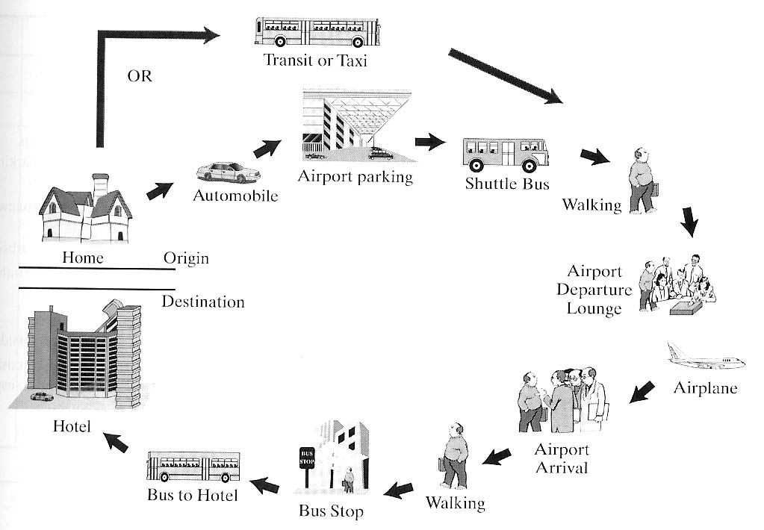
A trip may entail multiple modes…
Notes:
Home
Work/Work-Related
Shopping
Social/Recreational
Deliver Goods

Slide 23
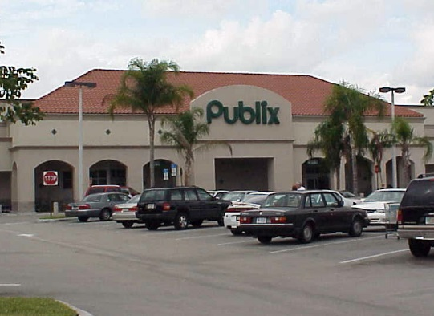
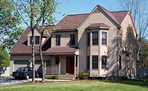
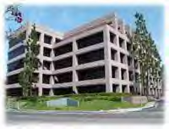
A Simple View of Trips and Purposes
Shop Trip
Work Trip
Most travel is typically assumed to have home as either an origin or destination.

Slide 24
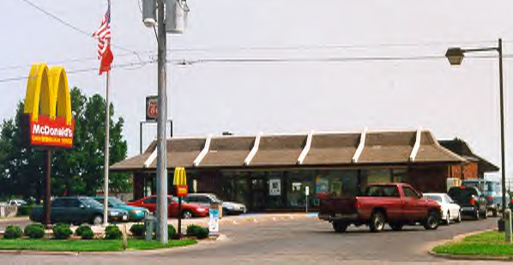
Trip Tours
In reality, people link trips into multi-purpose tours

Slide 25
Transportation System
A system is a group of interdependent and interrelated components that form a complex and unified system intended to serve some purpose through the performance of its interacting parts.
Understanding of the transportation system is very important to understand travel pattern and behavior of people in urban area.

Slide 26
Transportation System
A transportation system may be defined as consisting of the fixed facilities, the flow entities, and the control system that permit people and goods to overcome the friction of geographical space (i.e. to move from one point to other) efficiently in order to participate in a timely manner in some desired activity.
Fixed Facilities
Flow Entities
Control System

Slide 27
Transportation System
Fixed facilities: Fixed facilities are the physical component of the system that are fixed in space and constitute the network of links (e.g. roadways, rail tracks etc) and nodes (e.g. intersections, interchanges, transit terminals, airports etc)

Slide 28
Transportation System
Flow entities: flow entities are the units that use the fixed facilities. They include all types of vehicles.

Slide 29
Transportation System
Control system: The control system consists of vehicular control and flow control.
Vehicular control: e.g. Manual control in vehicles
Flow control: e.g. control of traffic on roads.

Slide 30
Transportation System Classification
Mainly- Passenger and Freight Transportation
Four major subsystems according to modes
Land Transportation
o Highway
o Rail
Air Transportation
o Domestic
o International
Water Transportation
o Ocean
Pipelines
o Oil
o Gas

Slide 31
Transportation System Classification
Modes of the System
Highways
Railways
Waterways
Airways
Pipelines
The Components of the mode
The way
The vehicle
The Terminal
The control
The user
Development of Components
Planning
Evaluation
Construction
Operation
Maintenance

Slide 32
Modal Classification
Any transportation system consists of various modes of travel ranging from walking to driving to use crafts that fly.
The classification of transportation system is to form classes of different modes of travel. Such classification is termed as modal classification.

Slide 33
Modal Classification
Mode: A mode of transport may be simply defined as means of transportation. A mode includes walking, bus, train, ferry boat, ship, aircraft, helicopter and so on.
1. Roadways
2. Railways
3. Airways
4. Waterways

Slide 34
Modal classification
ROADWAYS: All vehicles use roadways to travel from one point to other.
Motorized vehicles: automobiles, trucks, buses etc
Non-motorized vehicles: cycles, animal carts
Types of Roads:
Expressways/Freeways
Arterials/state highways
Collectors/District roads
Local roads

Slide 35
Modal classification
Expressways/Freeways: These are intercity roads with high speed of travel and with limited access.
State Highways/ Arterials: These are intra city roads with high speed and controlled access.
Collectors: These roads collects traffic from local and merge it into arterials.
Locals: These roads have very good accessibility. These can be accessed by every home. But these roads offer very low speed.

Slide 36
Modal classification
Important aspects of roadways are:
Safe and efficient operation
Control of road traffic
Layout of roads
Structural design of roads
Pavement design
Public transportation

Slide 37
Modal classification
RAILWAYS: In this mode of travel all vehicles use rail track to move from one point to another.
Vehicles in this class consist of a long train of coaches attached to locomotive. This mode is used to transport people as well as goods. These are good for high speed mass transit.
The movement of trains on rail tracks is controlled through signal systems, operated either manually or automatically.

Slide 38
Modal classification
Stations: Pre-specified locations where trains stop are known as stations.
Following activities take place at stations:
Boarding and alignment of passengers
Loading and unloading of goods
Regrouping of coaches
Maintenance of activities
Ticketing

Slide 39
Modal classification
Important aspects of railways are:
Safe and efficient operation
Control of rail traffic
Layout of rail tracks
Structural design of sub grade on which rail tracks run
Planning of stations

Slide 40
Modal classification
WATERWAYS: In this form of transport all vehicles use channels in water bodies (like rivers, lakes, and oceans) to travel from one point to another.

Slide 41
Modal classification
Important aspects of waterways are:
Safe and efficient operation
Control of ship traffic specially at and near ports
Planning and operation of ports

Slide 42
Modal classification
AIRWAYS: In this mode of transport vehicles use air routes to travel from one point to another.
Air routes are charted paths in the air based on various characteristics like directness of connections, prevailing atmospheric and wind connections, international agreements and safety issues,
The activities at an airport are:
Boarding and alighting of passengers
Loading and unloading of cargo
Refueling
Maintenance
Air traffic control
Ticketing

Slide 43
Modal classification
Important aspects of airways are:
Safe and efficient operation
Control of air traffic specially at and near airports
Planning and operation of airports
Orientation of runways
Planning and parking pattern of aircrafts
Structural design of runways, taxiways, and aprons
Planning and operation of vehicle circulation and parking

Slide 44
Elemental classification
A transportation system can be classified in terms of the basic elements which constitute any mode of transport. These are
Driver
Vehicle
Way
Control
Terminal
User

Slide 45
Elemental classification
Driver: Every mode of transportation have a driver who controls the vehicle used in that mode.
Vehicle: The vehicles used in the transportation have certain characteristics (for example: turning radius, braking distance, accelerating capabilities.
Way: Every mode of transportation uses a specified path which is either constructed or charted.
Control: in order to ensure the safety, there are controls which are imposed on the system.

Slide 46
Elemental classification
Terminal: the locations where vehicles stop for certain reasons.
User: all transportation systems are working to facilitate its users, and users are the people using the facilities.

Slide 47
Functional classification
This scheme of classification divides the transportation engineering in terms of the different functions required of an engineer working in this field. Functionally transportation engineering can be divided into following classes:
Traffic Engineering
Pavement Engineering
Public Transportation
Transport Planning
Transport Economics

Slide 48
Functional classification
Traffic Engineering:
This area of Transportation Engineering deals with the analysis, design, and operation of transportation facilities used by vehicles of various transportation modes.

Slide 49
Functional classification
Pavement Engineering:
This area of Transportation Engineering deals with the structural analysis and design of the way used by different modes of transportation.
The scope of this engineering is limited to the analysis, design , construction and maintenance of roadway pavements, runways, and rail tracks and their drainage as well as materials used in all such structures.

Slide 50
Functional classification
Public Transportation:
This area of Transportation Engineering deals with the analysis, design, and operation of public transportation systems.
This public transportation is used to move general public from one point to other point.
The scope of this engineering includes the design of routes (including stop locations, design of schedules, determination of fare structure etc)

Slide 51
Functional classification
Transport Planning:
This area of Transportation Engineering deals with the planning transportation facilities which will be able to meet the present and future needs.
This field focuses on the issues like estimation of future demands, needs and problems generation of alternative transportation solutions, studying the technological and economical implications.
It also focuses on impact of these estimates on the land use and demographic trends.

Slide 52
Functional classification
Transport Economics:
This area deals with the various economics costs and benefits of building and operating different transportation facilities.
The scope is to identify economic costs, study of numerous techniques available, formulating new techniques to estimate these costs.

Slide 53
Transportation Planning Outcomes
Factors commonly used to justify projects
Improved traffic flow
Improved safety
Savings in energy consumption
Savings in travel time
Economic growth
Increased accessibility
Other reasons
Stimulate employment in a particular region
To compete with other cities
To attract industry

Slide 54
Factors Affecting the Planning Projects
Population Characteristics
Average household size
Workers per household
Labor force participation
Distribution of population (age groups)
Economy
Societal concerns and issues
Transportation legislation
Technological developments in planning process

Slide 55
Public Passenger Transportation
If you demand no-transfer service, as many people do, you may be demanding a mediocre network for your city.

Slide 56
A. Classification of Urban Transport Demands
Trips along radial routes focused basically in the CBD
Trips along circumferential routes
Trips b/w and within local areas
Trips within CBD
Trips connecting major activity centers

Slide 57
B. Mass Transit Classification
The classification of modes can be done for transit based on three characteristics:
Right-of-way (R/W)
Type of service, and
Technology

Slide 58
1. Right-of-way (R/W)
R/W: strip of land on which transit vehicles operate
R/W-A: fully controlled without any legal access
R/W-B: physically separated, but allows at-grade crossings
R/W-C: mixed traffic

Slide 59
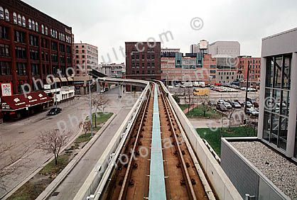
Category – A
Grade-separated or ‘exclusive’
fully controlled without any legal access
Resembles a freeway system

Slide 60
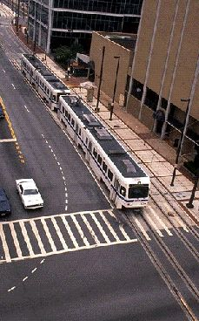
Category - B
Longitudinally, physically separated, but allows at-grade crossings (for vehicles and pedestrians)
e.g. Light-rail system crosses a few street at the surface

Slide 61
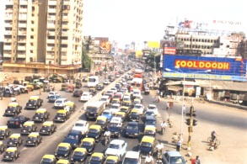
Category - C
Surface streets with mixed traffic
Most bus system and streetcar system fall into this category

Slide 62
2. Type of service
Short haul: low-speed service within small areas with high travel density, such as CBD
City transit: which is the most common type, transport in the city
Regional transit: serves long trips, makes a few stops, has high speeds (e.g. rapid rail and express bus system)

Slide 63
C. Transit System Characteristics
Transit trips can be both time and cost competitive to the auto under certain operating conditions, where exclusive right-of-way operation, or on-street transit lanes or signal priority can be provided. With the trend towards Transportation System Management solutions to urban transport problems, there has been increased the focus on moving persons and not simply vehicles on transportation systems. This has increased awareness on the part of local jurisdictions on the benefits transit priority treatments can play in attracting transit ridership and reducing overall traffic congestion. With the higher transit ridership levels in larger cities, transit can provide more efficient use of energy and improve air quality.

Slide 64
Transit System Characteristics (contd.)
Evaluation and comparative analysis of transit systems must include all following categories
1. System Performance refers to the entire set of performance elements;
Service frequency (f): no of transit departure per hour
Operation speed (v_{o}): Speed of travel experienced by passenger
Reliability: % of vehicle arrival with less than a fixed time duration
Safety: no of accidents per million km

Slide 65
Transit System Characteristics (contd.)
e) Line capacity (c): maximum no of persons a transit system can carry past a point during one hour
Product capacity (P_{c}): product of operating speed and capacities of the line
Productivity: the quality of output per unit of resources (vehicle-km)
Utilization: Ratio of output (person-km/space-km)

Slide 66
Transit System Characteristics (contd.)
2. Level-of-Service (LOS): the overall measure of all service characteristics. LOS is a basic element in attracting potential users to the system.
Performance elements: e.g. operating speed, reliability, and safety
Service quality (SQ): consisting of qualitative elements

Slide 67
Transit System Characteristics (contd.)
3. Transit Service Impacts: the effects transit service has on its surroundings and the entire area (either positive or negative).
Short-run impacts: e.g. include reduced street congestion, changes in air pollution, noise and aesthetics
Long-run impacts: changes in land values, economic activities, physical form or social environment
4. Costs: investment costs and operating costs

Slide 68
D. Family of Regular Transit Modes
Three generic classes: (1) street transit, (2) semirapid, and (3) rapid transit
Taxis
Dial-a-ride or dial-a-bus
Jitneys
Subscription buses
Carpools
Vanpools

Slide 69
Family of Regular Transit Modes (contd.)
Regular buses
Express buses
Trolley buses
Street cars or tramways
Semi-rapid buses
Light-rail transit
Rapid transit (light-rail rapid transit, rubber-tired rapid transit, rail rapid transit, regional rail)
Street transit
Semi-rapid transit

Slide 70
Paratransit
Small passenger vehicles operating informally on a fare-paying basis, and serving in some places as an alternative to regular bus transit services.
Paratransit system represents modes of semi-public and public transportation, consider intermediate b/w pvt. transportation and conventional transit.
Paratransit operates in the environment of
  Fixed space – variable time (jitney)
  Fixed time – variable space (vanpool/carpool)
  Variable time-variable space (taxi, dial-a-ride)

Slide 71
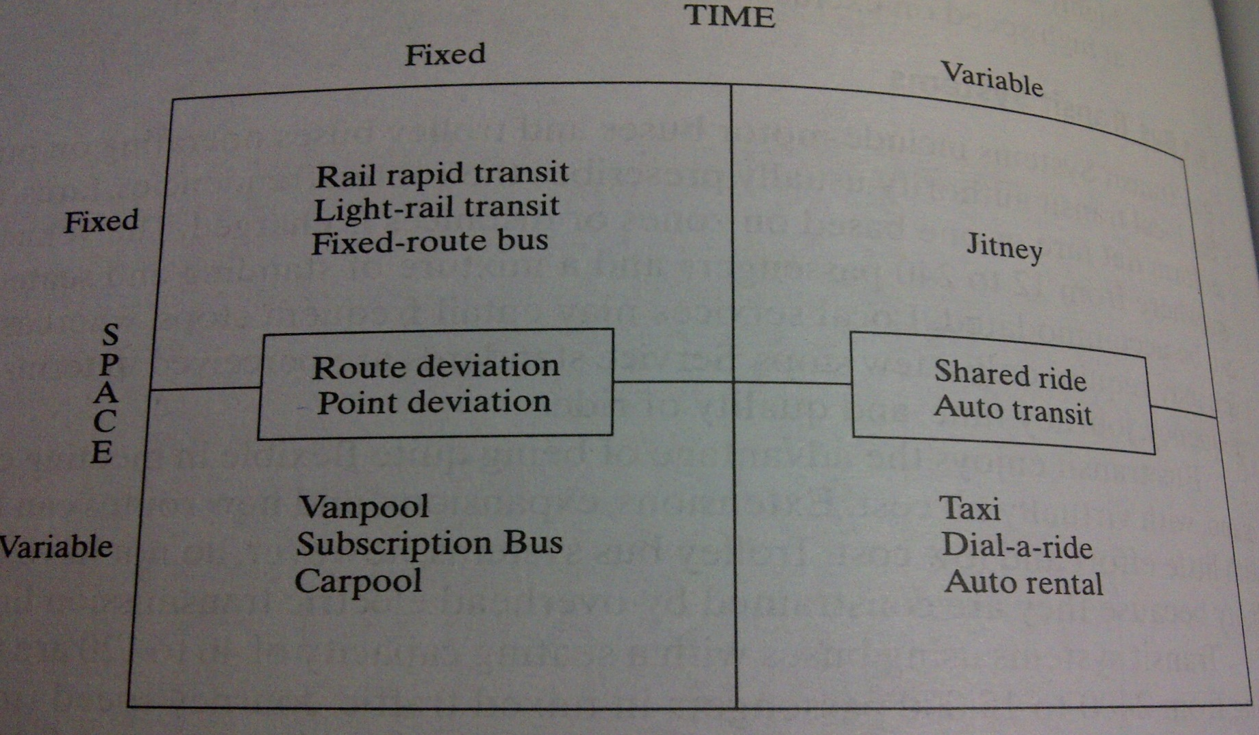
Paratransit (contd.)
Temporal - Spatial Characteristics of Urban Transport Alternative

Slide 72
E. Capacity of Urban Transit
Transit capacity is different than highway capacity: it deals with the movement of both people and vehicles; depends on the size of the transit vehicles and how often they operate; and reflects the interaction between passenger traffic concentrations and vehicle flow.
  Passenger-carrying capacity
  Vehicle-carrying capacity
Notes:
Passenger-carrying capacity is a less precise measure than vehicle-carrying capacity. The later is a measure of the max. no. of vehicles capable of passing a point during a given period of time multiplied by the max. no. of passengers that can be transported in each vehicle.

Slide 73
Important Terms in TC
Clearance Time: all time losses at a stop other than passenger dwell times, in seconds. It should not be less than 15 seconds b/w successive buses.
Dwell time: the time, in seconds, that a transit vehicle is stopped for the purpose of serving passengers. (includes t. passenger service time + the time needed to open and close doors)
Passenger loads: the no. of passengers in a single transit vehicle. The occupancy of vehicle is typically related to the no. of seats, expressed as a load factor. A factor of 1.0 means that all of the seats are occupied.
Productive capacity: a measure of efficiency or performance. The product of passenger capacity along a transit line and speed.

Slide 74
LAB WORK
ROADWAY INVENTORY STUDIES
(REQUIRED DATA, CONDITION DIAGRAM)

Slide 75
Roadway Inventory Studies
Physical Roadway Environment at a Location
Roadway Geometry
Roadway and Roadside characteristics
Functional classification of roadways
Parking conditions
Corner radii
Sidewalks and Crosswalks
Signage, Pavement markings
Traffic control

Slide 76
Required Data
Roadway inventory data such as
Lanes (Number and width)
Pavement Markings
Signage
Traffic Control Devices
Measuring Distances
Corner Radius
Cross walk
Side walk
Channelization

Slide 77
Condition Diagram
Location Information
Streets
Geometry
Measurements
Lane widths
Pavement markings
Stop bars
Signage
Traffic control devices
Corner radii
Developments in surrounding areas
Access points, etc.

Slide 78
Exercise
Prepare a Condition Diagram (Layout only) of any Signalized Intersection.
What type of crashes do you expect at this intersection?
What type of crashes are the most preventable?
How are you going to prevent it or what improvements would you make?

Slide 79
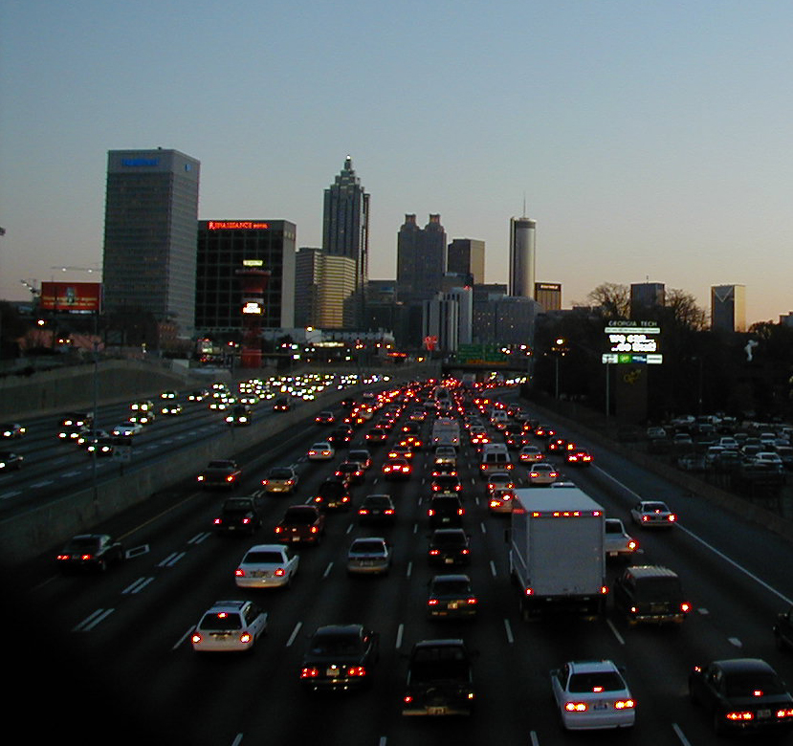
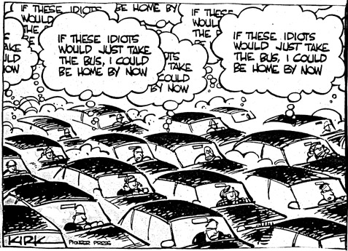

Slide 80

Any Questions

