Slide 1
AUTOCAD Engineering Drawing & Graphics

Slide 2
AUTOCAD
AutoCAD is a software application for computer aided design (CAD) and drafting in both 2D and 3D.
AutoCAD is available for English, German, French, Spanish, Japanese, Italian, Chinese, Russian, Brazilian, Dutch and etc., The extent of localization varies from full translation of the product to documentation only.
AutoCAD is entirely written in the C programming language, is presently over 100,000 lines of source code.

Slide 3
AUTOCAD
AutoCAD Graphics window is Graphical User Interface. (GUI).
Graphical User Interface (GUI)is a type of user interface that allows user to interact with electronic devices with images rather than text commands.
A GUI represents the information and actions available to a user through graphical icons and visual indicators

Slide 4
Advantages of AUTOCAD
Easy erasing and changing.
Can be zoomed in for more detailed sections
Can be copied and pasted many times
Save time, money and reduce errors.
Increase value to client by delivering more design alternatives in less time.
Complete projects faster and reduce the chance of coordination errors.
Clearly communicate design intent and complete final proposals with realistic 3D rendering

Slide 5
HOW TO INSTALL AutoCAD 2007

Slide 6
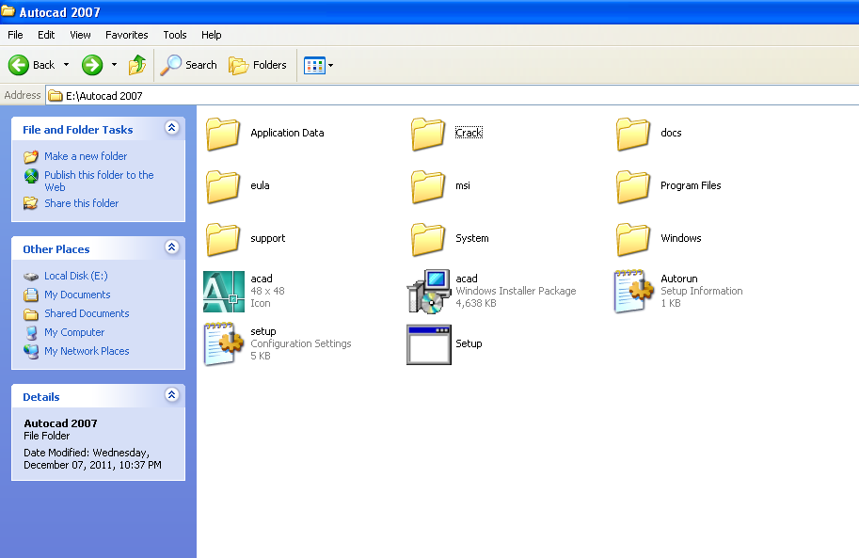

Slide 7
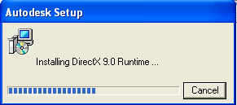

Slide 8
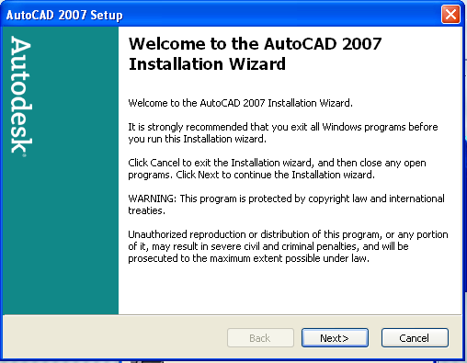

Slide 9
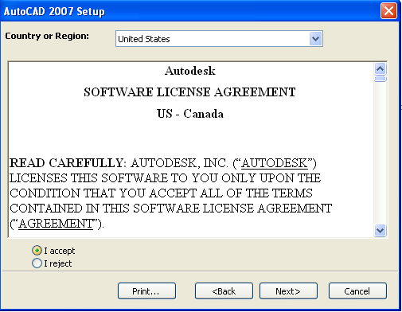

Slide 10
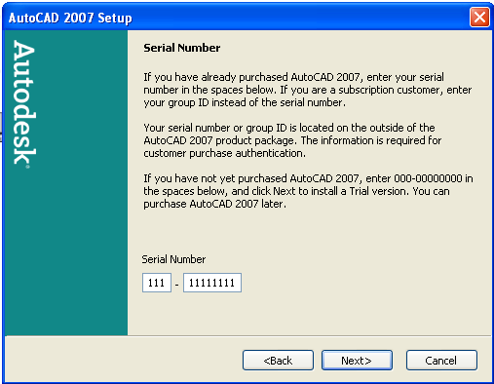

Slide 11
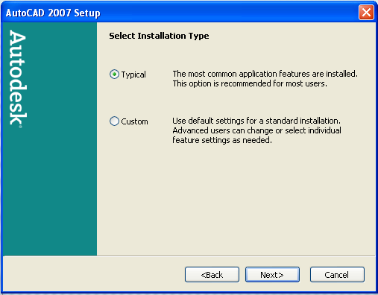

Slide 12
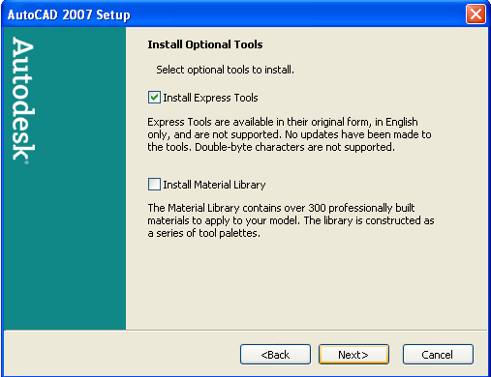

Slide 13
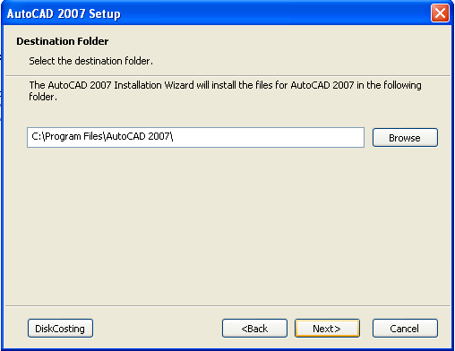

Slide 15
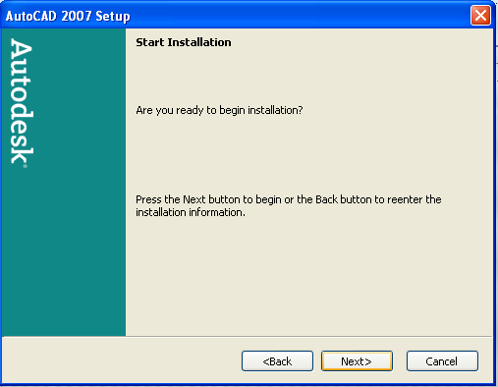

Slide 16
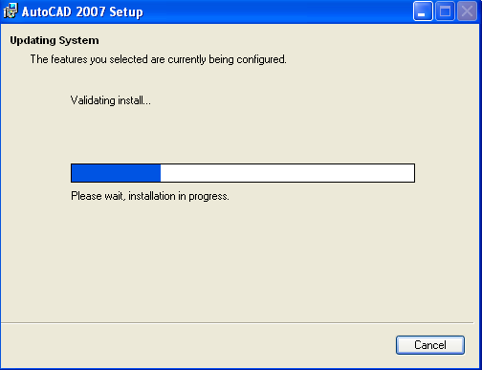

Slide 17
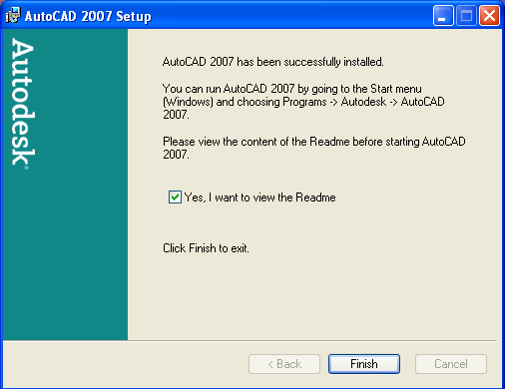

Slide 18
HOW TO ACTIVATE THE AUTOCAD

Slide 20
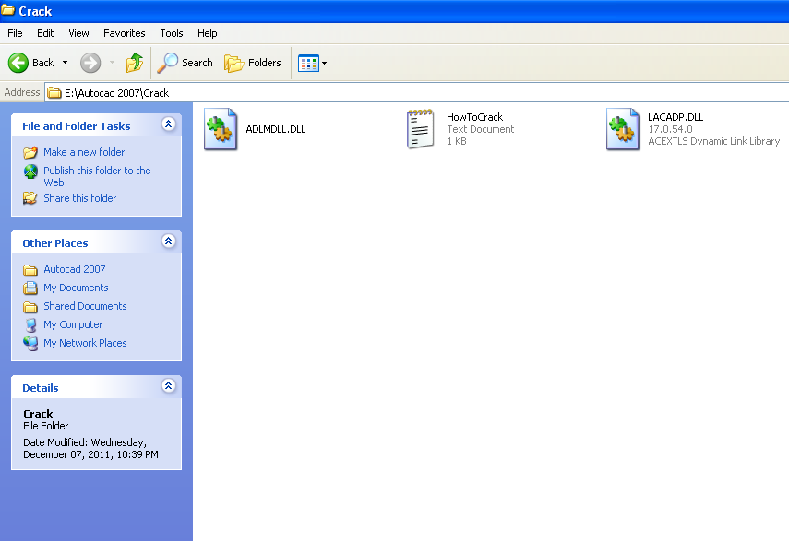
Copy these Crack files and Paste them in the folder of autocad2007 save in “Program Files”

Slide 23
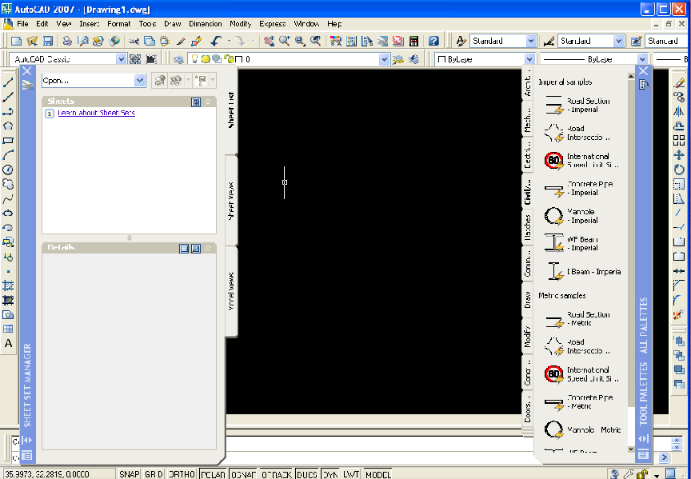

Slide 24
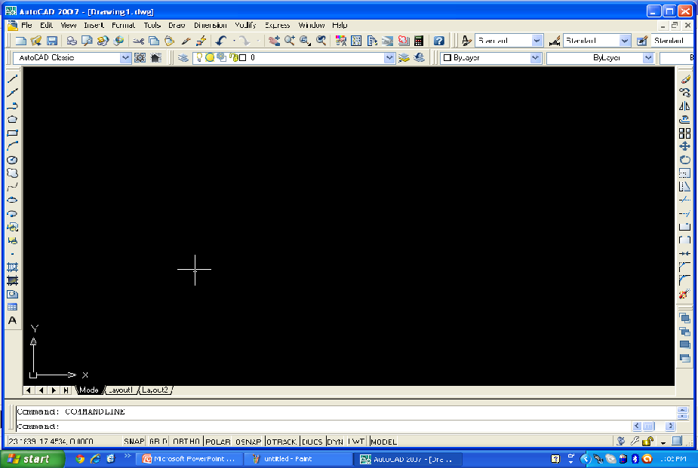

Slide 25
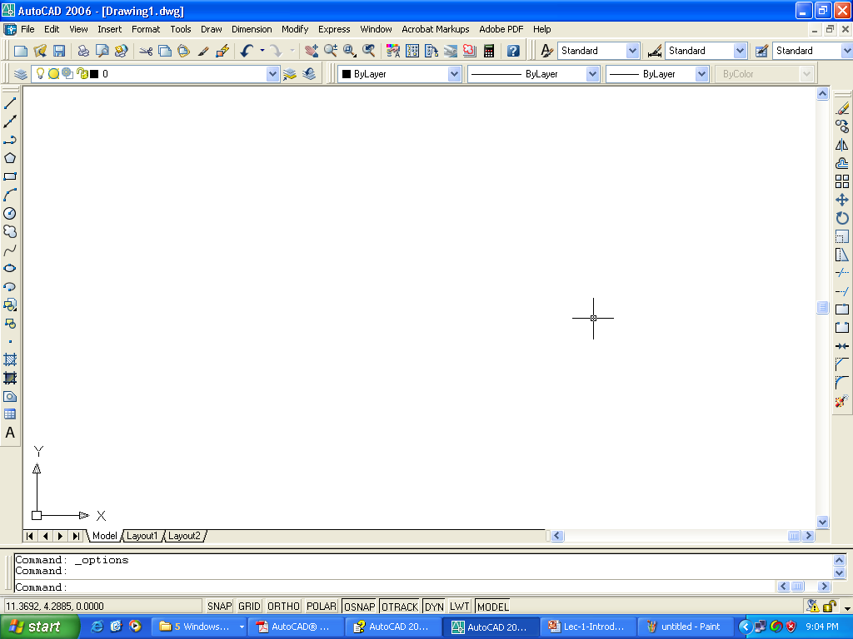
AutoCAD Graphic Window
Standard toolbar
Application close
button
Menu bar
Title bar
Styles toolbar
Layers toolbar
Properties toolbar
Drawing close
button
Draw tool bar
Modify toolbar
Layout tabs
Status bar
Status bar menu
User Coordinate System (UCS)
Model tab
Command window
Crosshairs
Pickbox
Drawing area

Slide 26
AutoCAD Graphic Window
Drawing Area
The blank area in the middle of the screen is called the graphics window or drawing area, where one can draw. This is a sheet of drafting paper, however this piece of paper can be of any size.
Drawing area

Slide 27
AutoCAD Graphic Window
Model and Layout tabs
At the bottom of the drawing area there is a tab labeled Model. This tab is used to draw. There is also another tabs labeled Layout 1. This tab is used to lay out the drawing for plotting.
Model tab
Layout tabs

Slide 28
AutoCAD Graphic Window
User Coordinate System (UCS) icon
Notice the symbol with two arrows at the bottom-left corner of the drawing area. This symbol is called the User Coordinate System (UCS) icon. The arrows Point to the positive directions of the X and Y axes.
User Coordinate System (UCS) icon

Slide 29
AutoCAD Graphic Window
The crosshairs
In the drawing area notice the two intersecting lines with a small box at their intersection. The small box is called the pickbox because it helps to select, or pick, objects.
The lines are called crosshairs. They show the location of the mouse cursor in relation to other objects in the drawing. With the movement of mouse around, the pickbox and crosshairs will also move with the mouse.
Crosshairs
Pickbox

Slide 30
AutoCAD Graphic Window
The command line
At the bottom of the screen, there is a separate window showing approximately three lines of text. (You can change it to show as many lines as you like by dragging the top edge of the window up or down.) Notice the word Command:. This is the command line. All commands can be executed by typing them on the command line.
Command window

Slide 31
AutoCAD Graphic Window
The status bar
At the very bottom of the screen is the status bar. At the left are the X,Y coordinates. As mouse moves, these coordinates change. (If they don’t change, click the drawing area and move your mouse again.) The status bar also contains several buttons that will be explained later.
Status bar

Slide 32
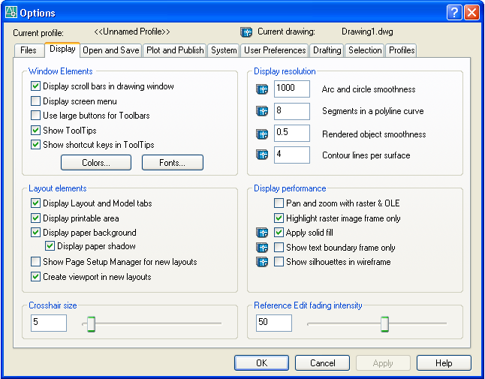
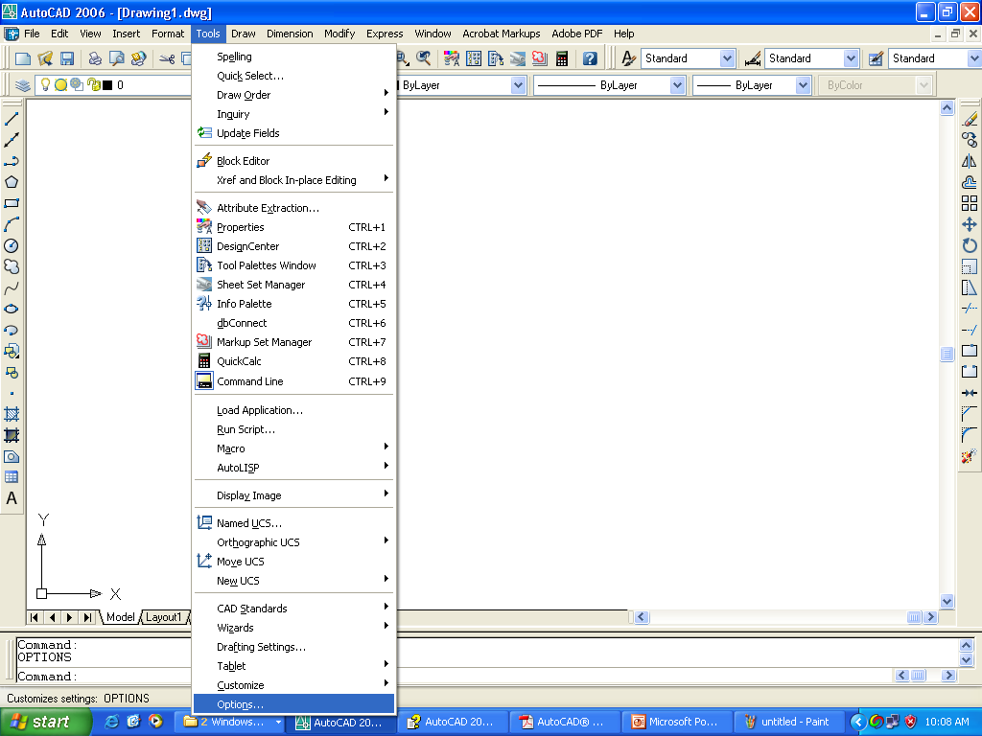
Modification of Display
Choose Tools → Options to open the Options dialog box.

Slide 33
Exercise
Change the default color of drawing area to white color.
Turn off the scroll bars from the display.
Change the crosshair size so that it extends fully across the screen.

Slide 34
User Coordinate Systems (UCS)
There are three types of coordinate/feeding system:
Absolute Co-ordinate System
Relative Co-ordinate System
Polar Co-ordinate System

Slide 35
User Coordinate Systems (UCS)
Absolute Co-ordinate System (ACS):
Absolute Co-ordinate uses the “Cartesian System” to specify a position in the X, Y and Z axes ( if needed) to locate a point from 0-X, 0-Y and 0-Z (0,0,0) point. To locate the point using ACS, type the X-value, Y-value and Z-value ,if needed, separated by commas(with no space)

Slide 36
User Coordinate Systems (UCS)
Relative Co-ordinate System (RCS):
Relative coordinates specify the X and Y distance from the immediate previous point. They are called relative because they are measured relative to a point previously specified.
To specify relative coordinates @ symbol is used before specifying X and Y coordinates.
In relative Cartesian coordinates origin is immediate previous point. For example
For a line AB, 4 units long, if A is starting point then relative Cartesian coordinates of point B will be as follows
@4,0
A
B
4

Slide 37
User Coordinate Systems (UCS)
Polar Co-ordinate System :
Polar Co-ordinate system allows you to select a point that is a specific length and at a specific angle to the last point indicated.
To locate a point using Relative Polar Coordinate:
type @, the length of the line , a less than symbol (<) followed by the desired angle of the line.
@50<45 is correct
@50,<45 is wrong

Slide 38
User Coordinate Systems (UCS)
How to input fractional distances
When typing architectural units, partial inches are indicated by fractions in the form a/b. You need to separate the fraction from the whole inches by a hyphen. This can be a little confusing because the hyphen is also used for negative numbers. For example, to draw a horizontal line of 5 1⁄4 inches in the negative direction of the X axis, type -5-1/4,0.

Slide 39
Setting up a New Drawing
Defining Drawing Units
The first step after starting a new drawing is to set its limits and unit type.
Units are set through the Drawing Units dialog box.
Drawing units dialog box can be opened by one of the following methods:
Format → Units
Type units or un in Command Line → Press Enter

Slide 40
Setting up a New Drawing
Defining Drawing Limits
One can specify the area of drawing, also called the limits. The drawing limits are the outer edges of the drawing, specified in X,Y coordinates.
The limits define an artificial and invisible boundary of the drawing. However, one can draw outside the limits.

Slide 41
Setting up a New Drawing
Defining Drawing Limits
Limits are set through the LIMITS COMMAND.
Limits command can be started by one of the following methods:
Format → Drawing Limits
Type limits in Command Line → Press Enter

Slide 42
Setting up a New Drawing
Defining Drawing Limits
After defining the Limits it is required to Zoom All the view. This will bring the full area within the display window.
To zoom all the view do one of the following
View → Zoom → All
Type z in Command Line → Enter → a → Enter
Click Zoom All Button from Standard Toolbar.

Slide 43
Methods To Initiate The Commands
One can give commands in AutoCAD by one of the following methods:
Using menus
Using shortcut menus
Using toolbars
Using The Command Line

Slide 44
Methods To Initiate The Commands
Using Menu:
A menu item can do three things — execute a command, open a submenu, or open a dialog box.
As in all Windows programs, the menu items provide clues to let you know what is going to occur after you click a menu item, as follows:
A right arrow opens a submenu with more options.
An ellipsis (. . .) opens a dialog box.
A plain menu item immediately executes a command.

Slide 45
Methods To Initiate The Commands
Using Shortcut:
Shortcut menus appear when you right-click your mouse. The shortcut menus try to include the most common tasks you might want to complete. As a result, the menu that appears on right-click depends on the situation:
If you have neither started a command nor selected any object, you get the default menu when you right-click in the drawing area. Here you can cut, copy, paste, undo, pan, zoom, and so on.

Slide 46
Methods To Initiate The Commands
If you’ve selected any objects, you see the edit-mode menu, which lists the most common editing commands.
If you’ve started a command, the command-mode menu opens, letting you choose an option for that command.
Other menus include the toolbar list you get when you right-click a toolbar and the command-line history you see when you right-click the command line and choose Recent Commands.

Slide 47
Methods To Initiate The Commands
Using Toolbar:
Toolbars provide a quick way to execute a command with one click of the mouse.
When you click a toolbar button, in order to complete the command, you usually need to look at the command line, to follow the prompts there.
A few of the toolbars have fly outs, attached toolbars containing additional buttons.
Click and hold a second and the fly out flies out, revealing several other buttons, drag down and choose any one of the options.

Slide 48
Methods To Initiate The Commands
Using Command Line:
You can execute a command by typing it directly on the command line.

Slide 49
Methods To Initiate The Commands
Command Format
AutoCAD displays a prompt that tells what to do next after executing any command.
The format for command prompts on the command line is as follows:
current instruction or [options] <current value>:
The current instruction explains what to do. For example, choosing an editing command, the prompt usually instructs to “Select objects.”
The text in the square brackets lists the various options available for the command
The angled brackets tell the current value or default option for the command, if any.

Slide 50
Basic Commands
Command Techniques
To make working with commands easier, AutoCAD offer shortcuts for repeating and canceling commands as well as undo and redo options.
1. Repeating commands
The most common way to repeat a command you have just used is to press Enter. The most recent command appears again.
You can also press the Spacebar at the Command: prompt to repeat a command you just used.
You can also use the shortcut menu to repeat the command you just use.

Slide 51
Basic Commands
2.Canceling commands
Sometimes you start a command and then realize you don’t need it. In this situation, you can cancel the command and then choose a different command.
Press Esc to cancel a command that you’ve already started. The Command: prompt reappears.

Slide 52
Basic Commands
3. Undoing a command
Like other Windows applications AutoCAD also offers Undo and Redo commands.
AutoCAD remembers every command starting from the time you open a drawing. You can therefore undo every action and return your drawing to its initial condition when you opened it.

Slide 53
Basic Commands
How to start Undo command
Undo command can be started by one of the following methods
Ctrl + Z (like other window applications)
Edit → Undo
Click Undo Button from Standard Toolbar.
Type u in Command Line → Press Enter

Slide 54
Basic Commands
4. Redoing a command
If you undo a command, you might realize that you want to undo the undo. This is called redoing a command. Redoing only applies when you have just undone a command.
Redo command can be started by one of the following methods
Ctrl + y (like other window applications)
Edit → Redo
Click Redo Button from Standard Toolbar

