Slide 1
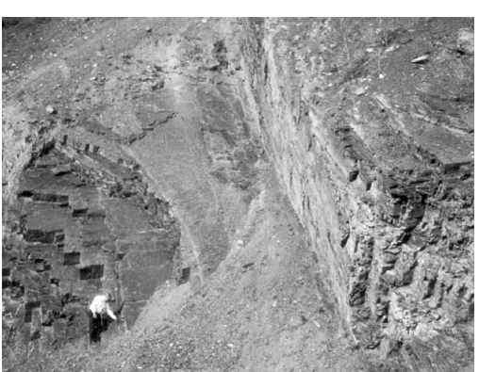

Slide 2
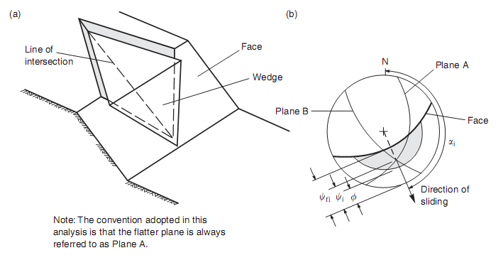

Slide 3
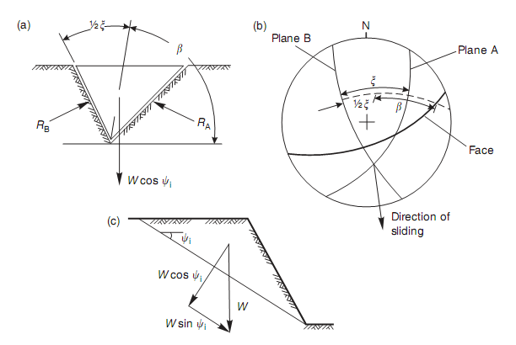

Slide 4
Landslides

Slide 6
Rotational and Translational Slides

Slide 7
Rotational Slides

Slide 8
Translational slide

Slide 9
Types of Landslides
Falls
Topples
Flows
Debris flow
Debris Avalanche
Earthflow
Mudflow
Creep
Lateral Spread

Slide 10
Falls

Slide 11
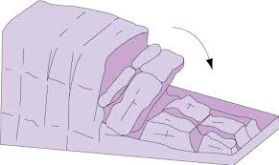
Topples

Slide 12
Flows (Debris flow)

Slide 13
Debris Avalanche

Slide 14
Earthflow/Mudflow

Slide 15
Creep

Slide 16
Lateral Spread

Slide 17
Lateral spread

