Slide 1
Slope Stability Analysis using Stereographic Projections

Slide 2
Stereographic Projection
The stereographic projection allows the three-dimensional orientation data to be represented and analyzed in two dimensions.
Data is represented in the form of lines or points.
Line represents the “Plane”.
Point represents the “Line”.
The stereographic projection consists of a reference sphere.

Slide 3
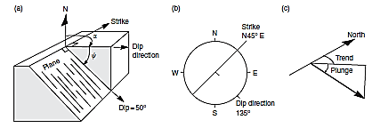

Slide 4
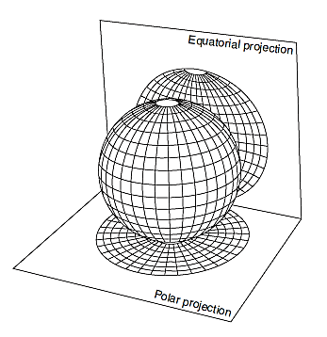

Slide 5
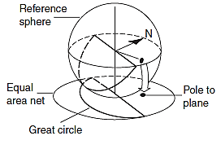

Slide 6
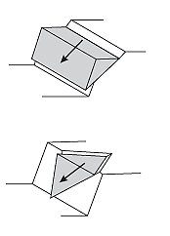
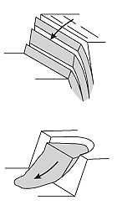

Slide 7
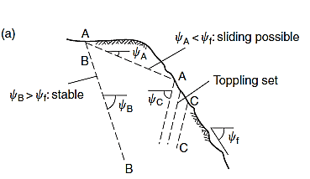

Slide 8
Kinematic Analysis
Kinematic analysis is a method used to analyze the potential for the various modes of rock slope failures (plane, wedge, toppling failures), that occur due to the presence of unfavorably oriented discontinuities.
Discontinuities are geologic breaks such as joints, faults, bedding planes, foliation, and shear zones that can potentially serve as failures planes.

Slide 9
Lab Work
Objective:
To check the slope stability of a given data using kinematic analysis.
Given data:
Features Dip Dip direction
Over all slope face 66° 186°
Plane A 46° 106°
Plane B 70° 236°
Friction Angle = 20°

