Slide 1
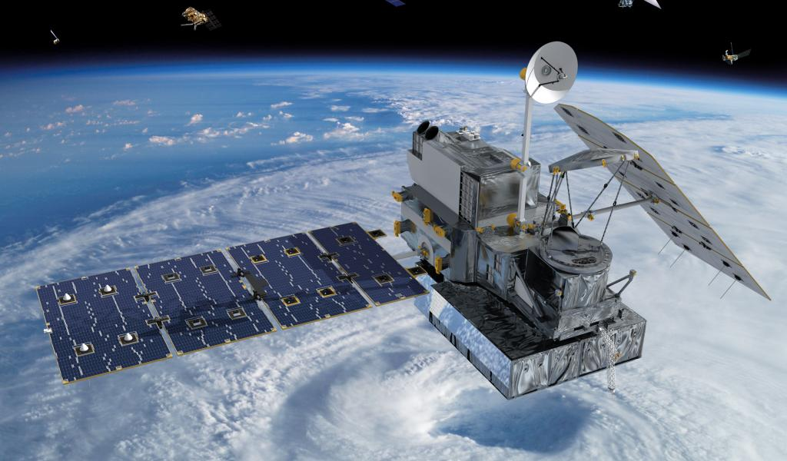
RADAR AND SATELLITE ESTIMATION OF PRECIPITATION
LECTURE 6

Slide 2
MEASUREMENT OF PRECIPITATION
Main approaches to measure precipitation are
Rain gauges Ground Measurements
Using radars Atmospheric Measurements
Satellite measurements Remote Sensing

Slide 3
RADAR ESTIMATION OF PRECIPITATION
We can estimate through radar
Amount of precipitation
Intensity of precipitation
Areal extent of precipitation
Duration of precipitation
Movement of rainstorm

Slide 4
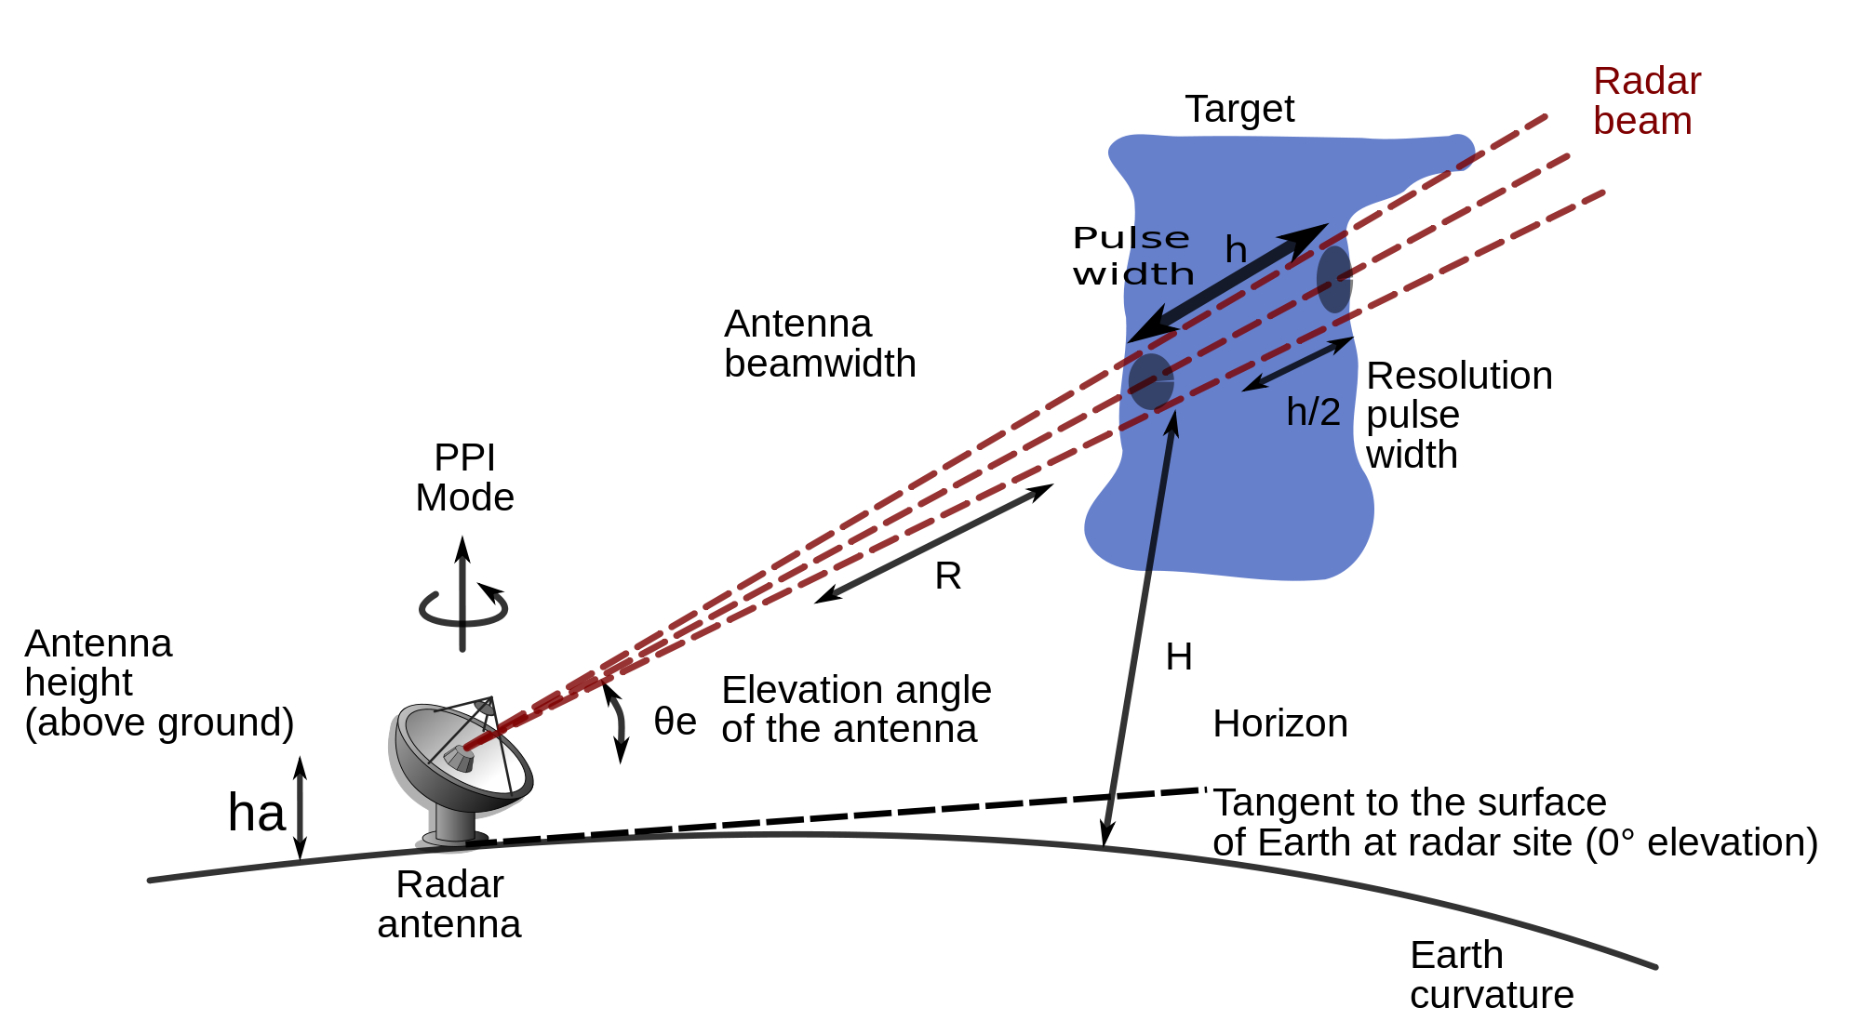
RADAR ESTIMATON OF PRECIPITATION

Slide 5
RADAR ESTIMATION OF PRECIPITATION
Radar transmits a pulse of electromagnetic energy as a beam in a direction determined by moveable antenna
Beam width and shape are determined by the antenna size and configuration
Radiated waves travel at the speed of light
These waves are partially reflected by precipitation particle in the cloud and returns to the radar and is received by the antenna
Part of these waves is diffracted, scattered and absorbed
The amount of energy returned to the radar is called “Return Power”

Slide 6
RADAR ESTIMATION OF PRECIPITATION
Time interval between the emission of the pulse and its reception on the radarscope is a measure of the distance or range of the target from the radar
Direction of the target is determined by the direction of the antenna at the time of reception of the pulse

Slide 7
ATTENUATION
Loss of radar energy due to passage through precipitation is called attenuation
Part of the loss results from the scattering and part from absorption
Larger the rain or snow diameter to wave length ratio greater will be the attenuation
For a given particle diameter shorter the wavelength more will be attenuation
Thus for short wavelength total energy may be greatly diminished completely dissipated by a relatively short penetration into a storm
Even the lightest precipitation intensities will seriously attenuate radar energy of wavelengths less than 1cm
Wavelengths less than 5cm are considered unsuitable for measuring precipitation.
However these short wavelengths may give satisfactory estimation for light precipitation intensities at small distance
Wavelengths within 5 to 10cm with beam width less than 2⁰ are generally recommended for precipitation measurement.

Slide 8
RETURNED POWER
Amount of energy returned to the radar antenna is called “Returned Power”
Returned power is a measure of radar reflectivity of the hydrometeors
Reflectivity of a group of hydrometeors depends on various factors
Drop size distribution
No. of particles per unit volume
Physical state i.e., solid or liquid
Shape of individual elements

Slide 9
RETURNED POWER
The average returned power “P_{R} “ is a measure of the radar reflectivity of all particles at range “r” intercepting the radiated beam, or
P_{R} = $\frac{C}{r^{2}}$ Z
Z=$\sum{d^{6}}$= aR^{b}
P_{R} = $\frac{C}{r^{2}}$ $\sum{d^{6}}$
P_{R} = $\frac{C}{r^{2}}$ aR^{b}
R = [$\frac{P_{R}}{C}$ x$\frac{r^{2}}{a}$ ]^{1/b}
P_{R} = average returned power
C = a coefficient that is function of wavelength, shape and width of the beam and pulse length
a= Coefficient (15-1100)
b= Coefficient (1.2-3.2)
These coefficients a and b are determined by calibration. It is generally agreed that values of 200 and 1.6 for a and b yield the most reliable results on the average
r= radius
R= Rain rate
d= diameter of individual particles

Slide 10
RADAR BEAM
Main obstacles in accurate radar estimation is that it measures precipitation in the atmosphere while gauges measure it at the ground
In order to avoid interferences from the buildings, hills and trees (ground Clutter) the radar beam is directed upwards at 0.5-1⁰
Height of beam increases with increase in distance from the radar hence measurements are exaggerated
Calibration with the ground precipitation stations is must
Movement of the clouds may also cause errors

Slide 11
RADAR BEAM

Slide 12
SATELLITE ESTIMATION

Slide 13
SATELLITE ESTIMATION OF THE PRECIPITATION
Studies of water balance on a global scale require information on the precipitation where gauge or radar networks are inadequate or non-existent as over the oceans
Satellites do not measure the precipitation directly
They estimate precipitation based on brightness of cloud photographs
This brightness is related to rainfall intensities
Degree of brightness is an indication of the temperature, or height of the cloud tops.
Brighter is the image higher is the cloud top
Tallest densest clouds produce heaviest precipitation
Relation between the intensity and cloud brightness is usually determined by calibration with ground measurements

Slide 14
SATELLITE ESTIMATION OF THE PRECIPITATION
A major problem in this technique is that photographs often do not reveal precipitation producing clouds because of overlying clouds layer
This approach is most suitable in measurement of precipitation over oceans and in remote areas
This is helpful in monitoring the track of cyclones

Slide 15
THANK YOU
ANY QUESTIONS???

