Slide 1
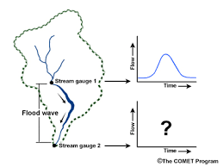
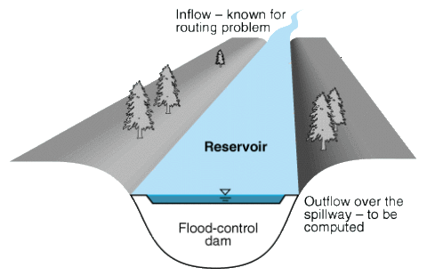
FLOOD ROUTING
LECTURE 14

Slide 2
FLOOD ROUTING
Procedure to compute output hydrograph when input hydrograph and physical characteristics of water shed are known
As discharge in a channel increases, its stage also increases and with it the volume of water in temporary storage in the channel
Flood may be considered as wave moving down a channel appears to have lengthened its base time and peak gets attenuated
Hydrologic routing procedures are used to route this flood wave along a channel

Slide 3
FLOOD ROUTING

Slide 4
THE STORAGE EQUATION
The continuity equation may be expressed as
$I−O=\frac{dS}{dt}$ or
$∆S=S_{2}−S_{1}=\int_{t_{1}}^{t_{2}}{I dt} −\int_{t_{1}}^{t_{2}}{O dt}$
To provide a more convenient form for hydrologic routing, it is commonly assumed that the average of the flows at times t₁ and t₂ , the beginning and end of the routing period $\frac{I_{1}+I_{2}}{2} t−\frac{O_{1}+O_{2}}{2} t=S_{2}−S_{1}$
Most storage-routing methods are based on this equation, in which I₁ ,I₂ , S₁, and O₁ are known but S₂ and O₂ are unknown
So there are two unknowns and one equation this is the major difficulty in storage routing
I: inflow rate
O: outflow rate
S: storage
T: time
All terms are defined for a specific
Reach of river

Slide 5
APPLICATIONS OF FLOOD ROUTING
Following might be the probable uses of flood routing
To predict flood propagation
To actuate flood warning and protection systems
To design various hydraulic structures and hydro-systems operations

Slide 6
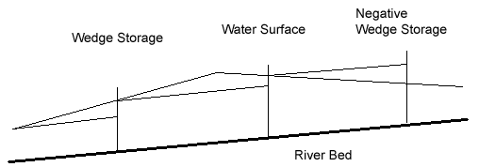
DETERMINATION OF STORAGE
Before a relation in storage and flow can be established, it is necessary to compute volume in the channel at various times
Obvious method of determining this storage is to calculate volumes in channel from cross sections by using prismoidal formula
Routing in natural channels is complicated by the fact that storage is not a function of outflow alone

Slide 7
DETERMINATION OF STORAGE
The storage between the channel bed and line parallel to it is called prism storage
Between this line and actual profile is called wedge storage
During rising stages a considerable volume may consist of these wedges before any large outflow occurs
As the falling starts inflow drops more rapidly than outflow negative wedge storage may exist

Slide 8
MUSKINGUM STORAGE EQUATION
To correct the problem of two unknowns in the storage equation there are a few analytical techniques. One of them is Muskingum’s storage equation
$S=\frac{b}{a}[x {I }^{\frac{m}{n}}+\left(1−x\right)O^{\frac{m}{n}}$]-------------(1)
Where a and n are constants from the mean stage-discharge relation for the reach
Q=a.H ^{n}
And b and m are constant in mean stage-storage relation
S=b.H^{m}
Notes:
Would vary

Slide 9
MUSKINGUM STORAGE EQUATION
Constant x expresses the relative importance of inflows and outflows in determining the storage. For natural streams its value ranges from 0-0.3 with mean value 0.2
Muskingum’s method assumes that m/n =1 and lets b/a=K
Equation 1 then becomes
S=K[x.I +(1-x)O] ------------- (2)
Constant K, known as storage constant, is the ration of storage to discharge and has the dimensions of time
It is approximately equal to time of travel through the reach and in absence of data K is estimated this way

Slide 10
MUSKINGUM STORAGE EQUATION
Storage equation
$\frac{I_{1}+I_{2}}{2} t−\frac{O_{1}+O_{2}}{2} t=S_{2}−S_{1}$
The above storage equation when substituted for the value of S from equation (2) and simplified gives following equation
O₂ = c_{o} .I₂ + c₁ .I₁ + c₂ .O₁ ---------------(3)
Where
$C_{o}=−\frac{K.x −0.5t}{K−Kx+0.5t}$
$C_{1}=\frac{K.x+0.5t}{K−Kx+0.5t}$
$C_{2}=\frac{K−K.x −0.5t}{K−Kx+0.5t}$
In these equations t is the routing period in the same time units as of K

Slide 11
MUSKINGUM STORAGE EQUATION
Once values of K, x and t are established these coefficients can be computed
All these must be positive in order to get valid solutions from equation
Routing operation is simply a solution of the equation (3) with the O₂ of one routing period becoming the O₁ of the succeeding period.
Muskingum’s method assumes K to be constant at all flows.

Slide 12
NUMERICAL PROBLEM
For the given inflow hydrograph compute outflow hydrograph if K is 2 days and x being 0.2
Routing period is one day. Initial outflow may be taken as 4000 m³/s
Time (days) | Q(m³/s)
1 | 4000
2 | 7000
3 | 11000
4 | 15000
5 | 8000
6 | 4000

Slide 13
NUMERICAL PROBLEM
Step1. knowing the values of K, x and t compute the values of coefficients
$C_{o}=−\frac{K.x −0.5t}{K−Kx+0.5t}$
$C_{1}=\frac{K.x+0.5t}{K−Kx+0.5t}$
$C_{2}=\frac{K−K.x −0.5t}{K−Kx+0.5t}$
Use this equation for each interval to get outflow for the corresponding time
O₂ = c_{o} .I₂ + c₁ .I₁ + c₂ .O₁

Slide 14
DETERMINATION OF MUSKINGUM’S CONSTANTS
If the flow data is unavailable K is estimated by travel time in the reach. And x is taken between 0-0.3
But when the past flood data is available K and x are determined by plotting a graph between S and xI+(1-x)O
The best value of x is that which causes the data to plot most nearly as a single valued curve. The slope of this straight line is K.

Slide 15
NUMERICAL PROBLEM
Given record of past floods. Use these observations to obtain the Muskingum routing parameters k and x for this river reach. The initial storage in the system is 715,000 m³
Time (hr) | Inflow (m³/s) | Outflow (m³/s) | Time (hr) | Inflow (m³/s) | Outflow (m³/s)
1 | 93 | 85 | 11 | 634 | 642
2 | 137 | 91 | 12 | 571 | 635
3 | 208 | 114 | 13 | 477 | 603
4 | 320 | 159 | 14 | 390 | 546
5 | 442 | 233 | 15 | 329 | 479
6 | 546 | 324 | 16 | 247 | 413
7 | 630 | 420 | 17 | 184 | 341
8 | 678 | 509 | 18 | 134 | 274
9 | 691 | 578 | 19 | 108 | 215
10 | 675 | 623 | 20 | 90 | 170

Slide 16
The graphical procedure consists in generating graphs of [xI + (1-x)O] vs. S for different values of x, arbitrarily selected such that 0 < x < 0.5. The optimal value of x is selected as that which produces the narrowest and straightest loop graph of [xI + (1-x)O] vs. S. The slope of the least squares linear fit to the resulting points is the estimate of k.
Generate accumulated storage in the system. Use continuity equation as follows:
$$\frac{I_{1}+I_{2}}{2} t−\frac{O_{1}+O_{2}}{2} t=S$$

Slide 17
Inflow (m³/s) | Outflow (m³/s) | Avg. Inflow (m³/s) | Avg. Outflow (m³/s) | Cumm. Storage (m³) | Weighted average Flux (m³/s)
I₁ | O₁ | - | -
I₂ | O₂ | =(I₁ +I₂)/2 | =(O₁ +O₂)/2 | (Col.3-Col.4)x t | x.Col1+(1-x).Col2
I₃ | O₃ | =(I₂ +I₃)/2 | =(O₂ +O₃)/2
I₄ | O₄ | =(I₃ +I₄)/2 | =(O₃ +O₄)/2
Assume different values of x in the range (0-0.5) and plot graph between column 5 and column 6.
Whichever trial of x gives the graph to be a straight line select that x and slope of that line is K

