Slide 1
Building drawing
Chapter 6 (basics of engg drawing)

Slide 2
Basic definitions
(1) CONCRETE
Binding Material ( cement or lime)
Filler material (Aggregates)
(2) PLAIN CEMENT CONCRETE (PCC)
Lean Concrete (cement < 10% of concrete)
e.g., PCC (1:4:8), PCC(1:6:12)
(1+4+8=13, cement=(1/13)*100= 7.7%) calculate cement %age for
PCC(1:6:12)

Slide 3
Basic definitions
Normal Concrete (cement is 10 to 15% of concrete)
e.g., PCC (1:2:4) (14.28%)
Rich Concrete (cement > 15% of concrete)
e.g., PCC (1:1.5:3) ( %age=?)
(3) REINFORCED CEMENT CONCRETE (RCC)
(4) MORTAR

Slide 4
Basic definitions
(5) DAMP PROOF COURSE (DPC)
1.5 in or 3 in thick layer of PCC (1:2:4)
Over two coats of bitumen are applied
The top of DPC is made in level with the ground floor level of building

Slide 5
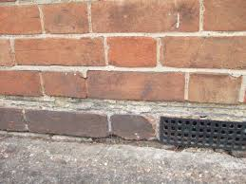
DPC
DPC

Slide 6
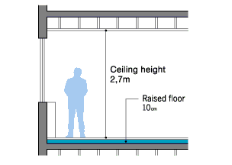
Basic definitions
(6) CEILING HEIGHT
Bottom of roof slab is called ceiling
Clear height available inside a building is known as Ceiling Height
Generally it is 8 to 12 ft

Slide 7
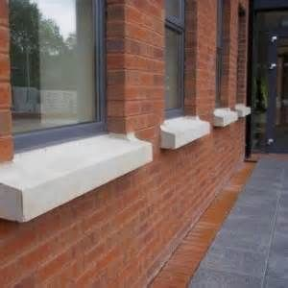
Basic definitions
(7) SILL LEVEL
It is the level of bottom of main windows generally 3 ft.
In past sill or slab was provided at bottom of window projecting from the wall
Sill
3 ft high

Slide 8
Basic definitions
(8) FINISHED FLOOR LEVEL (FFL)
Top level of floor in any part of the building
May be different for rooms, verandahs and open areas of building
Also different for different storeys of building

Slide 9
Basic definitions
(9) PLINTH LEVEL (PL)
It is the level of ground floor top in main part of the building.
It is made higher than the ground level by an amount depending upon following factors (min. PL is 1 ft)
(i) Prevention from rain water
(ii) Drainage of used water
(ii) Future trends like rising of road level

Slide 10
Basic definitions
(10) GROUND LEVEL
It is the level of ground in or near the building which may be natural or developed ground level
(11) SUPER-STRUCTURE
The portion of a structure which is visible or which is above the ground level is called superstructure
(12) SUB-STRUCTURE
The portion of the structure present underground is called substructure including foundation and basement if present

Slide 11
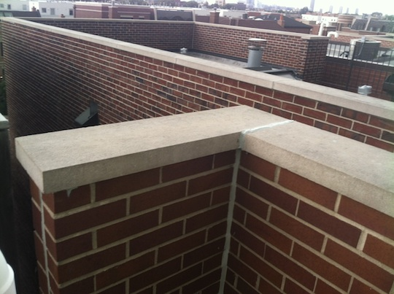
Basic definitions
Parapet walls
(13) PARAPET
Small wall provided on periphery of the roof for safety and privacy purpose is called parapet wall
It has height from 1 ft to 5 ft from top of roof slab

Slide 12
Basic definitions
(14) FOUNDATION
The portion of the structure under columns and walls which transfer the load of the structure to the soil underneath in a safe way without excessive settlement (compression)
Distribute load to larger area reducing load per unit area (load intensity) until it becomes equal to safe bearing capacity of soil underneath (0.5 to 1.5 tons per square ft)
(1 ton = 1000 kg)

Slide 13
Basic definitions
STEPPED FOUNDATION
In stepped foundation, brick wall is expanded below ground level in different steps
The increase in thickness of wall in one step should be 2.25 in on either side with total of 4.5 in.
The height of step may vary in the multiples of 3 in depending upon required depth of foundation from the ground level

Slide 14
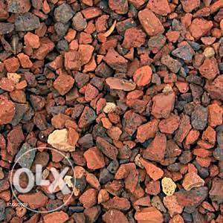
At the bottom of foundation, lean concrete (discussed earlier) or compacted mixture of brick ballast with 25% sand is to be provided.
Offset of this layer must be lesser than or equal to its depth (6” or 9”)
No. of steps can be found by dividing the wall thickness in inches to 4.5”.
Brick Ballast (Rory)
Brick Ballast

Slide 15
2.25”
9”
2.25”
2.25”
6”
2.25”
13.5”
13.5”
2.25”
18”
2.25”
6”
18”
2.25”
2.25”
6”
22.5”
22.5”
6”
6”
27”
6”
27”
6”
Lean Concrete PCC (1:4:8)
Lean Concrete PCC (1:4:8)
39”

Slide 16
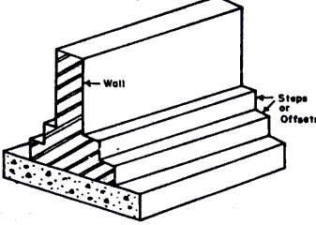
Four stepped footing
Two stepped footing

Slide 17
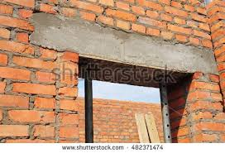
Basic definitions
lintel
LINTEL
Lintel is a small beam usually concealed beam provided over openings in wall like doors, windows and ventilators

Slide 18
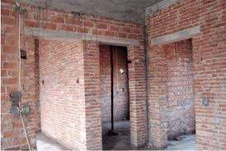
Lintel
After plastering, lintels hide, it is common mistake that students don’t draw lintels on drawings

