Slide 1
APPLICATION OF REMOTE SENSING AND GEOGRAPHICAL INFORMATION SYSTEM IN CIVIL ENGINEERING
INSTRUCTOR
ENGR. FAIZAN MAHMOOD
DEPARTMENT OF CIVIL ENGINEERING
UET LAHORE, PAKISTAN

Slide 2
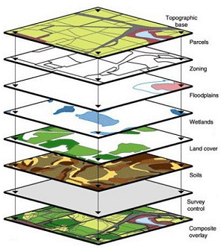
Application of Remote Sensing and Geographical Information System in Civil Engineering
2
Remote Sensing (RS)
Remotely sensing the useful information of object (earth)
Geographic Information System (GIS)
A system that deals with all types of geographically referenced data

Slide 3
Application of Remote Sensing and Geographical Information System in Civil Engineering
3
Remote Sensing (RS)
Remotely sensing the useful information of object (earth)
Process of recording, measuring and interpreting imagery and digital representations of energy patterns derived from noncontact sensor systems
Geographic Information System (GIS)
A system designed to capture, store, manipulate, analyze, manage, and present all types of geographically referenced data

Slide 4
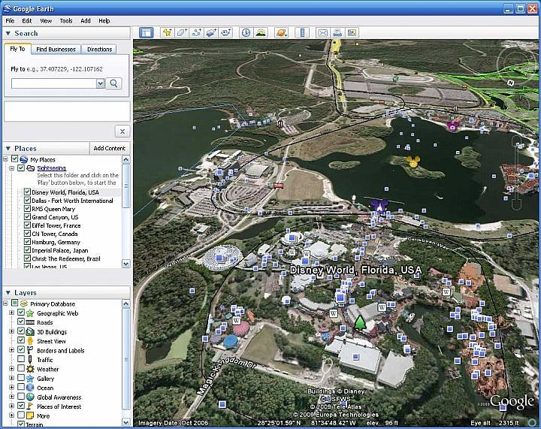
Can you recall Google Earth ?
4
The information in the Google earth is obtained through Remote Sensing While its representation and management on geographical locations is made possible through GIS

Slide 5
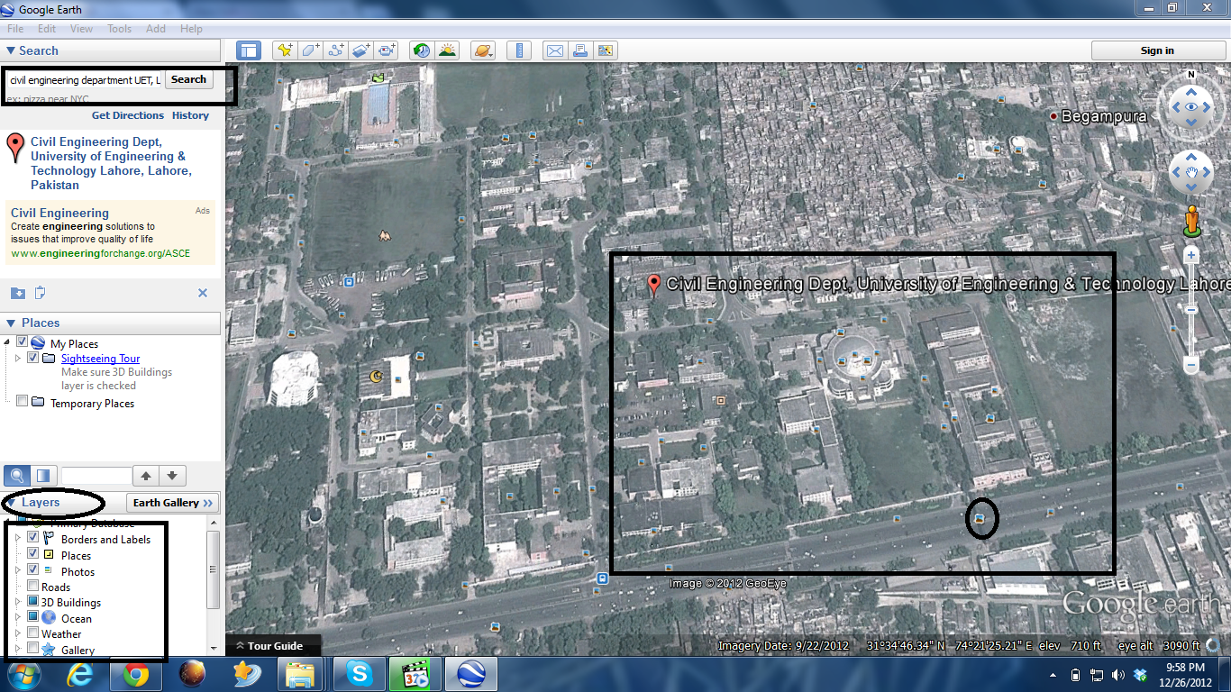
Can you recall Google Earth ?

Slide 6
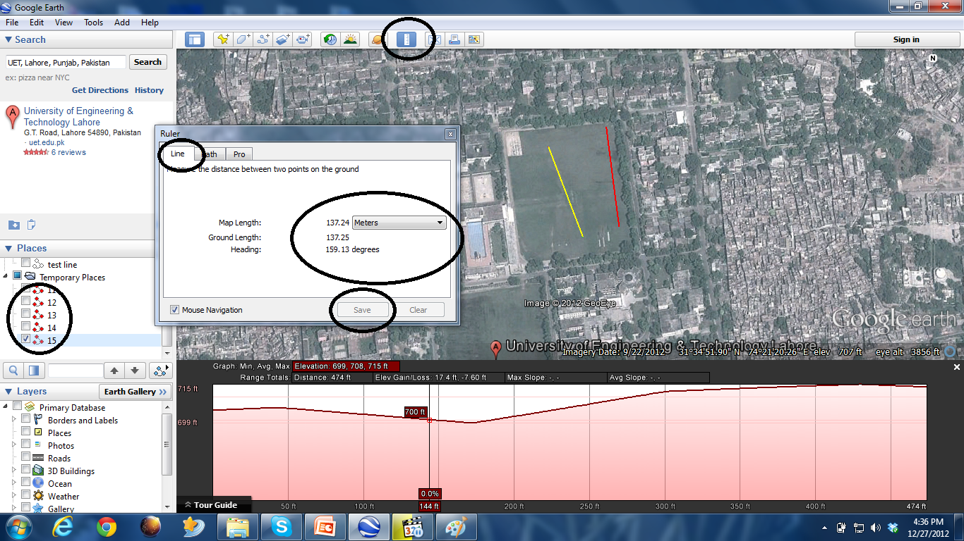
Can you recall Google Earth ?

Slide 7
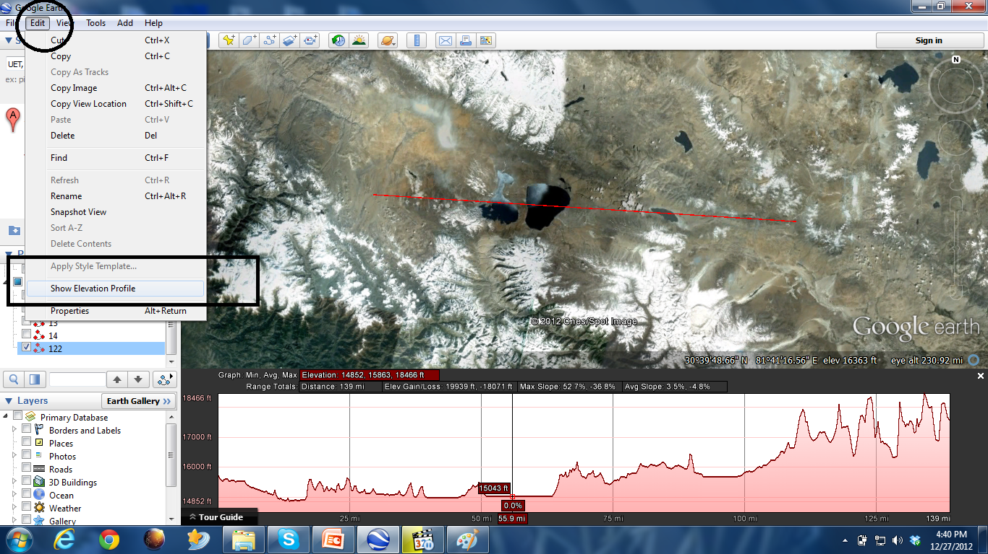
Can you recall Google Earth ?

Slide 8
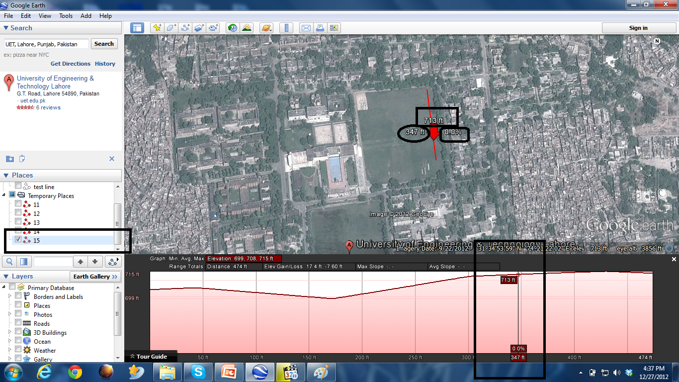
Can you recall Google Earth ?

Slide 9
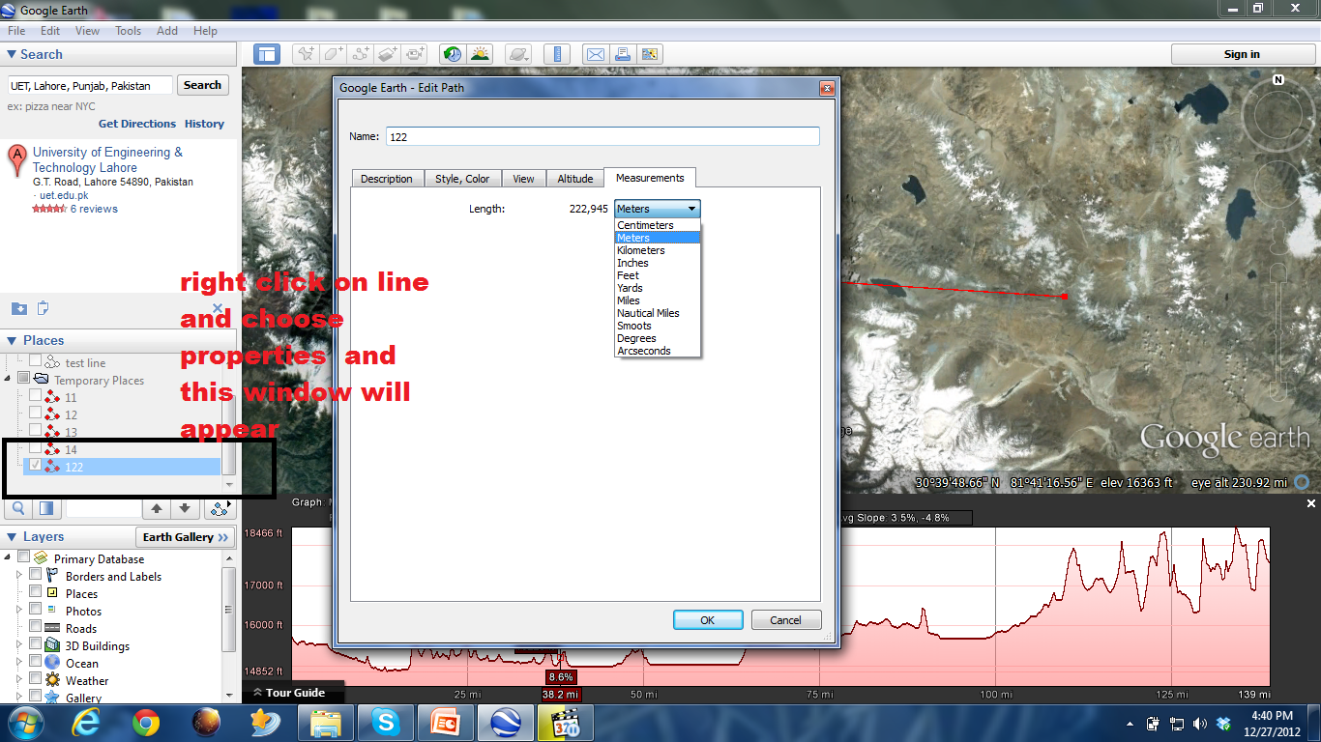
Can you recall Google Earth ?

Slide 10
Remote Sensing
Remote sensing has been variously defined but basically it is the art or science of telling something about an object without touching it. (Fischer et al., 1976, p. 34)
Remote sensing is the acquisition of physical data of an object without touch or contact. (Lintz and Simonett, 1976, p. 1)
The term “remote sensing” in its broadest sense merely means “reconnaissance at a distance.” (Colwell, 1966, p. 71)
Remote sensing is the art, science and technology of obtaining reliable information about physical objects and the environment, through the process of recording, measuring and interpreting imagery and digital representations of energy patterns derived from noncontact sensor systems (Lecture Note by Wataru, 2009)

Slide 11
Remote Sensing
Remote sensing is the science of deriving information about an object from measurements made at a distance from the object, i.e., without actually coming in contact with it. The quantity most frequently measured in present-day remote sensing systems is the electromagnetic energy emanating from objects of interest, that's why our attention . . . is focused upon systems which measure electromagnetic energy. (D. A. Landgrebe, quoted in Swain and Davis, 1978, p. 1)
Remote sensing is the practice of deriving information about the Earth’s land and water surfaces using images acquired from an overhead perspective, using electromagnetic radiation in one or more regions of the electromagnetic spectrum, reflected or emitted from the Earth’s surface. (James B. Campbell, Randolph H. Wynne (2011): Introduction to Remote Sensing)

Slide 12
Remote Sensing
12
Modern day remote sensing using satellites

Slide 13
Various Steps in RS
(A) Energy Source
(B) Radiation and the Atmosphere
(C) Interaction with the Target
(D) Recording of Energy by the Sensor
(E) Transmission, Reception, and Processing
(F) Interpretation and Analysis
(G) Application

Slide 14
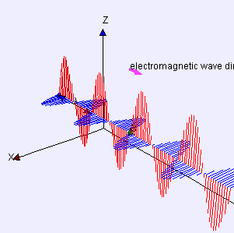
Electromagnetic Radiations (EMR)
Electromagnetic radiation (EM radiation or EMR) is a form of energy emitted and absorbed by charged particles, which exhibits wave-like behavior as it travels through space. EMR has both electric and magnetic field components,
which stand in a fixed ratio of intensity to each other, and which oscillate in phase perpendicular to each other and perpendicular to the direction of energy and wave propagation. In a vacuum, electromagnetic radiation propagates at a characteristic speed, the speed of light.

Slide 15
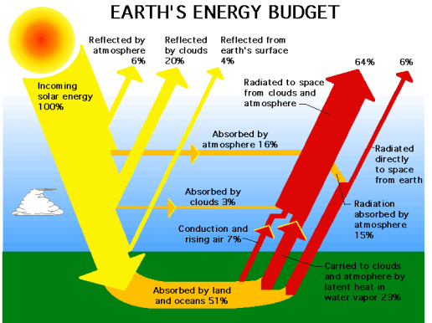
Source of Electromagnetic Radiation
15
Nuclear reactions within the Sun produce a full spectrum of electromagnetic radiation, which is transmitted through space without experiencing major changes.
As this radiation approaches the Earth, it passes through the atmosphere before reaching the Earth’s surface.
Some is reflected upward Some is reflected upward from the Earth’s surface; it is this radiation that forms the basis for photographs and similar images. Other solar radiation is absorbed at the surface of the Earth and is then reradiated as thermal energy..
Notes:
All objects emit electromagnetic radiation. Objects also reflect radiation that has been emitted by other objects.

Slide 16
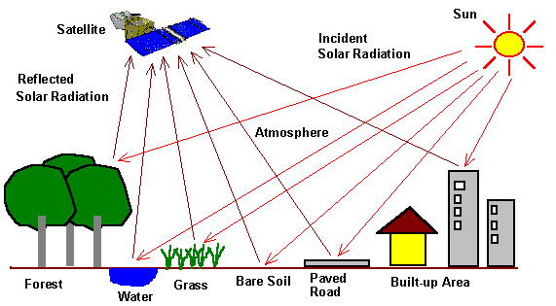
Source of Electromagnetic Radiation
16
By recording emitted or reflected radiation and applying knowledge of its behaviour as it passes through the Earth’s atmosphere and interacts with objects, remote sensing analysts develop knowledge of the character of features such as vegetation, structures, soils, rock, or water bodies on the Earth’s surface.
Notes:
All objects emit electromagnetic radiation. Objects also reflect radiation that has been emitted by other objects.

Slide 17
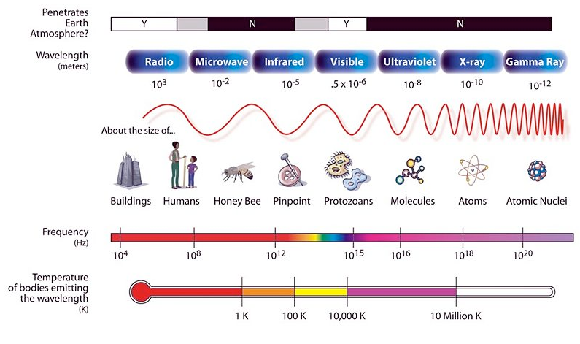
Electromagnetic (EM) Spectrum
17
The most familiar form of EMR is visible light, which forms only a small (but very important) portion of the full EM spectrum.
The large segments of this spectrum that lie outside the visible range require our special attention because they may behave in ways that are quite foreign to our everyday experience with visible radiation.

Slide 18
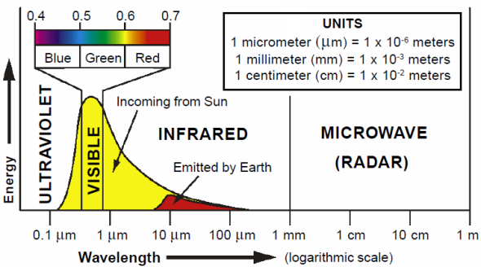
Electromagnetic (EM) Spectrum of solar energy

Slide 19
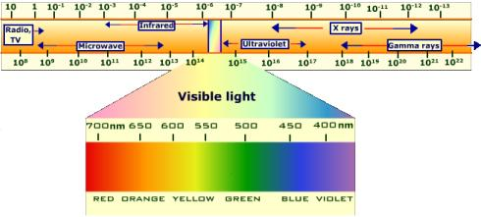
Electromagnetic (EM) Spectrum

Slide 20
Atmospheric Windows
20
Earth’s atmosphere is by no means completely transparent to electromagnetic radiation because the gases (O3, O2, CO2 & H2O ) together form important barriers to transmission of electromagnetic radiation through the atmosphere
Atmosphere selectively transmits energy of certain wavelengths; those wavelengths that are relatively easily transmitted through the atmosphere are referred to as atmospheric windows
Atmospheric windows are vitally important to the development of sensors for remote sensing

Slide 21
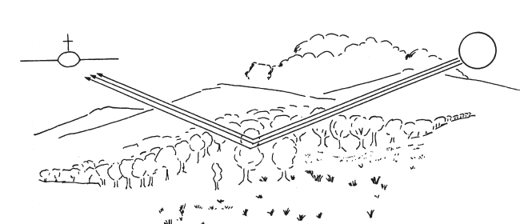
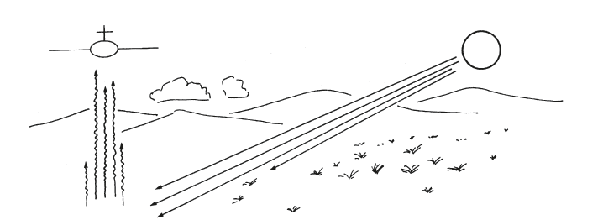
Type of Remote Sensing (RS)
21
Passive RS
Natural (EMR from Sun)
Active RS
Technological Assisted Radiation
(Microwave RS)
RS using reflected solar radiation
RS using emitted terrestrial radiation
RS using senor’s transmitted radiation

Slide 22
Technological Assisted Remote Sensing
Force Field
(Gravitational and Magnetic)
Acoustical Energy
For Sonar Survey
Electromagnetic Energy
Pass through free space
Pass through atmosphere
Variety in Behaviour
Can be exploited in different ways

Slide 23
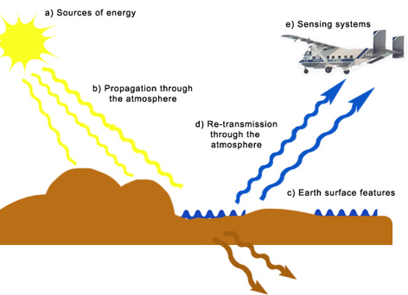
RS and GIS of Earth Resources
Remote Sensing
Sensing System
GIS
Geo referencing
Pictorial and Numerical data
Data Product
Interpretation
Products
Users
Electromagetic remote sensing of earth and its processing

Slide 24
Basic definition of GIS
G (Geography) - a particular form of Information System applied to geographical data (location, co-ordinates, maps etc..)
I (Information) S (Systems) is a set of processes, executed on raw data, to produce information which will be useful in decision-making
A series of steps from observation and collection of data through analysis to information (Data Handling)
The DATA into INFORMATION PATHWAY ( Data =Facts; Information = Facts with Meaning)

Slide 25
Basic definition of GIS
Definition
Geographic Information System (GIS) is defined as an information system that is used to input, store, retrieve, manipulate analyze and output geographically referenced data or geospatial data, in order to support decision making for planning and management of land use, natural resources, environment, transportation, urban facilities, and other administrative records.

Slide 26
Geographic Information System (GIS)
26
Geographic Information Systems (GIS) system designed to capture, store, manipulate, analyze, manage, and present all types of geographically referenced data
GIS are computerized systems designed for the storage, retrieval and analysis of geographically referenced data
GIS uses advanced analytical tools to explore at a scientific level the spatial relationships, patterns, and processes of cultural, biological, demographic, economic, geographic, and physical phenomena
GIS stores related geographic features in separate collections of files called map layers
Map layers can be reused easily and assembled into any number of map compositions and overlaid for analysis
Unique capabilities of GIS

Slide 27
Key Component of GIS
Computer
Hardware, Software for capturing, storing, processing, and Analysis, and display etc.
Geospatial Data
 Maps, Arial Photos, Satellite Images, Statistical Tables etc.
Users
For Design of Standards, for analysis, updating and implementation

Slide 28
GIS Functional Elements
Acquisition
digitizing, editing, topology building, projection transformation, format conversion, attribute assignment etc. , g
Pre-Processing
 Analogue to digital
 Conversion of units
Management
Data archival, databases (hierarchical model, networking model, relational databases etc.)
Manipulation and Analysis
Buffering, overlay, connectivity operations etc.
Output (Product Generation)
Thematic maps, 3D birds eye view, scaled maps etc

Slide 29
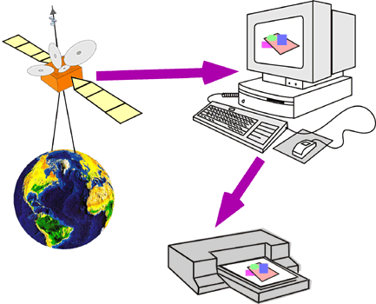
Tools for GIS
29
Information
Remote sensing data
Geographic data
Hardware
Computer
Digitizer
Scanner
Printer/Plotter
Software
Desktop GIS
Internet GIS
CAD Software
Database Software
Multimedia (photos, videos, 3D models)
Hardware/software
Information
Multimedia

Slide 30
Why a GIS
Old Records/maps are poorly maintained
Poorly Updated
Inaccurate
No Sharing
No data retrieval service for maps

Slide 31
Benefits of GIS
Once a GIS is implemented, following benefits are expected:
Better Maintained data
Standard format
Easy revision,
Easy updation
Easy Units conversion Easy Units conversion
Easy to share
Easier to search, analyze and represent
Many value added products
Enhance productivity of staff
Time and Money saved
Better Decision making

Slide 32
GIS as a Multi--Disciplinary Science
Combination of following traditional sciences
Geography Geography
Statistics
Cartography
Remote Sensing
Photogrammetric
Computer Science Computer Science
Operation Research
Mathematics
Surveying
Civil Engineering
Geodesy
Urban Planning
Environmental Engineering, etc.

Slide 33
Alternate Names of GIS
Land Information System (LIS)
AM/FM-Automated Mapping and Facilities Management
Environmental Information System (EIS)
Resource Information System (RIS)
GIS Is now becoming independent DISCIPLINE in the name of GEOINFORMATICS, or GEOSPATIAL INFORMATION SYSTEM. ,

Slide 34
GIS answers the following
34
Location: What is at...? Where is it…?
(Location question ; what exists at a particular location)
Condition: Status of features…?
(Conditional question ; which locations satisfy certain conditions)
Trends: What has changed since...?
(Trendy question ; identifies geographic occurrence or trends that have changed or in the process of changing)
Patterns: What spatial patterns exist…?
(Relational question : analyzes the spatial relationship between objects of geographic features)
Modeling: What if…?
(Model based question ; computers and displays an optimum path, a suitable land, risky area against disasters etc. based on model)

Slide 35
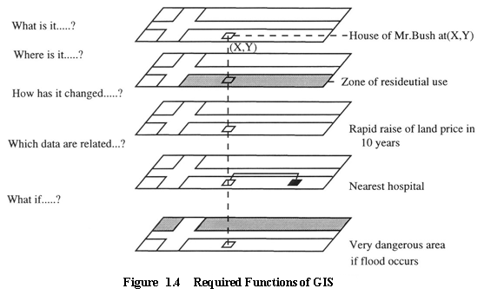
GIS answers the following
35
Location: What is at...? Where is it…?
Condition: Status of features…?
Trends: What has changed since...?
Patterns: What spatial patterns exist…?
Modeling: What if…?
XYZ

Slide 36
Application of RS and GIS
36
Facilities Management
 e.g. PTCL, SNGPL, Irrigation, WASA, for: locating underground pipes and cables)
Environmental and Natural Resource management
 suitable lands for crops, management of forests, Disaster Management etc.
Street Network
 Car Navigation, locating houses and streets, rescue services etc.
Planning and Engineering
 DAMS, Power Projects, urban planning, regional planning
Land Information System
 Board of Revenue, taxation, zoning, land acquisition.

Slide 37
Application of RS and GIS
37
Agriculture and Soil
Precision Agriculture, Crop Acreage and Production Estimation, Soil and Land Degradation Mapping
Forest, Biodiversity and Environment
Forest Cover and Type Mapping, Biodiversity Characterisation, Environmental Impact Studies, Monitoring of Environmental Sensitive Area, Monitoring of Wetland Areas, Forest Fire and Risk Mapping
Engineering and Geology
Mineral Potential Mapping, Groundwater Potential Zoning, Infrastructure Planning
Regional/ Land Development
Town and Country Planning, Land Alienation, Solid Waste Disposal

Slide 38
Application of RS and GIS
38
Marine and Oceanography
Potential Fishing Zone (PFZ), Coastal Zone Mapping, Marine Resources, Physical Oceanography
Disaster Management
Monitoring and Mapping of Disaster Areas (Forest fire, Flood and Landslide), Landslide Hazard Zonation, Flood Damage Assessment, Forest Fire
Meteorology
Extended Range Monsoon Forecasting, Ocean State Forecasting
Water
Potential Drinking Water Zones, Monitoring of Catchment and Reservoir Areas, Surface Water, Watershed Development

Slide 39
Application of RS and GIS
39
Environmental Health
Dengue Risk Mapping Zoning, Children Malnutrition Study, Air Pollution Study, Tick Borne Disease
Landuse Monitoring
Landuse/ Land Cover Mapping, Wasteland Mapping, Topography and Geographic Positioning, Urban Development, Geology
National Security
Intelligence, Territorial Security Management, Mapping and Rescue Planning, Strategic and Tactical, Ground Mobility

Slide 40
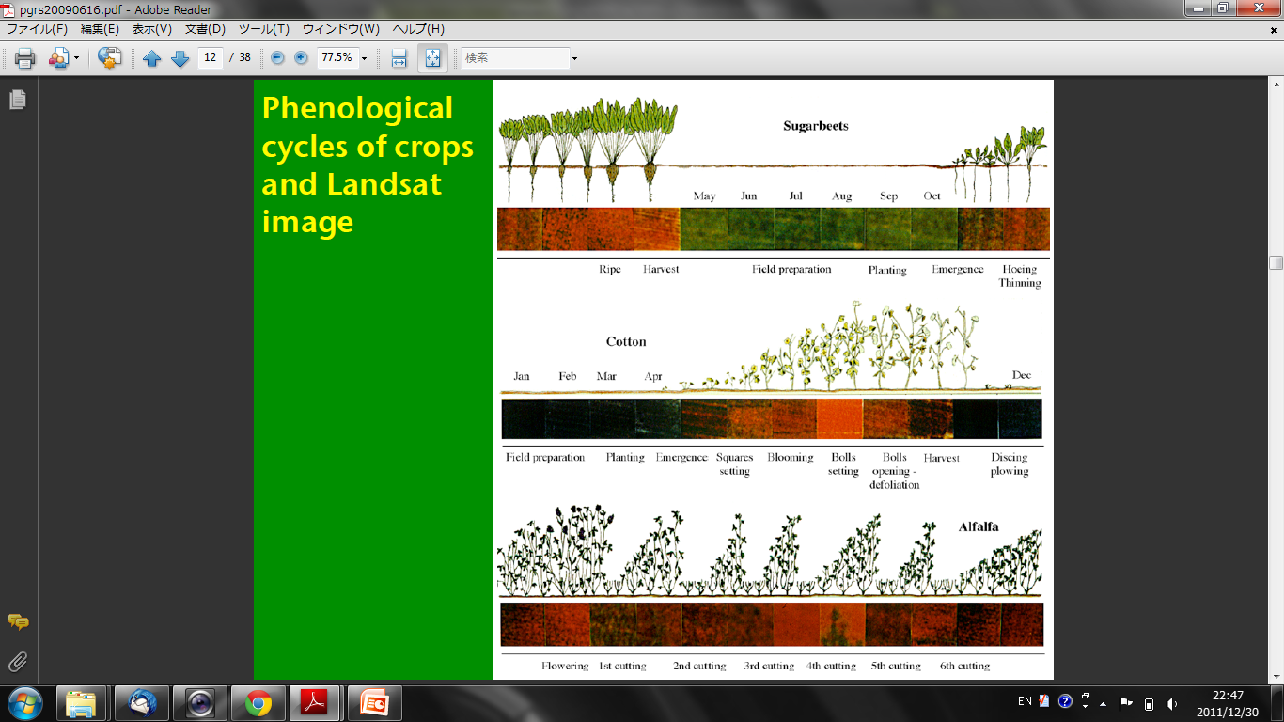
Application of RS: Crop Growth Monitoring
40

Slide 41
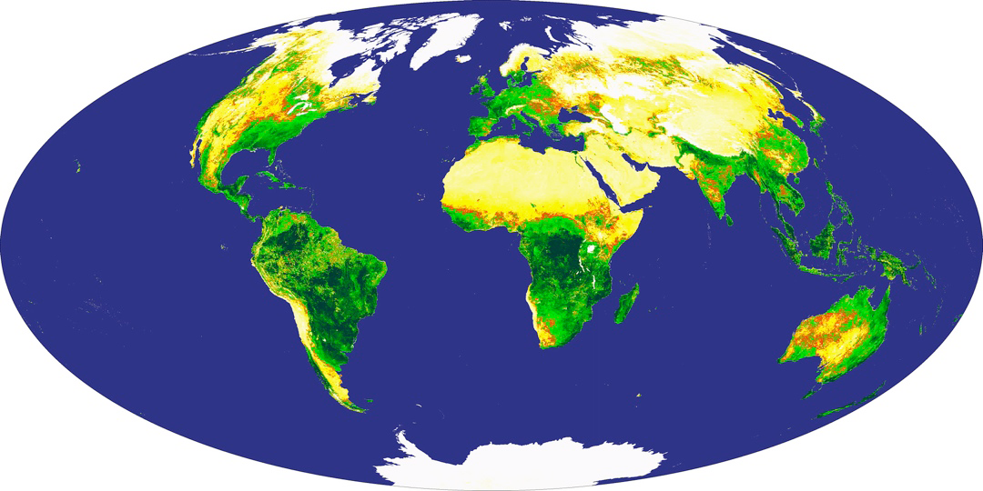
Application of RS: Crop Growth Monitoring
41
Global Normalized difference vegetation index (NDVI) map by MODIS (2003)
[GSFC, 2003]

Slide 42
Application of RS: Forest Monitoring
42

Slide 43
Application of RS: Urban Heat Island Monitoring
43
Land Surface temperature is clearly enhanced by land cover

Slide 44
Application of RS: Wild Fire Monitoring
44

Slide 45
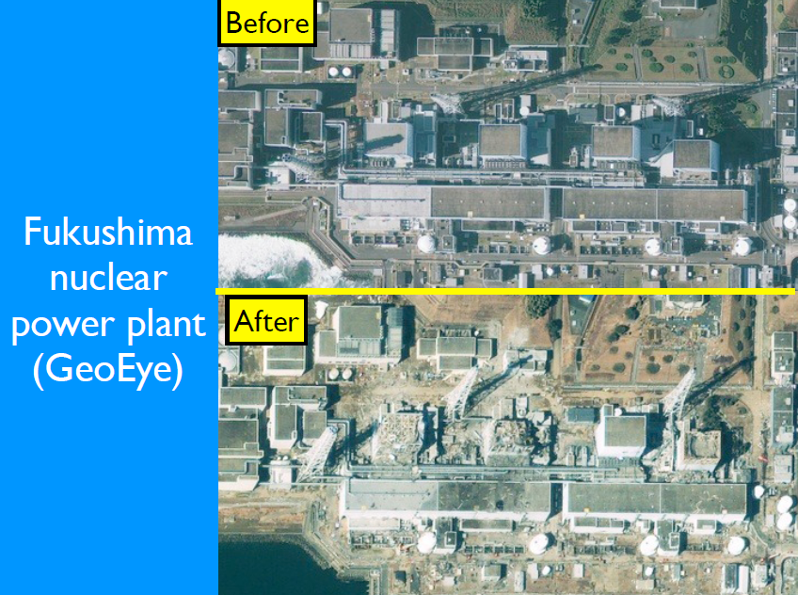
Application of RS: Disaster Management
45

Slide 46
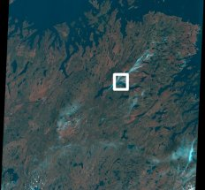
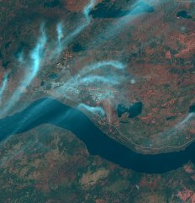
Application of RS: Land Uses
Newfoundland , Canada
Landsat Composite Image

Slide 47
Application of RS: Land Use change
47

Slide 48
Application of RS: Water
48

Slide 49
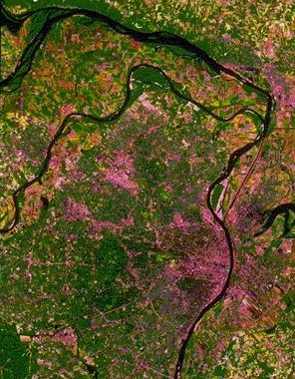
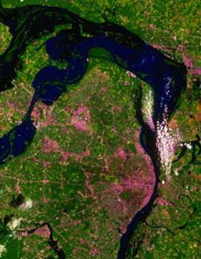
Application of RS: Flood Mapping
satellite image of St. Louis on July 4, 1988, during normal river levels.
St. Louis on July 18, 1993, during the height of the flooding.

Slide 50
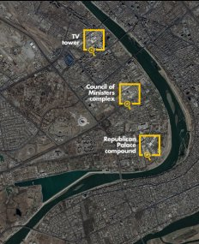
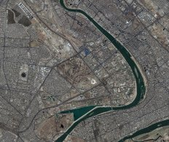
Application of RS: Military Use

Slide 51
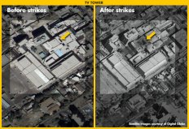
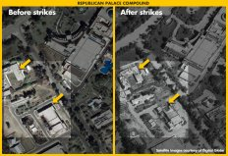
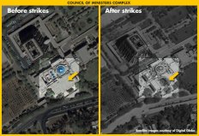
Application of RS: Military Use

Slide 52
GIS Software
ESRI: ARC/INFO, ARC VIEW, ARC GIS
Intergraph: MGE Intergraph: MGE
Grass Information Centre: GRASS*
Clark University: IDRISI Clark University: IDRISI
AUTODESK: ARC MAP
ILWIS: Integrated Land and Water Information
System.

Slide 53
Advantages and Disadvantages of GIS
53
Advantages of GIS
Exploring both geographical and thematic components of data in a holistic way
Stresses geographical aspects of a research question
Allows handling and exploration of large volumes of data
Allows integration of data from widely disparate sources
Allows analysis of data to explicitly incorporate location
Allows a wide variety of forms of visualisation
Limitations of GIS
Data are expensive
Learning curve on GIS software can be long
Shows spatial relationships but does not provide absolute solutions
Origins in the Earth sciences and computer science. Solutions may not be appropriate for humanities research

Slide 54
Basic Geographical Concepts
Spatial Object: Delimited Geographical areas, with a number of different kind of associated attributes
Point: A spatial object with no area. A key attribute is its geodetic location. Many Attributes can be associated with a Point
Line: A spatial object, made up of a connected sequence of points. Lines have no width, thus a specified location will be on one side of a line or other, but never on a line.
Nodes: Special kinds of points showing start, end and junction of line segments.
Polygon: A closed Area. Simple Polygons are undivided areas, while complex polygons are divided into areas of different characteristics.
Chains: Special kinds of line segments, which corresponds to a portion of the bounding edge of polygon.

Slide 55
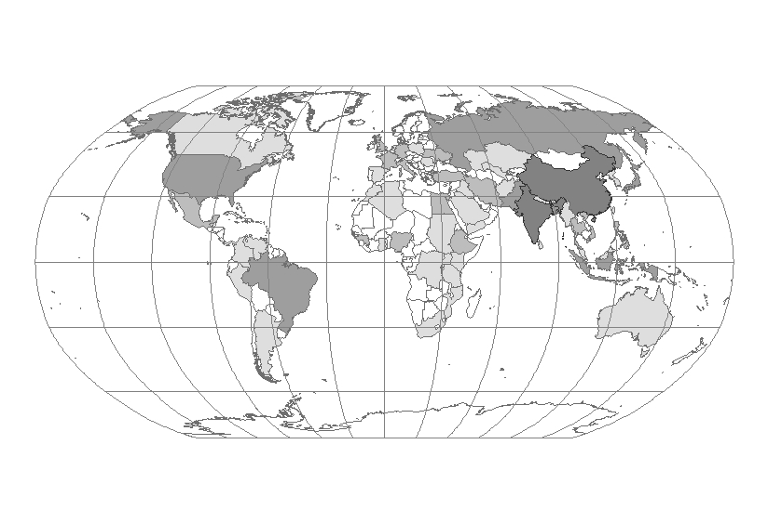
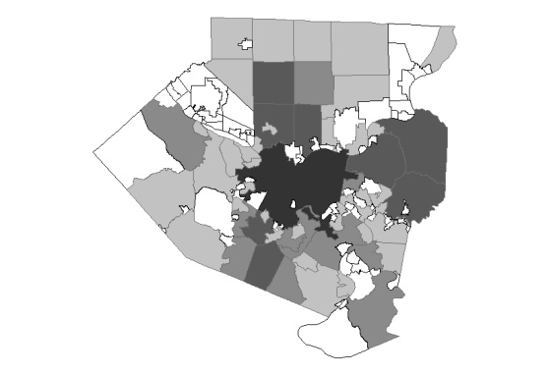
Basic data manipulation in RS & GIS
55
One of the most common products of a GIS is a map
Points
Lines/nodes
Polygon/chain
Global to local

Slide 56
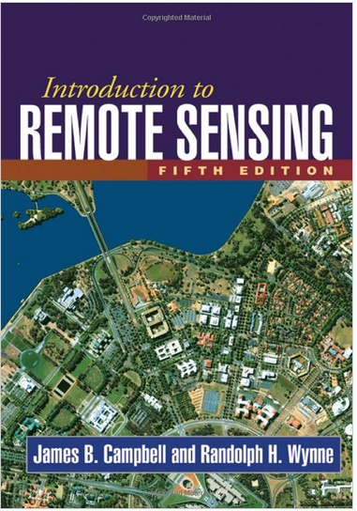
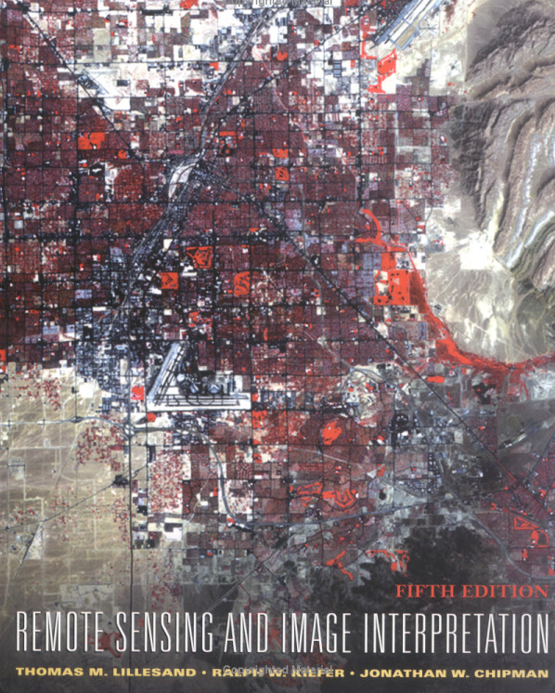
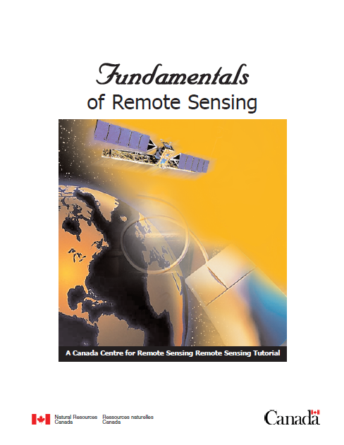
Books and Tutorials
Books on Remote sensing
James B. Campbell, Randolph H. Wynne (2011):Introduction to Remote Sensing, Fifth Edition
Canada Centre for Remote Sensing Fundamentals of Remote sensing
Thomas M. Lillesand (eds.), 2007. Remote sensing and image interpretation, Willey.

Slide 57
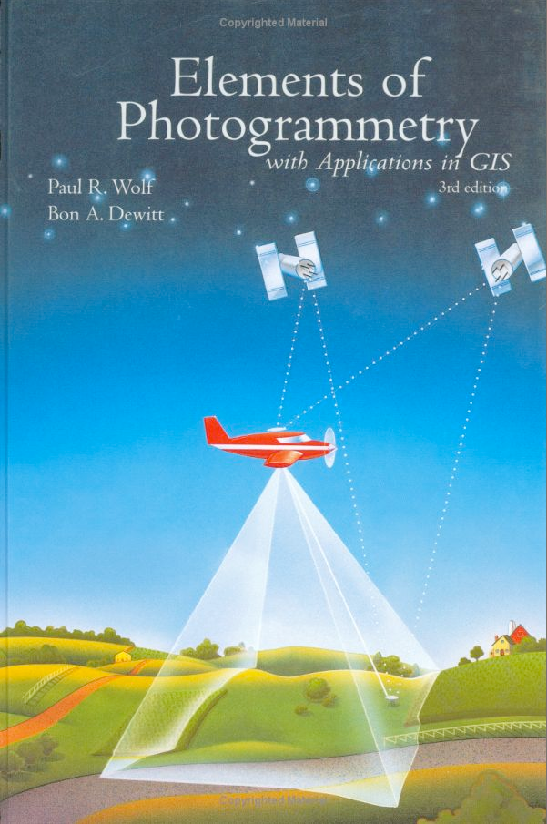
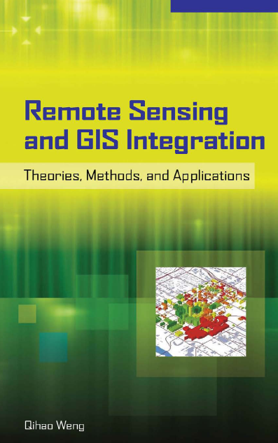
Books and Tutorials
57
Books on Remote Sensing and GIS
Paul R. Wolf (eds.), 2000. Elements of photogrammetry with applications in GIS, McGraw-Hill Science.
Qihao Weng, Remote Sensing and GIS Integration, Theory, Methods and Applications

Slide 58
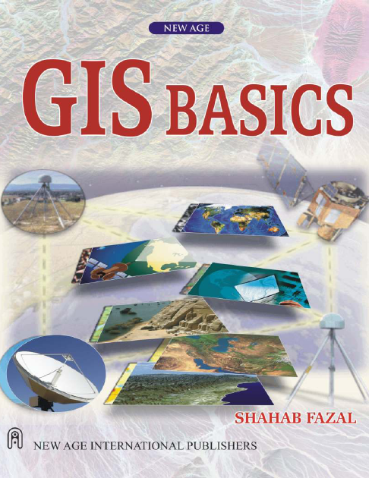
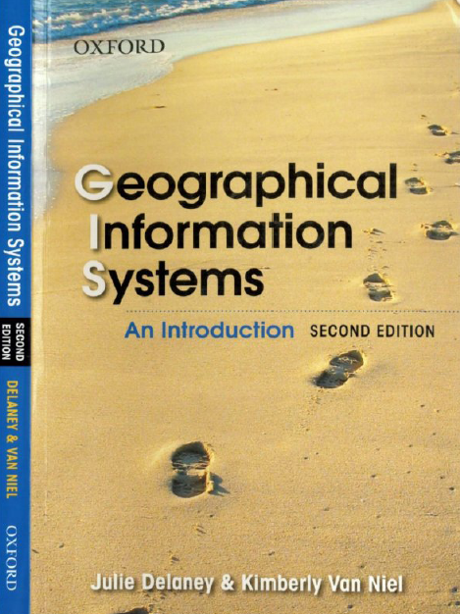
Books and Tutorials
Books on GIS
Shahab Fazal, GIS Basics
Michael N. DeMers, GIS for Dummies
Julie Delaney & Kimberly Van Niel, Geographic Information system An introduction

Slide 59
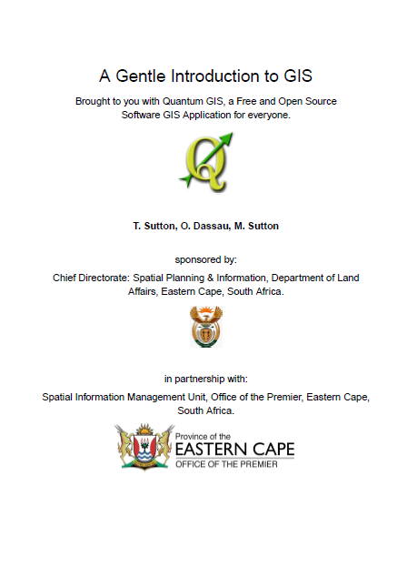
Books and Tutorials
Books on GIS
To be added with the help of Sir Google ….☺
T. Sutton, O. Dassau, M. Sutton, A gentle introduction to GIS

Slide 60
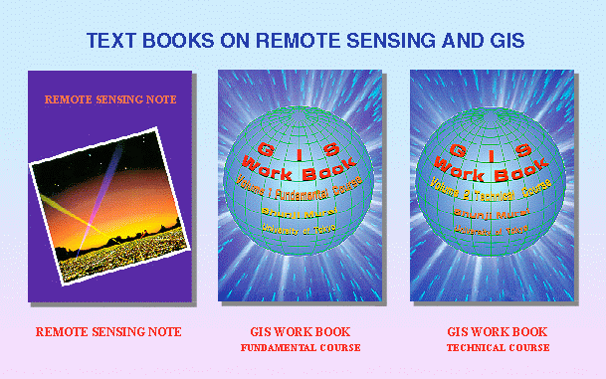
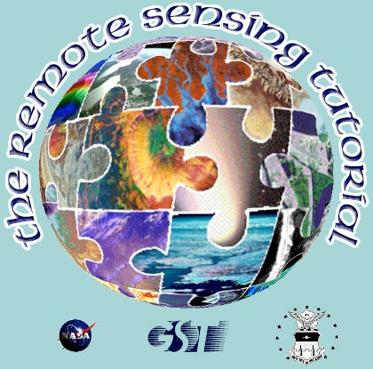
Books and Tutorials
Tutorial on Remote Sensing and GIS
Remote Sensing and GIS Tutorial by JARS/JAXA/AIT/RESTEC
(http://stlab.iis.u-tokyo.ac.jp/~wataru/lecture/rsgis/)
Remote Sensing Tutorial by GSFC/NASA: (http://rst.gsfc.nasa.gov/)
History of Remote Sensing by GSFC/NASA
(http://stlab.iis.u-tokyo.ac.jp/~wataru/lecture/rsh/)

Slide 61
Comments…. Questions…. Suggestions….
Thanks you !
I am greatly thankful to all the information sources (regarding remote sensing and GIS) on internet that I accessed and utilized for the preparation of present lecture.

