Slide 1
Theories of Failure

Slide 2
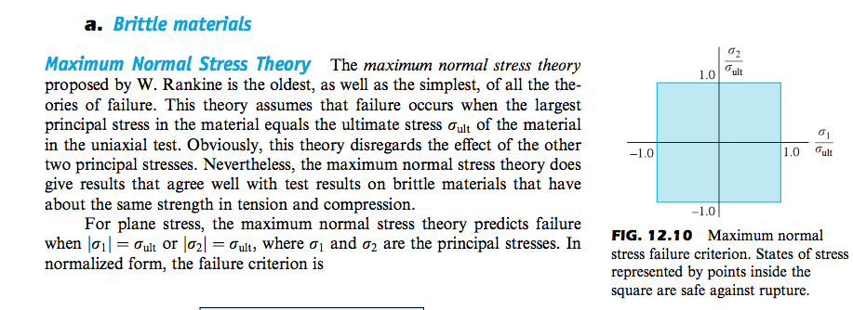

Slide 3
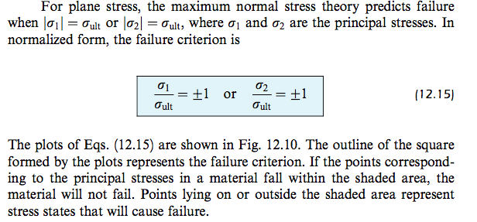
In other words:

Slide 4
envelop is obtained by drawing curves that are tangent to each of the three curves.

Slide 6
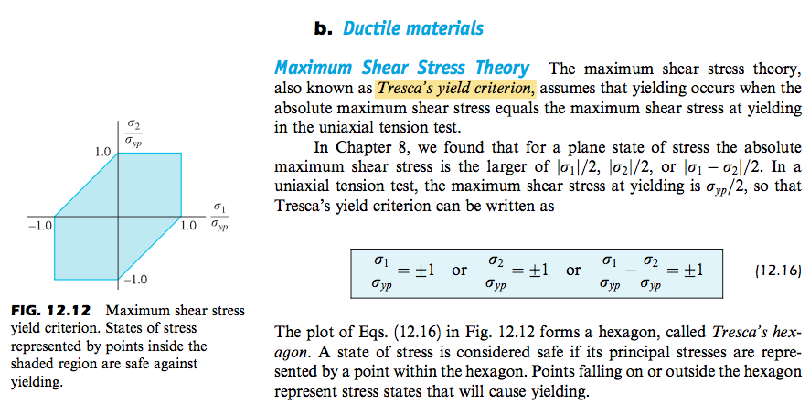

Slide 12
