Slide 1
Crop Coefficients (Kc)

Slide 2
Crop evapotranspiration under standard conditions (ET_{c})
Evapotranspiration from disease-free, well-fertilized crops, grown in large fields, under optimum soil water conditions and achieving full production under the given climatic conditions.
The difference of surface resistance (r_{s}) between reference crop and the actual crop is accounted in CROP Coefficient (K_{c}).

Slide 3
Crop Coefficients: Calculation Approaches
The single crop coefficient approach
  In the single crop coefficient approach, the difference in evapotranspiration between the actual crop and reference grass is combined into one Single coefficient
  used for most applications related to:
    irrigation planning,
    design, and
    management
The dual crop coefficient approach
  In the dual crop coefficient approach, the crop coefficient is split into two factors describing separately the differences in evaporation and transpiration between the crop and reference surface
  used for detailed estimates of soil water evaporation, such as:
    real time irrigation scheduling applications,
    water quality modeling, and
    research

Slide 4
Methods of estimating ET_{c}
Direct Methods
  Energy Balance Approach
  Water Balance Approach
    Lysimeter
    Cropped Plots
  Penman-Monteith equation (Need Met. data and need crop data)
  considerable lack of information on the aerodynamic and canopy resistances for the Various cropped surfaces, so:
  the FAO Penman-Monteith method is not used for direct calculation of ETc

Slide 5
Crop coefficient approach
Weather Effects are incorporated into the ET_{o}
Kc varies with crop characteristics
Thus Kc values (for same crop) can be transferred from one place to other and from one climatic condition to other
Primary Reason for
Global Acceptance of
Crop Coeff. Method

Slide 6
Crop Characteristics Affecting K_{c}
Crop height.
  It influences the aerodynamic resistance term, r_{a}, and the turbulent transfer of vapour from the crop into the atmosphere.
Albedo (reflectance).
  depends on
    fraction of ground covered by vegetation and
    soil surface wetness.
  Albedo influences the net radiation, R_{n}
Canopy resistance (r_{s}).
  depends on
    leaf area (number of stomata),
    leaf age and condition, and
    the degree of stomatal control.
  The canopy resistance influences the surface resistance, r_{s}.
Evaporation from soil, especially exposed soil.
  depends on
    Bare soil area,
    Leaf area

Slide 7
Some typical Kc
Pineapple closes its stomata during day
Citrus and deciduous trees have stomata on one side of leave only
Tall crops have higher Kc
Low density of crop/trees will cause low Kc

Slide 8
Effect of evaporation on Kc
If soil surface is kept wet all the time then Kc≅1.1
Else
It varies as shown

Slide 9
Crop growth stages for various kinds of crops
Initial (0-10% cover)
Crop Development (cover = 10%-100%) or LAI =>3
Mid Season (from Full Cover to maturity)
Late Season (from maturity to harvest)

Slide 10
Kc for Standard Climatic Condition
A sub-humid climate with average daytime minimum relative humidity (RHmin) ≈ 45% and having calm to moderate wind speeds averaging 2 m/s.
Kc for crops increases as wind speed increases and as relative humidity decreases.

Slide 11
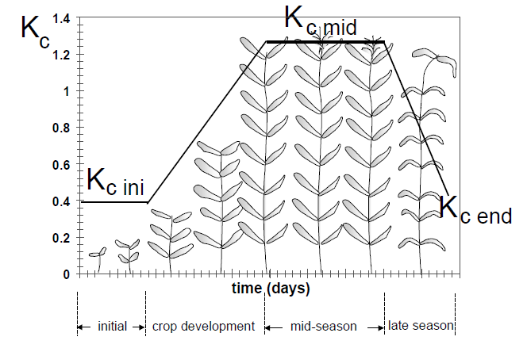
Generalized Kc Values (single crop coeff.)

Slide 12
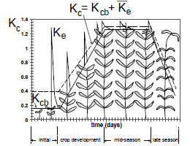
Generalized Kc Values (dual crop coeff.)

Slide 13
Kc calculation flowchart
Improve

Slide 14
Calculation steps
Identifying the crop growth stages, determining their lengths [Table 11], and selecting the corresponding Kc coefficients [Table 12]
Selecting more accurate Kc coefficients for frequency of wetting & amount of wetting [Fig 29,30]
Adjusting Kc for non-standard climatic conditions during the each stage;
constructing the crop coefficient curve (allowing one to determine Kc values for any period during the growing period); and
calculating ETc as the product of ETo and Kc.

Slide 15
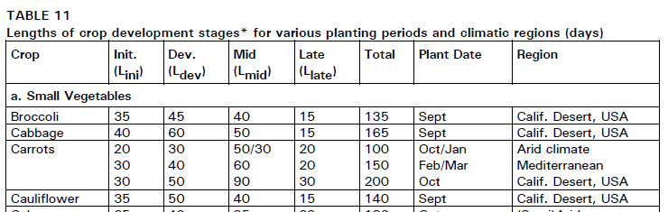
Crop growth stages (Table 11 in FAO-56)

Slide 16
Crop growth stages

Slide 17
Crop growth stages

Slide 18
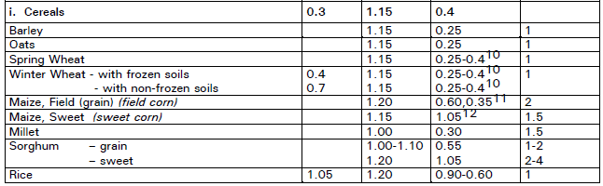
Kc values (Table 12 in FAO-56)
Table 12 gives general value. Preference should be given to Kc’s from local data

Slide 19
Improve K_{cin} based on:
Frequency of wetting
Fraction of wetting
Correction on the Estimates
Climatic condition
Type of crop (Trees, Rice)

Slide 20
K_{cin} based on frequency of wetting & infiltration
For: Light wetting events (infiltration 3-10mm), e.g. drizzling, light shower, Infiltration will be low (whatever may be the soil)

Slide 21

K_{cin} For High Wetting & Infiltration (>=40mm)
Fig-30 in FAO-56
a. High wetting event >=40mm, then: High infiltration
For: Coarse Grained Soils, the Water
available for evaporation will be less
as compared to Medium Soil (because more
water will be drained/deep percolated)
b. High wetting event >=40mm
Then: High infiltration
For: Medium & Fine Grained Soils, the
Water available for evaporation will be
more as compared to Coarse Soil

Slide 22
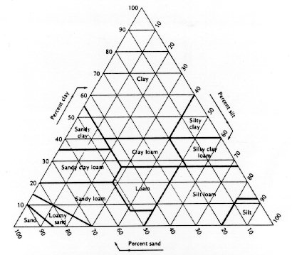
USDA Textural Triangle
Coarse Textured Soils:
  Sand, Loamy Sand
Medium Textured Soil:
  Sandy Loam, Loam, Silty Loam, Silt
Fine Textured Soils:
  Sandy clay loam, clay loam, Silty clay loam, Sandy clay, silty clay, clay

Slide 23
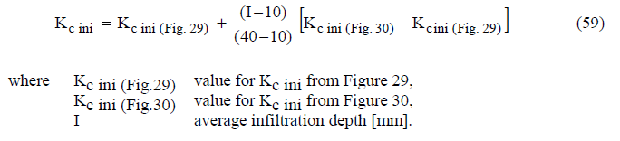
For average wetting event
Where average infiltration depths are between 10 and 40 mm, the value for Kc ini can be estimated from Figures 29 and 30:

Slide 24
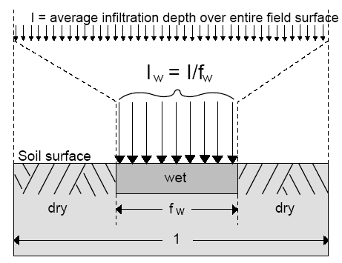
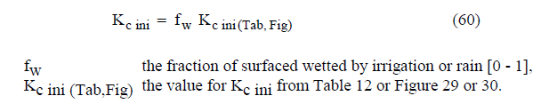
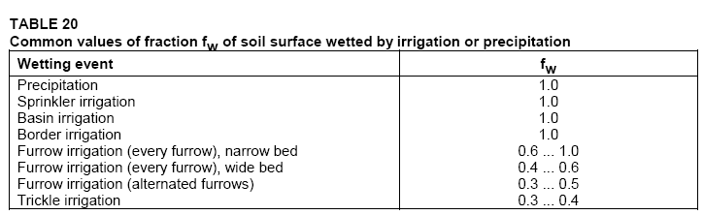
Adjustment for fraction of wetting f_{w}
Surface Area wetted
  For trickle --- upto 0.4
  For furrow --- 0.3-0.8

Slide 25
Other adjustments for K_{cin}
For trees
  Depend on Ground cover and canopy cover
For Rice
  Depend on Climate (use table 14)

Slide 26
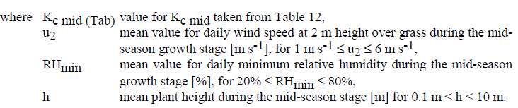
Adjustment of K_{c mid}
Climate (Wind and Humidity, crop height)
Frequency of wetting (does not affect much)
  If interval is < 3day and Kcmid is <1 then increase it to 1.1-1.3

Slide 27

Adjustment to K_{cend}
Climate

Slide 28
Expected K_{cend} values
Depends on:
If the crop is harvested green or dry?

Slide 29
Construction of Kc Curve

Slide 30
Problem
Construct Kc (SINGLE) curve for Wheat crop (h=1.2m) in Lahore, with following data:
RH_{min} = 60%
Frequency of Irrigation = 10 days, with wetting (or infiltration) quantity 30 mm
Wind Speed = 3 m/sec
Medium textured Soil
Assume suitable missing data.
Use FAO-56 Chapter 6

Slide 31
Dual Crop Coefficients
Kc = Kcb + Ke
  Kcb: Basil Crop Coefficient Kcb
  Ke: Evaporation from soil
Basal crop coefficient (Kcb)
  The basal crop coefficient (Kcb) is defined as the ratio of the crop evapotranspiration over the reference evapotranspiration (ETc/ETo) when the soil surface is dry but transpiration is occurring at a potential rate, i.e., water is not limiting transpiration (Figure).
  'Kcb ETo' represents primarily the transpiration component of ETc.
EVAPORATION COMPONENT (Ke ETo)
  Ke, describes the evaporation component of ETc.
  Where the topsoil is wet, following rain or irrigation, Ke is maximal. Where the soil surface is dry, Ke is small and even zero when no water remains near the soil surface for evaporation.

Slide 32
Procedure
Identifying the lengths of crop growth stages, and selecting the corresponding K_{cb} coefficients
Adjusting the selected K_{cb} coefficients for climatic conditions during the stage
Constructing the basal crop coefficient curve (allowing one to determine K_{cb} values for any period during the growing period
Determine daily K_{e} values for surface evaporation; and
Calculating ET_{c} as the product of ET_{o} and (K_{cb}+K_{e})

Slide 33
Kc calculation flowchart
Improve

Slide 34
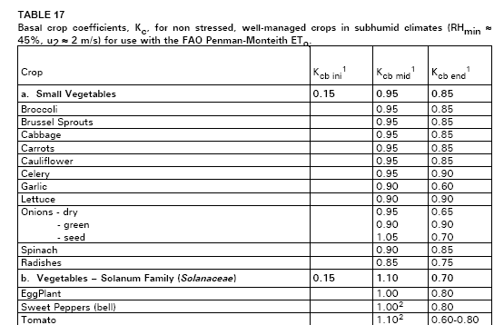
K_{cb} for various crops
(Part of Table 17 FAO-56)

Slide 35
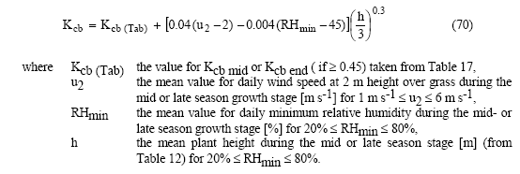
Adjust K_{cb.mid} and K_{cb.end} for Climate conditions

Slide 36
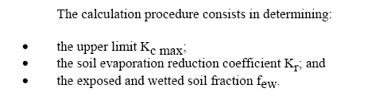
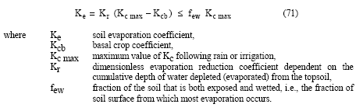
Procedure for Ke

Slide 37
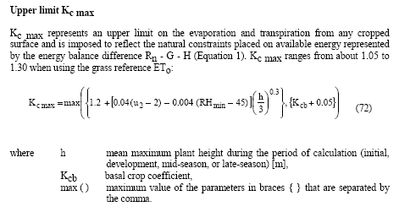
K_{c max}
The factor 1.2 in above equation should be replaced with 1.1 if irrigation is
more frequent than 3 days.

Slide 38
Kr calculation
Kr is Evaporation Reduction Coefficient
Depends on Cumulative water depleted from soil
After Rainfall: Kr= 1
Later-on it drops and reaches to 0 when soil is completely dry
It also depends on exposed and wetted soil fraction f_{ew}

Slide 39
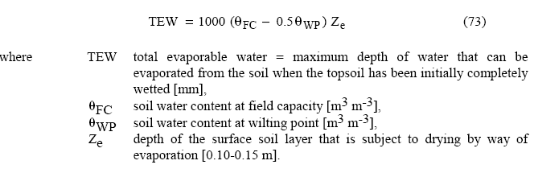
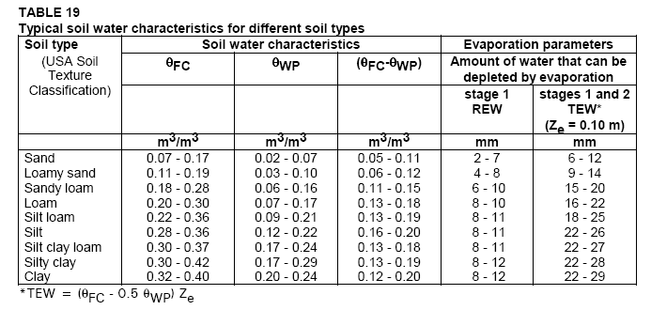
Estimation of Kr:
Depends on Total Evaporable Water (TEW) and Readily Evaporable Water (REW):
TEW is the Max amount of Water available for evaporation. It depends on Soil.

Slide 40
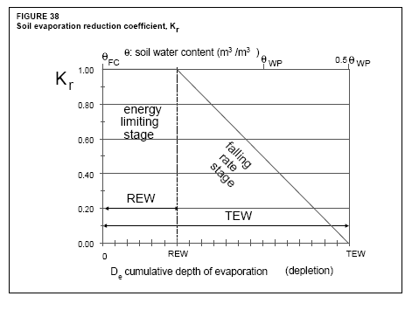

Kr
Energy limiting stage: When max. evaporation occurs, and limited only by energy, not by water. It occurs till Cumulative evap water = REW [depend on soil: From table 19]
Falling rate stage: when not enough water is available for evaporation
REW: Readily evaporable water
Given in TABLE 19, above side

Slide 41
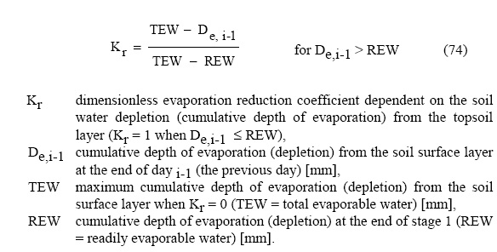
Kr
During first stage Kr = 1
During Falling Stage Kr is computed from following:

Slide 42
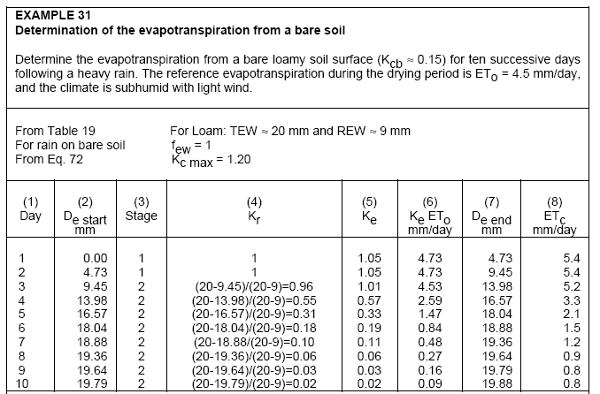
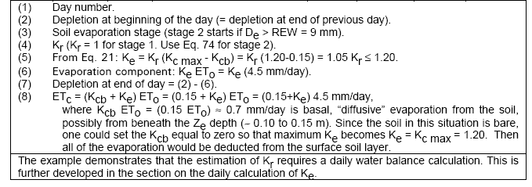

Slide 43
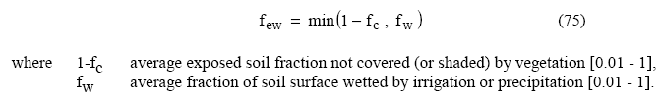
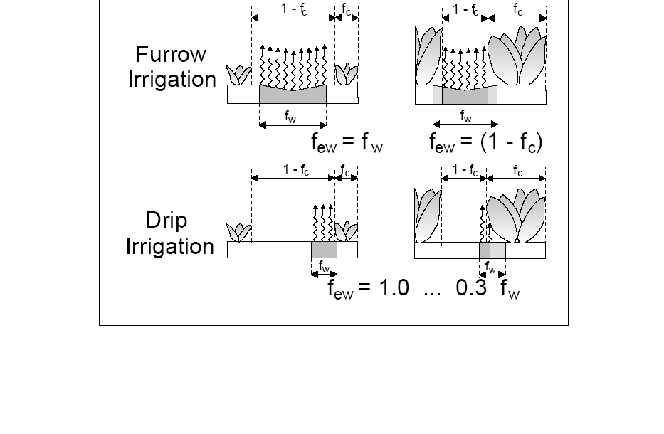
f_{we}
Fraction of Exposed, wet soil

Slide 44
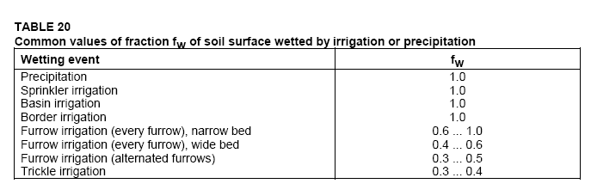
Common fw
For drip irrigation fw =

Slide 45
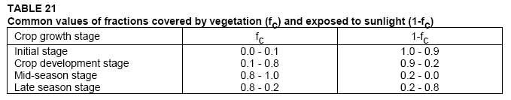
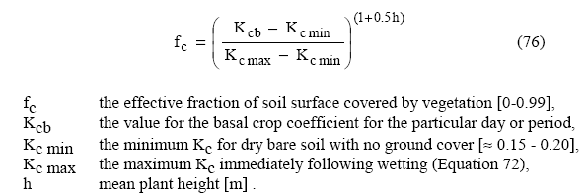
fc
Or use→

Slide 46
Problem
Construct Kc (DUAL) curve for Wheat crop in Lahore, with following data:
RH_{min} = 60%
Frequency of Irrigation = 7 days
Wind Speed = 2.5 m/sec
Medium Soil : Silt Loam
Border Irrigation method
Assume suitable missing data.
Use FAO-56 Chapter 7

