Slide 1
Systems Approach to Water Resources
By: Dr. Noor M Khan
Professor
May-2015
Source:
Lecture notes By Prof. Asim Das Gupta and Prof. U. Nanduri for the subject of Water Resources System Analysis, Water Engineering and Management, Asian Institute of Technology, Thailand.

Slide 2
Outline
System Analysis
  Definition of a System
  Classification of systems
  Types of problems in systems approach
Linear Programming
  Formulation of the problem
  Solution through Graphical method

Slide 3
What is a System?
A system is a collection of parts which interact with each other to function as a whole
  Example: cooling system in a car: consisting radiator, fan, water pump, thermostat, hoses and clamps
A set of objects, which interact in a regular, independent manner
Several definitions available in literature for system

Slide 4
Schematic Representation of a System
Parameters, β
Inputs, I
System
Outputs, Q
Policies, α
Transformation function
Q(t) = Ω[α(t), β(t)]*I(t)
Feedback

Slide 5
Elements of a System
1.INPUT: Input involves capturing and assembling elements that enter the system to be processed.
2.OUTPUT: Those elements that exists in the system due to the processing of the inputs is known as output.
3.PROCESSOR(S): The processor is the element of a system that involves the actual transformation of input into output.
4.CONTROL/CONSTRAINT: The control element guides the system. It keeps the system within the boundary set.
5.FEEDBACK: Self controlling systems have Feedback. It measures output against a standard in some form of automatic procedure that includes communication and control.
6.BOUNDARY AND INTERFACE: A system should be defined by its boundaries-the limits that identify its components, processes and interrelationships when it interfaces with another system.
7.ENVIRONMENT: The environment is the 'super-system' within which an organization /system operates.
Ref. http://en.wikipedia.org/wiki/Systems

Slide 6
Examples of System
Examples: computer system, a university, respiratory system, river basin, irrigation system
For each of above system: List the each of the element:
System Name:______________
Input: ????
Output: ???
Processes:???
Constraints:???
Feedback:???
Boundary: ???
Environment:???

Slide 7
Example: Irrigation System
System Name: Irrigation System
Input:
Output:
Processes:
Constraints: ???
Feedback:???
Boundary: ???
Environment:???
Flow at Head, Finances, HR
  Flow at outlet
Diversions, Losses, Allocation

Slide 8
Water Resources Subsystems
Surface water systems
  Reservoirs
  Irrigation systems
  River basins
Groundwater systems
Water distribution systems
  Canal distribution systems
  Piped networks

Slide 9
System and subsystems
Systems can be part of a larger system (subsystems)
    particle
    atom
    molecule
    brain cell
    brain
    nervous system
    individual
    local community
    state
    nation
    world civilization
    world ecosystem
    planet earth
    solar system
    galaxy
    universe

Slide 10
Classification of systems
Abstract system vs. Real system
  A reservoir is a physical system
  Policy of water allocation – abstract system
Natural system vs Devised system
  Catchment – natural system
  Reservoir – devised system
Static system vs. dynamic system
  Time variant and time invariant
Linear system vs. Non-Linear system

Slide 11
What is a System Approach or System Theory
In 1920 research of patterns began (general systems theory).
  startling discovery: no matter how different the ingredients of different systems looked, they were all put together according to the same general principles of organization.
  great impact: development of computers (practical application of “systems analysis” - essential for the management of all business and institutions).
Systems theory views the world as a complex system of interconnected parts.
systems theory provides a way of tackling big, messy, real-world problems.
systems theory provides a way for a person to get a good, clear picture of how his/her environment works

Slide 12
What is a system approach? (cont..)
Scientific approach to learning: take apart and find out what it is made of (division of science into specialties).
  “Something is nothing but the sum of its parts”.
  Example: a house is the same as a pile of building material.
The main difference is how these components are arranged together (organization)
It is a way of looking at a system as a whole, focusing on the relationships between the elements

Slide 13
Types of Problems/Questions in System Approach
Problem | Inputs | Parameters | Outputs | Method
Direct Problem – Prediction | Known | Known | Unknown | Simulation
Inverse – Parameter Estimation | Known | Unknown | Known | Design
Capacity Detection of a component | Unknown | Known | Known | Analysis

Slide 14
Types of Problems in Water Resources
Direct Problems:
  Estimation of runoff from a catchment
  Determining yield of a reservoir/ aquifer
  Flow forecasting in rivers
Indirect problems
  Estimation of aquifer parameters from pumping test
  Deriving the unit hydrograph of a catchment
  Design of a reservoir capacity
  Deriving the operating policy of a reservoir
  Calibration of models(e.g. HECRAS)

Slide 15
Design / Simulation / Direct Problem
Simulation provides the outputs against a certain set of inputs and system parameters.
The desirable outputs can be maximized and the undesirable outputs can be minimized through controlled and partially controlled inputs, and through variation of system parameters (if in user control)
Environment
Inputs
Outputs
Controlled
Desirable
Partially Controlled
System
Undesirable
Uncontrolled
Neutral
Feedback

Slide 16
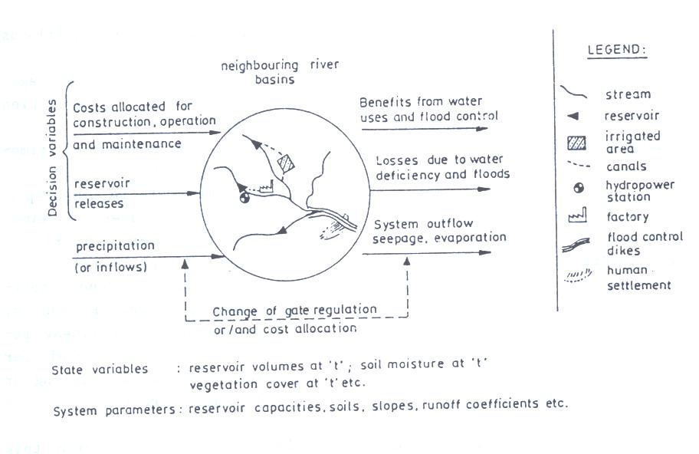
Application of system concepts in Water Resources:
Example – A River Basin

Slide 17
Systems Analysis
Systems analysis is the study of sets of interacting entities.
System analysis helps a decision maker to identify and select a preferred course of action from several feasible alternatives
Systems analysis is a problem solving technique wherein attempts are made to build a replica of a real world system or situation, with the objective of experimenting with the replica to gain some insight into the real world problem
Analysis means "to take apart“. Synthesis means "to put together".
Analysis is defined as the procedure by which we break down an intellectual or substantial whole into parts.
Synthesis is defined as the procedure by which we combine separate elements or components in order to form a coherent whole.

Slide 18
Advantages of System Analysis
The systems analyst is free to consider a wide range of conditions and alternative systems
The configuration and scale of components comprising the system can be manipulated for purposes of optimization
The Systems Analysis requires relatively short time for obtaining results when compared to the equivalent field data collection exercise

Slide 19
Phases of Systems Analysis
Formulation of the problem
Construction of the mathematical model
Solution of the mathematical model
Testing the model
Implementation of the solution

Slide 20
Modeling of Water Resources Systems

Slide 21
Definition of Models
Models are tools used to derive answers to questions about the performance or behaviour of the system under consideration

Slide 22
Types of Models
Physical Models
Mathematical Models
Types of Mathematical Models
  Descriptive Models – Identification and direct problems
  Prescriptive Models – Decision making
  Deterministic Models
  Stochastic Models

Slide 23
A Physical Model

Slide 24
Phases of Systems Analysis
Formulation of the problem
Construction of the mathematical model
Solution of the mathematical model
Testing the model
Implementation of the solution

Slide 25
Objectives of Water Management
The ultimate objective of water management is to achieve from the resources the greatest enhancement of social welfare
  Economical growth is not the sole indicator of welfare
  Other dimensions of welfare not included in economical analysis need to be included

Slide 26
Objectives of Water Management (cont..)
Environmental quality protection
Regional economic growth
Equitable Redistribution of income

Slide 27
Design/ Simulation Problem
Normally the objective is to:
Maximize the desirable outputs and minimize the undesirable outputs through controlled and partially controlled inputs
Environment
Inputs
Outputs
Controlled
Desirable
Partially Controlled
System
Undesirable
Uncontrolled
Neutral
Feedback

Slide 28
Simulation vs. Optimization
In System analysis the words “mathematical modeling” are interchangeably used for the word “Optimization”.

Slide 29
Construction of Mathematical Model for optimization
The mathematical model describes the problem more concisely than the verbal description of the problem
The mathematical model is an idealised abstraction of the problem
General form of optimization model
Maximize z = f(X) …. objective function
[or Minimize z = f(X) ]
subjected to
g_{i}(X) ≤ / ≥ / = b_{i}, i = 1,2…m …. constraints

Slide 30
Example – Water Users
Allocate water diverted R to 3 users (1, 2, 3) and provide in-stream flow S, to maximize the benefits
Net-benefit from
allocation of x_{i}

Slide 31
Example
Note: if sufficient water is available the allocations are independent and equal to
How? See graph on last slide
Decision variables: x_{i}, i=1,2,3
Objective function:
Constraint:
Optimization model:
Please Note the nomenclature of modeling

Slide 32
Optimization problems
Find values of decision variables
Decision variables
f(x)
which optimize (max. or min.) an objective function
minimum
x*
x
Objective function
Feasible region
f(x)
X={x: a<x< b}
while satisfying constraints
Constraints
x*
a
X
b
x

Slide 33
Types of Optimization Models
Linear programming
  Objective function and constraints are linear
Non-linear programming
  Search techniques
    Quadratic programming
    Genetic algorithm
Dynamic programming
  Multi-stage programming
  Stochastic Dynamic programming
Multi-objective optimization
Dynamic programming is an approach to optimization that restates a multiperiod or multistep optimization problem in recursive form.

Slide 34
Types of Math Programming
Nonlinear
Classic
Linear

Slide 35
Linear Programming
General Form
Example

Slide 36
Linear Prog. Example:
Reservoir without hydropower
S_{t}
Q_{t}
R_{t}
K
Q_{t}
K
S_{t}
R_{t}

Slide 37
Max Y, Given K
Maximize constant release by varying release policy, if capacity and inflows are given.
  Q_{t} Inflows to the reservoir
  S_{t} Storage volumes in the reservoir
  Y Constant release (yield) from the reservoir
  K Capacity of the reservoir
S_{t}
Y
Q_{t}
K

Slide 38
Nonlinear Programming
General Form
Example

Slide 39
Example of non-linear model
Reservoir with hydropower
L_{t}
S_{t}
Q_{t}
R_{t}
K
P_{t}
Q_{t}
K
L_{t}
S_{t}
P_{t}
H_{t}
R_{t}

Slide 40
Reservoir with Power
S_{t}
Q_{t}
E_{t}
R_{t}
K
  Q_{t} = Inflows (mln.m³/period)
  S_{t} = Storage volume (mln.m³)
  K = Capacity (mln.m³)
  R_{t} = Release (mln.m³/period)
  E_{t} = Energy (kWh)
  H_{t} = Head (m)
  k = coefficient (efficiency, units)
Non-linear term in the model

Slide 41
Solutions – Global or Local?
Global Max
Local Max
Be careful not to be stuck in local optimal values

Slide 42
Solution of Linear Programming

Slide 43
Overview
General form of LP
Formulation of LP
Graphical Method
Sensitivity Analysis

Slide 44
General Form of LP
All the variables are continuous
Objective function and the constraints are linear

Slide 45
Example - 1
There are two possible crops that can be grown in the command area of an irrigation project. The total command area available is 1750 ha. Crop A gives a profit of $12 per ha and requires 4 units of water per ha. Crop B gives a profit of $9 per ha and requires 2 units of water per ha. The maximum area in which crop A can be grown is limited to 1000 ha, while the maximum area in which crop B can be grown is 1500 ha. The total water available is 4800 units. What should be the area that has to be allocated to each crop so as to maximize the profits?

Slide 46
Formulation steps
What is to be decided (Decision variable)?
What is criteria of checking the solution?
If there are any restrictions (constraints)
Cropped area of each crop, X_{i}
Maximum land (1750 ha), maximum land for each crop (1500 and 1000 ha), and maximum water available (4800)
Total income from the crops = 12 times of croped area of 1st crop and 9 times of area of 2nd crop

Slide 47
LP Model of Example - 1

Slide 48
Solution of Example - 1
Optimal Point: x₁* = 650 and x₂*=1100
Binding constraints: Land and Water
Maximum Profit: z* = $17,700

Slide 49
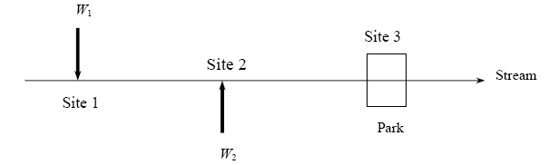
Example-2
There are two sites along a stream i = 1, 2 at which waste (BOD) is discharged. Currently, without any wastewater treatment, the quality (DO) q₂ and q₃ at each of sites 2 and 3 is less than the minimum desired Q₂ and Q₃ respectively. For each unit of waste treated/removed at site i upstream of site j, the quality at j improves by A_{ij}. Formulate a LP model to determine how much treatment is required at sites 1 and 2 that meets the standards at a minimal cost given the following data:
Q₂ = 6; Q₃ = 4; q₂ = 3; q₃ = 1;
A₁₂ = 1/ 20; A₁₃ = 1/ 40; A₂₃ = 1/ 30;
W₁ = 100; W₂ = 75; (W_{i} is the max. limit of waste that can be treated at site i)
C₁ = 10; C₂ = 8; (C_{i} is the cost per unit waste removal at site i)

Slide 50
Formulation of Example 2
(let the students try)
Objective function: Min z = 10x + 8y
Subject to:
q₂+x/20 ≥ 6 or x ≥ 60
q₃+x/40 + y/30 ≥ 4 or 3x+4y ≥ 360
x ≤ 100
y ≤ 75
x ≥ 0, y ≥ 0

Slide 51
Example - 3
For growing population, it is estimated that an increased water supply of at least 150 Million Litres per Day (mld) will be required by the end of ten years. Three alternate sources of water are identified, namely, a reservoir on a local stream (source 1), an aquifer (source 2) and a distant river (source 3). The details of quantity, quality and unit cost of these three sources are given in the following table.

Slide 52
Example – 3 (Cont’d)
 | Source 1 | Source 2 | Source 3
Cost 1000$/mld | 5 | 10 | 20
Max supply available (mld) | 25 | 120 | 100
Hardness (mg/Mill L) | 100 | 1150 | 350
The permissible total hardness is 600 mg/l. Formulate a LP model for meeting the future requirements of the city with least cost, while maintaining the quality of water within the permissible limits.

Slide 53
Formulation of Example 3
(let the students try)
Min z = 5000x + 10000y + 20000z
Subject to: x + y + z ≥ 150,
100x + 1150y + 350z ≤ 600 (x + y + z)
or -500x + 550y -250z ≤ 0
x ≤ 25
y ≤ 120
z ≤ 100
x ≥ 0, y ≥ 0, z ≥ 0

Slide 54
Solution of Liner Programming problem:
Graphical Method
All two dimensional LP models can be solved graphically
Graphical model gives an insight on the geometry of the LP models and how the solution can be obtained
Helps us in understanding the Simplex method better

Slide 55
Example solution using Graphical Method – Example4: Maximization
Max z = x + y
Subjected to
x + 2y ≥ 2
x ≤ 3
y ≤ 4
x ≥ 0, y ≥ 0

Slide 56
Solution of Example 4
Optimal Solution
y
4
Maximize z = x + y
3
Subject to:
x + 2 y ≥ 2
Feasible Region
x ≤ 3
2
y ≤ 4
1
x ≥ 0 y ≥ 0
0
x
0
1
2
3

Slide 57
Example solution
Example 5 : Minimization
Multiple Optimal Solutions!
y
4
Minimize z = x - y
3
Subject to:
1/3 x + y ≤ 4
-2 x + 2 y ≤ 4
2
Feasible Region
x ≤ 3
1
x ≥ 0 y ≥ 0
0
x
0
1
2
3

Slide 58
Another Example
(let the students try)
Minimize z = x + 1/3 y
Subject to:
x + y ≥ 20
-2 x + 5 y ≤ 150
x ≥ 5
x ≥ 0 y ≥ 0

Slide 59
Another Example
(let the students try)
y
40
Minimize z = x + 1/3 y
30
Subject to:
x + y ≥ 20
Feasible Region
-2 x + 5 y ≤ 150
20
x ≥ 5
10
x ≥ 0 y ≥ 0
x
0
Optimal Solution
0
10
20
30
40

Slide 60
What do we Interpret from the Graphical Method?
If a solution exists for LP, then it always lies in one of the corner points of the feasible space.
We need to identify all the corner points of the feasible space and determine which among them is the optimal point

Slide 61
Extending to Higher Dimensions ….

Slide 62
Basic Principles
The constraints define the geometric shape of the feasible space – a polyhedron
The optimal solution lies at one of the corners of this polyhedron
We need to identify all the corner points, evaluate the objective function at these points and determine the optimal point
Simplex method does this analytically. It moves from one corner point to another corner point until an optimal solution (if exists) is found
For further reading:
Introduction to Operations Research By Frederick S. Hillier, Gerald J. Lieberman Published by McGraw-Hill Professional, 2005 ISBN 0073017795, 9780073017792 1088 pages

Slide 63
Sensitivity Analysis
An exercise to find the effect of the changes in the data of the original LP model on the optimal solution
  Changes may take place in
    Objective function coefficients
    Right hand side values of the constraints
  Identify slack resources and their shadow prices

Slide 64
Thank you
Exercise:
Using graphical method find the optimum solution of Example-1

Slide 65
Solution of Example 1
(not to be shown to student)
Maximize z = 12X₁ + 9X₂
X₂
Subject to:
X₁+X₂ ≤ 1750
4X₁+2X₂ ≤ 4800
Feasible
Space
X₁ ≤ 1000
X₂ ≤ 1500
X₁ ≥ 0 , X₂ ≥ 0
X₁
Optimal Point: x₁* = 650 and x₂*=1100
Maximum Profit: z* = $17,700

Slide 66
Solution of Example 2
Optimal Solution
(60,45)
y
100
Minimize z = 10x + 8y
75
Subject to:
Feasible Region
x ≥ 60
50
3x+4y ≥ 360
x ≤ 100
25
y ≤ 75
x ≥ 0, y ≥ 0
0
x
0
25
50
75
100

