Slide 1
Various Methods of Irrigation:
Design of Sprinkler Irrigation System
Ref:
FAO Irrigation Design Manual (1988)
Irrigation Management (Vol II), by DARA and Raghuvanshi (1999)

Slide 2
Types
Surface Irrigation
  Basin
  Border
  Furrow
Sprinkler
Drip
Sub-Surface (Perforated underground pipes, or shallow groundwater)
http://www.fao.org/docrep/S8684E/s8684e00.htm#Contents

Slide 3
Basin Irrigation
Flat areas of land, surrounded by low bunds
The bunds prevent the water from flowing to the adjacent fields.
Basin irrigation is commonly used for Rice grown on flat lands or in terraces on hillsides.
Trees can also be grown in basins, where one tree is usually located in the middle of a small basin.
In general, the basin method is suitable for crops that are unaffected by standing in water for long periods (e.g. 12-24 hours).
Other crops which are suited to basin irrigation include:
- pastures, e.g. alfalfa, clover;
- trees, e.g. citrus, banana;
- crops which are broadcast (sowing by spreading seeds, instead of precision sowing), such as cereals;
- to some extent row crops such as tobacco.
Basin irrigation is generally not suited to crops which cannot stand in wet or waterlogged conditions for periods longer than 24 hours. These are usually root and tuber crops such as potatoes, beet and carrots which require loose, well-drained soils.

Slide 4
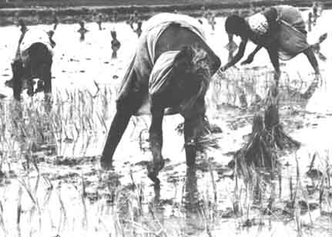
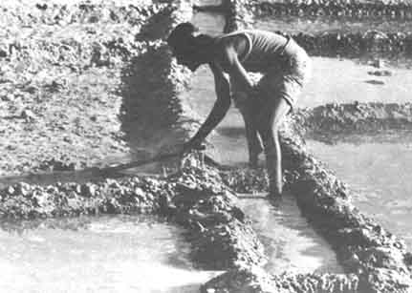
Basin Irrigation
Transplanting rice

Slide 5
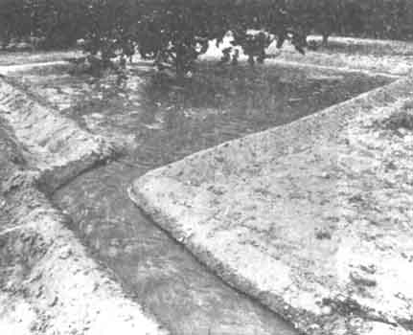
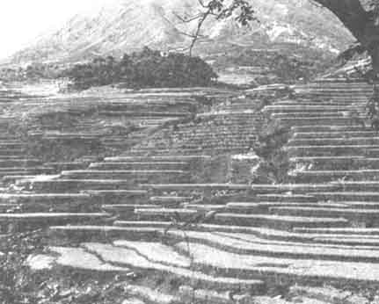
Basin: for tree, for terraces

Slide 6
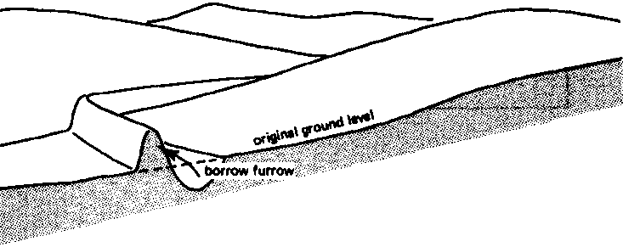
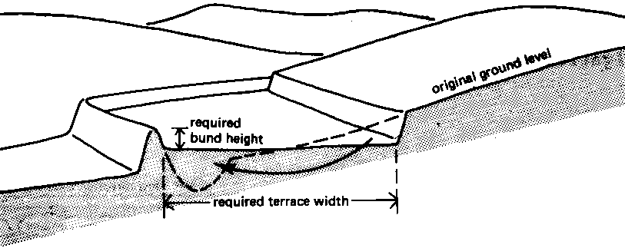
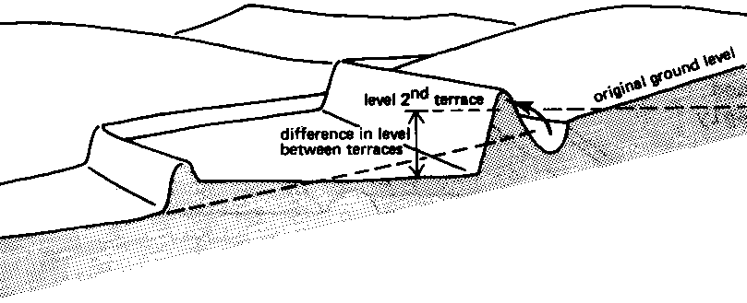

Slide 7
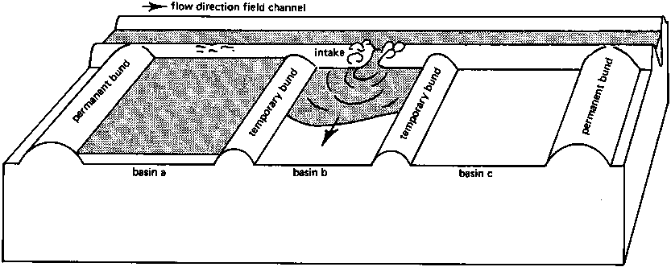
Basin Irrigation: Direct

Slide 8
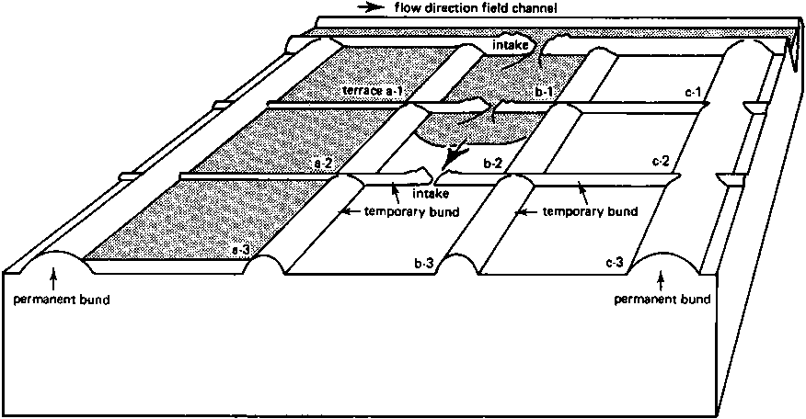
Basin Irrigation: Cascade

Slide 9
Suggested Size of Basin
APPROXIMATE VALUES FOR THE MAXIMUM BASIN OR TERRACE WIDTH (m)
SUGGESTED MAXIMUM BASIN AREAS (m²) FOR VARIOUS SOIL TYPES AND AVAILABLE STREAM SIZES (l/sec)
Slope % | Maximum width (m)
 | average | range
0.2 | 45 | 35-55
0.3 | 37 | 30-45
0.4 | 32 | 25-40
0.5 | 28 | 20-35
0.6 | 25 | 20-30
0.8 | 22 | 15-30
1.0 | 20 | 15-25
1.2 | 17 | 10-20
1.5 | 13 | 10-20
2.0 | 10 | 5-15
3.0 | 7 | 5-10
4.0 | 5 | 3-8
Stream size (l/sec) | Sand | Sandy loam | Clay loam | Clay
5 | 35 | 100 | 200 | 350
10 | 65 | 200 | 400 | 650
15 | 100 | 300 | 600 | 1000
30 (Approx 1 cusec) | 200 | 600 | 1200 | 2000
60 | 400 | 1200 | 2400 | 4000
90 | 600 | 1800 | 3600 | 6000

Slide 10
Border/Strip Irrigation
Borders are long, sloping strips of land separated by bunds. They are sometimes called border strips.
Irrigation water can be fed to the border in several ways:
  opening up the channel bank,
  using small outlets or gates or
  by means of siphons or spiles
Strips can be 3-20 metres wide and 100-400 metres long. These strips are separated by low levees (or borders).
The strips are level between levees but slope along the length according to natural slope.
If possible, the slope should be between 0.2 and 0.4 per cent. But, slopes as flat as 0.1 per cent and as steep as 8 per cent can also be used

Slide 11
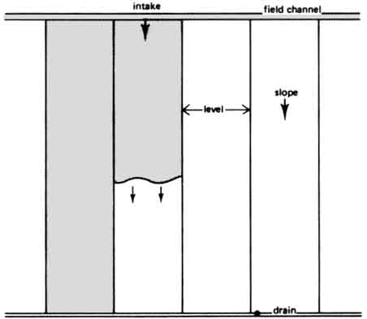
Border Irrigation

Slide 12
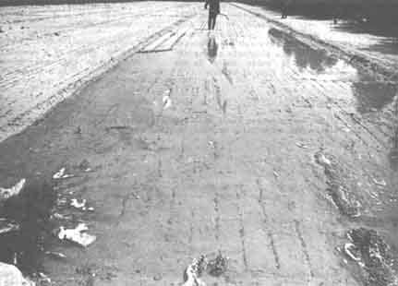
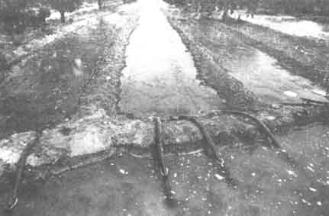
Border Irrigation

Slide 13
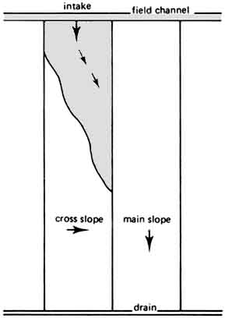
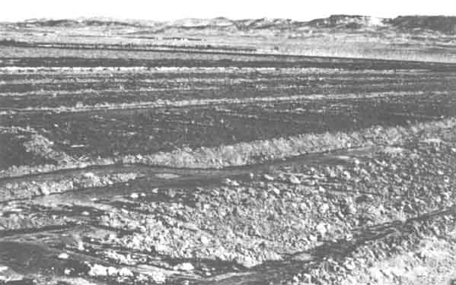
Leveling effects

Slide 14
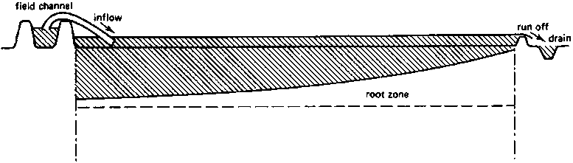
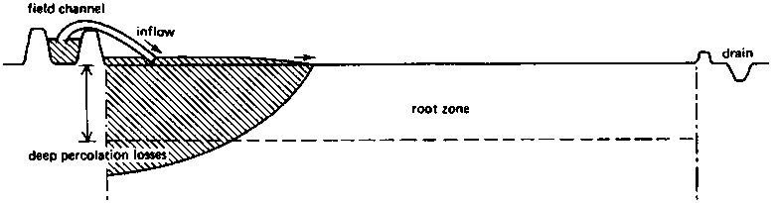
Border Irrigation: Stream size Effects
QUARTER TIME RULE should be Applied

Slide 15
Quarter time rule
The quarter time rule says that:
The stream size should be large enough that (or the field size should be such that) the water should reach the end of the field (furrow irrigation) or for the water to cover the entire field (basin irrigation) in a quarter of the time needed to fill the root zone with sufficient water (the contact time).
The contact time is the time needed to infiltrate the required amount of water & can be determined from the infiltration curve.

Slide 16
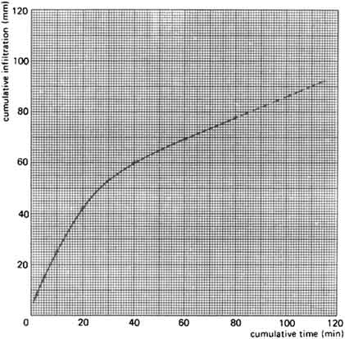
Infiltration curve
Contact time

Slide 17
Q~f~time~Area relationship
If
  t = time required to cover the area
  A = Area of land Strip to be irrigated
  f = Rate of infiltration of soil
  y = depth of water required on the strip
  Q = Discharge of supply (Tube well, or water course / ditch)
then
&
Ref: page 7-8 of Garg

Slide 18
FURROW IRRIGATION
Furrows are small channels, which carry water down the land slope between the crop rows.
Water infiltrates into the soil as it moves along the slope.
The crop is usually grown on the ridges between the furrows.
This method is suitable for all row crops and for crops that cannot stand in water for long periods.
Irrigation water flows from the field channel into the furrows by opening up the bank of the channel, or by means of siphons or spiles.

Slide 19
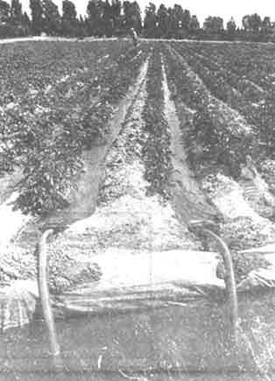
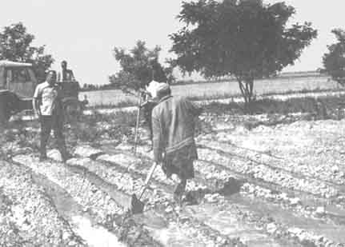
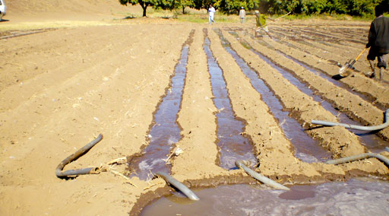
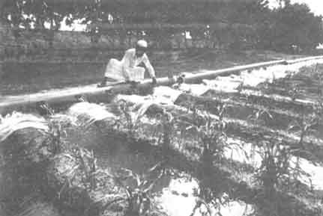
Furrows and Gates

Slide 20
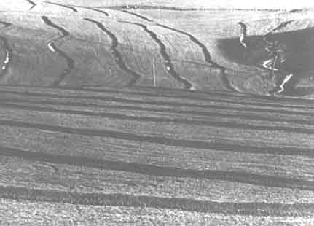
Furrow on Terraces

Slide 21
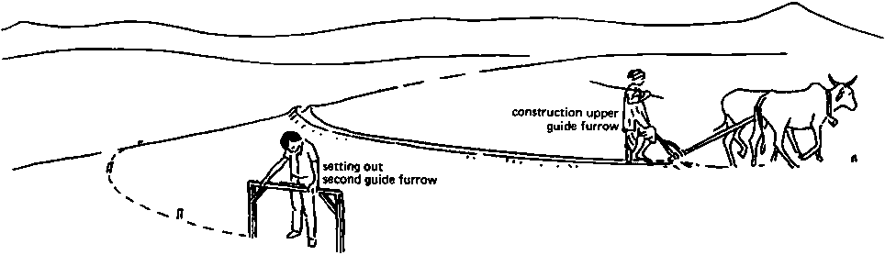
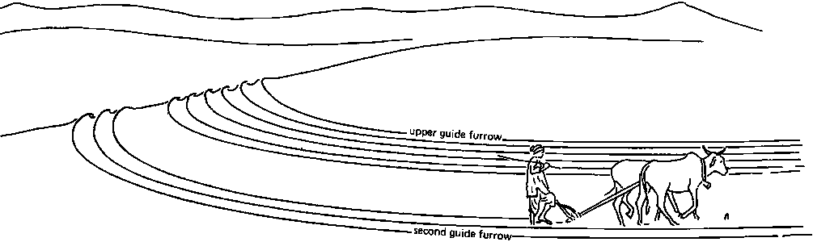
Developing Furrows

Slide 22
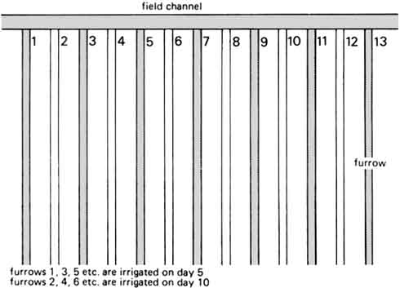
Furrow: Alternate Irrigation

Slide 23
Sprinkler Irrigation
Sprinkler irrigation is similar to natural rainfall. Water is pumped through a pipe system and then sprayed onto the crops through rotating sprinkler heads.

Slide 24
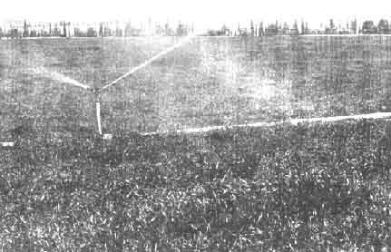
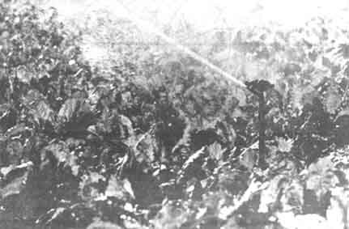
Various kinds of Sprinkler

Slide 25
Sprinkler System: Characteristics
Suitable crops
  Sprinkler irrigation is suited for most row, field and tree crops and water can be sprayed over or under the crop canopy
  Large sprinklers are not recommended for irrigation of delicate crops such as Lettuce because the large water drops produced by the sprinklers may damage the crop.
Suitable slopes
  Sprinkler irrigation is adaptable to any farmable slope, whether uniform or undulating.
  The lateral pipes supplying water to the sprinklers should always be laid out along the land contour whenever possible. This will minimize the pressure changes at the sprinklers and provide a uniform irrigation.
Suitable soils
  Sprinklers are best suited to sandy soils with high infiltration rates although they are adaptable to most soils.
  The average application rate from the sprinklers (in mm/hour) is always chosen to be less than the basic infiltration rate of the soil so that surface ponding and runoff can be avoided.
  Sprinklers are not suitable for soils which easily form a crust. If, however, Sprinkler irrigation is the only method available, then light fine sprays should be used. The larger sprinklers producing larger water droplets are to be avoided.

Slide 26
Sprinkler System: Characteristics
Suitable Irrigation Water
  A good clean supply of water, free of suspended sediments, is required to avoid problems of sprinkler nozzle blockage and spoiling the crop by coating it with sediment.
Sprinkler System Layout
  A typical sprinkler irrigation system consists of the following components:
    Pump unit
    Mainline and sometimes sub-mainlines
    Laterals
    Sprinklers

Slide 27
Components
The pump unit is usually a centrifugal pump which takes water from the source and provides adequate pressure for delivery into the pipe system.
The mainline - and sub-mainlines:
  Pipes which deliver water from the pump to the laterals.
  In some cases these pipelines are permanent and are laid on the soil surface or buried below ground.
  In other cases they are temporary, and can be moved from field to field.
  The main pipe materials used include asbestos cement, plastic or aluminium alloy.
The laterals:
  It deliver water from the mainlines or sub-mainlines to the sprinklers.
  They can be permanent but more often they are portable and made of aluminium alloy or plastic so that they can be moved easily.

Slide 28
Layout
  Common Layout: It consists of a system of lightweight aluminium or plastic pipes which are moved by hand.
  The rotary sprinklers are usually spaced 9-24 m apart along the lateral which is normally 5-12.5 cm in diameter. This is so it can be carried easily.
  The lateral pipe is located in the field until the irrigation is complete.
  The pump is then switched off and the lateral is disconnected from the mainline and moved to the next location.
  It is re-assembled and connected to the mainline and the irrigation begins again.
  The lateral can be moved one to four times a day.
  It is gradually moved around the field until the whole field is irrigated.
  This is the simplest of all systems. Some use more than one lateral to irrigate larger areas.

Slide 29
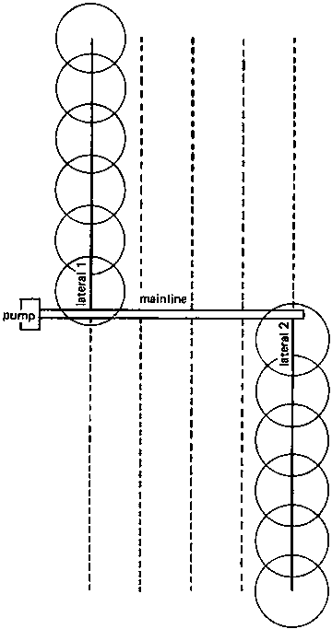
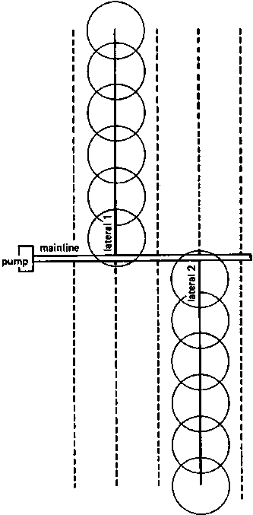
Most Common Layout

Slide 30
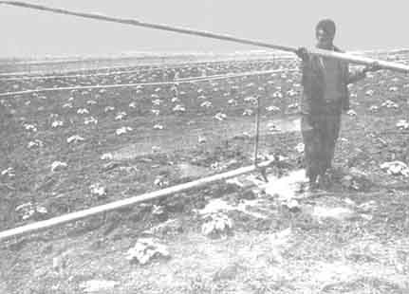
Moving the lateral

Slide 31
Moving System
Another system which does not need a large labour force is the drag-hose sprinkler system.
  Main and laterals are buried PVC pipes: One lateral covers three positions.
  Less numbers of buried laterals would be needed.
  Sprinklers on Risers carried by Skids are attached to the laterals through hoses (similar to garden sprinklers).
  Only the skid with the sprinkler (rather the laterals) has to be moved from one position to another, which is an easy task.

Slide 32
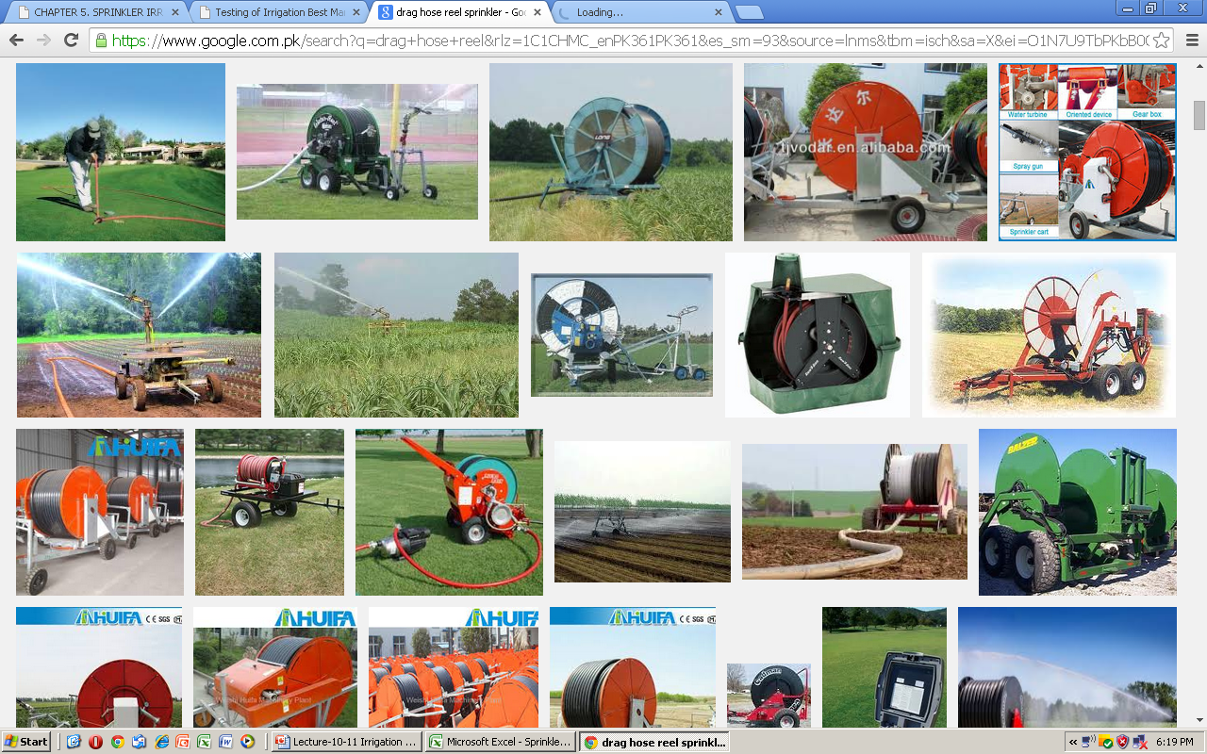

Slide 33
Problem
The large labour force needed to move the pipes and sprinklers around the field.
In some places such labour may not be available and may also be costly.
To overcome this problem many mobile systems have been developed such as the hose reel raingun and the centre pivot.

Slide 34
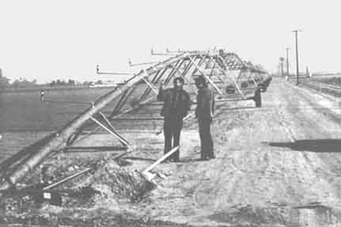
An example of sophisticated Sprinkler system

Slide 35
Operating Sprinkler Systems
The main objective of a sprinkler system is to apply water as uniformly as possible to fill the root zone of the crop with water.
Wetting patterns
The wetting pattern from a single rotary sprinkler is not very uniform. Normally the area wetted is circular (see topview).
The heaviest wetting is close to the sprinkler (see sideview).
For good uniformity several sprinklers must be operated close together so that their patterns overlap.
For good uniformity the overlap should be at least 65% of the wetted diameter. This determines the maximum spacing between sprinklers.

Slide 36
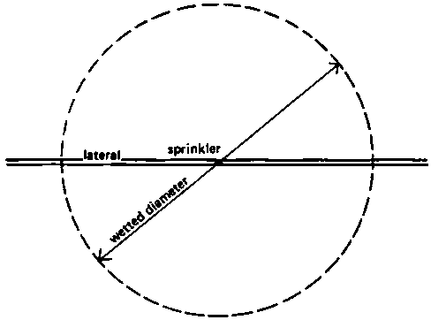

Wetting pattern

Slide 37
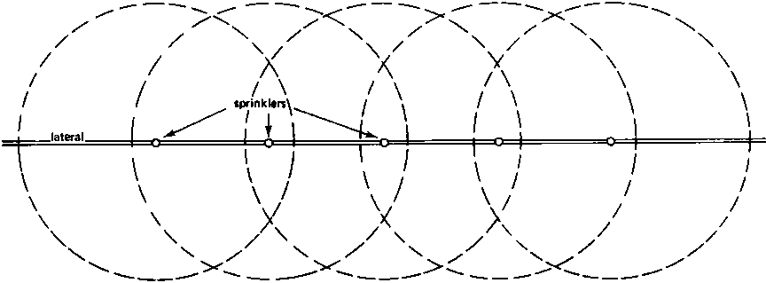
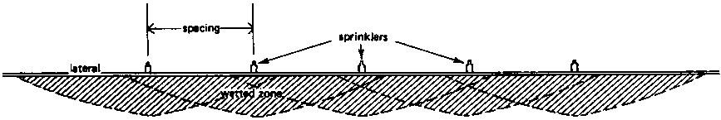
Overlapping for proper wetting
Should be >65% of the diameter

Slide 38
Wind and Pressure Losses
The uniformity of sprinkler applications can be affected by wind and water pressure.
Spray from sprinklers is easily blown about by even a gentle breeze and this can seriously reduce uniformity. To reduce the effects of wind the sprinklers can be positioned more closely together.
Sprinklers will only work well at the right operating pressure recommended by the manufacturer. If the pressure is above or below this then the distribution will be affected.
  The most common problem is when the pressure is too low. This happens when pumps and pipes wear.
  Friction increases and so pressure at the sprinkler reduces.
  The result is that the water jet does not break up and all the water tends to fall in one area towards the outside of the wetted circle.
  If the pressure is too high then the distribution will also be poor. A fine spray develops which falls close to the sprinkler.

Slide 39
Application Rate
This is the average rate at which water is sprayed onto the crops and is measured in mm/hour (or inches/hr).
The application rate depends on
  the size of sprinkler nozzles,
  the operating pressure and
  the distance between sprinklers.
When selecting a sprinkler system it is important to make sure that the average application rate is less than the basic infiltration rate of the soil. In this way all the water applied will be readily absorbed by the soil and there should be no runoff.

Slide 40
Sprinkler drop size
As water sprays from a sprinkler it breaks up into small drops between 0.5 and 4.0 mm in size.
The small drops fall close to the sprinkler whereas the larger ones fall close to the edge of the wetted circle.
Large drops can damage delicate crops and soils and so in such conditions it is best to use the smaller sprinklers.
Drop size is also controlled by pressure and nozzle size.
When the pressure is low, drops tend to be much larger as the water jet does not break up easily.
So to avoid crop and soil damage use small diameter nozzles operating at or above the normal recommended operating pressure.

Slide 41
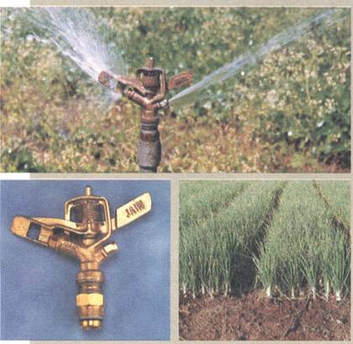
Sprinkler Irrigation System: Nozzels
Ref: http://dahd.nic.in/census/impd.htm

Slide 42
Sprinkler design Problem

Slide 43
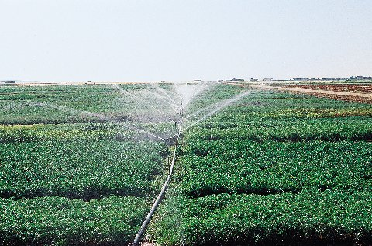
http://www.icarda.org/ICARDA_photogallery/Water-use/BRO-8.jpg

Slide 44
Drip Irrigation
Water is conveyed under pressure through a pipe system to the fields, where it drips slowly onto the soil through emitters or drippers which are located close to the plants.
Only the immediate root zone of each plant is wetted. Therefore this can be a very efficient method of irrigation.
Drip irrigation is sometimes called trickle irrigation, and micro irrigation.
Rate of application of water is kept equal to crop water requirement
The Discharge rate varies between 2 – 8 liters/hr
Application Efficiency:
  Surface Irrigation (Check Basin, Furrow) 30%-45% [means 70% to 55% water is wasted]
  Drip Irrigation : Application Efficiency as high as 90%
    (it is 20% more than Sprinkler, and 60-80% more than Conventional methods)

Slide 45
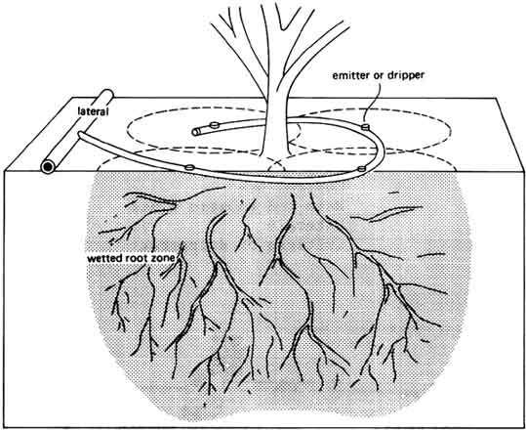

Slide 46
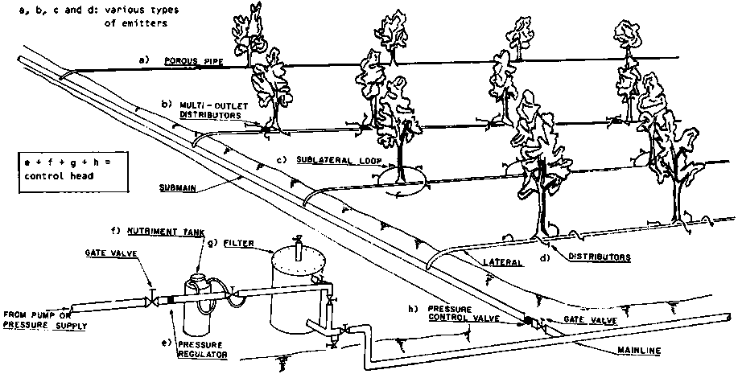

Slide 47
Ref: Dadex

Slide 48
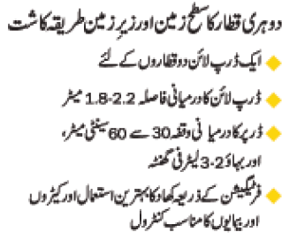
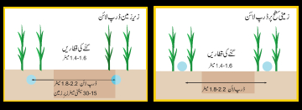

Slide 49
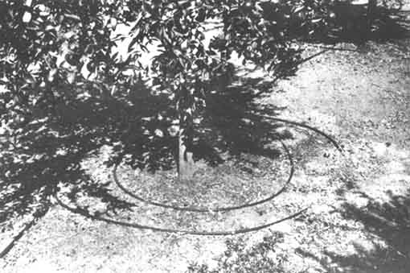
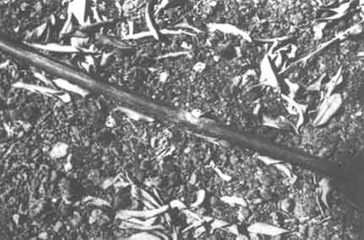
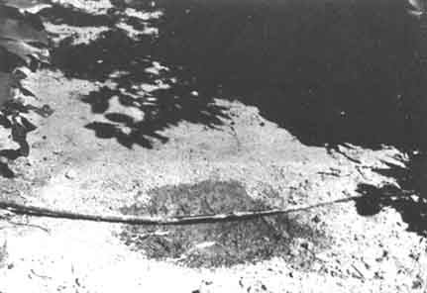

Slide 50
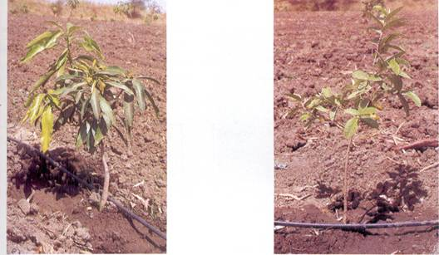
Drip Irrigation Set
Ref: http://dahd.nic.in/census/impd.htm

Slide 51
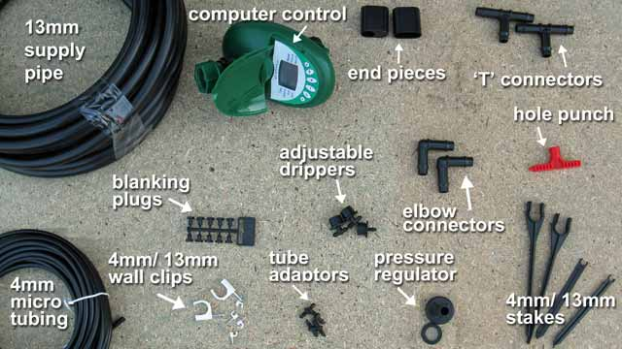
Components of Drip System
Ref: http://www.thompson-morgan.com/how-to-set-up-a-drip-irrigation-system

Slide 52
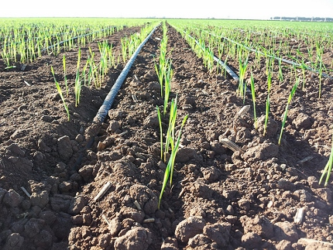
Cost
The approx. cost reported for 2009 is Rs. 75,000 (US$765) per acre,
Ref: Sindh Agricultural and Forestry Workers Coordinating Organisation (SAFWCO ), Sanghar. http://www.thethirdpole.net/drip-irrigation-makes-slow-gains-in-pakistan/

Slide 53
Ref: Effect of Basin, Furrow and Raingun Sprinkler Irrigation Systems on Irrigation Efficiencies, Nitrate-Nitrogen Leaching and Yield of Sunflower, by M. A. Rana, M. Arshad and J. Masud, in Pakistan Journal of Water Resources, Vol.10(2) July-December 2006/ 1-7
Experience in Pakistan

Slide 54
Study Setup
At Water Management Research Centre (WMRC), at Post-graduate Agricultural Research Station (PARS), University of Agriculture, Faisalabad during 1998-2002.
The type of soil in research area was sandy loam.
The total area (0.75 hectares) was divided into three portions for basin, furrow and raingun sprinkler irrigation systems.
The area for basin and furrow was 0.21 ha each while area for raingun sprinkler irrigation system was 0.23 ha.
Three replications were used for each treatment, the size of the basin was 28 m x 24.5 m while in furrow irrigation system each replication was consisted of 12 furrows with a length and width of 75 m and 0.75 m, respectively for each furrow.
For sprinkler irrigation, 48 m x 48 m plot was selected and water was applied through raingun sprinkler.
Sunflower was sown in all the irrigation systems using fertilizer rate of 40, 30 and 20 kg/ha of N, P and K, respectively.
The crop was sown with cotton hand-drill maintaining row to row distance of 0.75 m and plant to plant distance of 0.23 m.
Each irrigation was applied at 50% soil moisture deficit (Michael,1978) using cut-throat flume of 3'x8" for basin and furrow irrigations while for raingun sprinkler, the flow was measured from the storage tank for specified time interval. Gravimetric method was used for the soil moisture determination.
Replicates of the treatments were placed in the experimental plot according to the randomized complete block design.

Slide 55
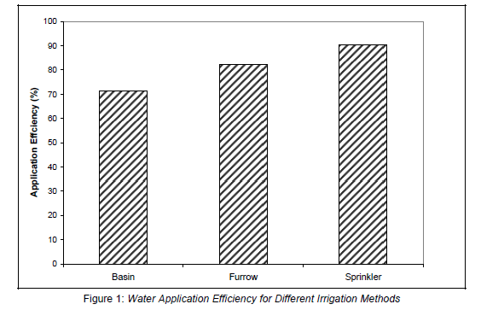
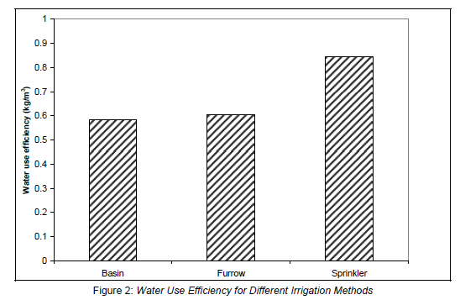
Results
Water Use Eff.= Crop Mass (kg) produced
per unit of water (kg/m3)
Applic. Eff. = Water Used by the crop
/ Water Supplied in field

Slide 56
Other studies
Haq (1990) reported that:
  Water saving in case of sprinkler irrigation compared with surface irrigation system was 30%.
  Crop production per unit of water used in sprinkler irrigation was 4.13 kg/m3 as compared to 2.88 kg/m3 by surface irrigation.
  Electrical conductivity of soil remained almost same in case of sprinkler system while in gravity system it was increased at post harvesting at 30 to 45 cm depth. Same was the case for sodium adsorption ratio (SAR).
  Nitrogen contents were more in case of sprinkler than gravity system.
Latif (1990) reported that:
  Saving of irrigation water under sprinkler irrigation was found to be 46 to 65% for different crops with an average of more than 50%.
Iqbal (1994):
  conducted a study in feasibility of raingun sprinkler irrigation for corn (fodder) under farmer’s condition and water use efficiency was 1.82 times more than surface method of irrigation with 34.52% of water saving.

Slide 57
Other studies
Cetin (2002)
  used sprinkler irrigation system for cotton
  Compared three different methods (drip, furrow, and sprinkler)
  The maximum cotton yields were 4380, 3630 and 3380 kg/ha for drip, furrow and sprinkler irrigation, respectively. Drip irrigation produced 21% more seed-cotton than the furrow method and 30% more than the sprinkler method.
  Water use efficiency proved to be 4.87, 3.87 and 2.36 kg/ha/mm for drip, furrow and sprinkler irrigation, respectively.
  Shedding ratios ranged from 50.8 to 59.0% (furrow), 52.9 to 64.8% (sprinkler), 50.8 to 56.8% (drip), depending on the amount of water applied.
Nazirbay et al., (2005)
  compared furrow (conventional) and drip irrigated corn yields for two consecutive years. It was found that maize irrigation water use for furrow irrigation ranged from 547 to 629 mm per year compared with 371 to 428 mm per year for drip irrigation (Saving of 32%).
Rajak et al., (2006)
  conducted field experiments on a saline vertisols during 2000–2002 for evaluating the response of cotton with drip and furrow irrigation method in four different blocks varying in soil salinity (ECe, surface 0.6 m) and watertable depth.
  The growth and yield performance of cotton irrigated through furrows, even though with good quality canal water, was poor when compared with drip irrigation with marginally saline water.

Slide 58
