Slide 1
Construction Safety A summary of various hazards and their remedies in light of OSHA (Part 1)
Faizan Shafique

Slide 2
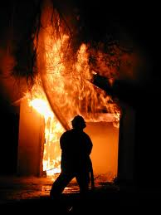
Fire Protection

Slide 3
Fire Protection
Fire Types
Class A Fires: Ordinary combustibles such as wood and paper.
Class B Fires: Flammable and combustible liquids and gases.
Class C Fires: Energized electrical equipment.
Class D Fires: Combustible metals.

Slide 4
Fire Protection
Steps to take
Extinguishers must be mounted and identified so they are readily available.
Only approved extinguishers can be used.
Extinguishers must be fully charged.
Extinguishers must be visually inspected monthly, maintained annually, and tested periodically.
Employees must be trained annually in the use of extinguishers.

Slide 5
Fire Protection
Common Extinguishing agents
Water
Carbon Dioxide
Dry Chemical (Sodium Bicarbonate)
Multipurpose Dry Chemical (Ammonium Phosphate)
Halon (Haloalkane)

Slide 6
Fire Protection
Note
Extinguishing agents must be selected carefully. For example, Water is effective on Class A fires, but may spread class B fires.

Slide 7
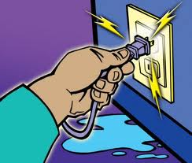
Electrical Safety

Slide 8
Electrical Safety
About 5 workers are electrocuted every week
Causes 12% of young worker workplace deaths
Takes very little electricity to cause harm
Currents above 10 mA can paralyze or “freeze” muscles.
Currents more than 75 mA can cause a rapid, ineffective heartbeat -- death will occur in a few minutes unless a defibrillator is used
75 mA is not much current – a small power drill uses 30 times as much

Slide 9
Electrical Safety
Hazards
Inadequate wiring
Exposed electrical parts
Wires with bad insulation
Ungrounded electrical systems and tools
Overloaded circuits
Damaged power tools and equipment
Using the wrong PPE and tools
Overhead powerlines
All hazards are made worse in wet conditions
Protective Measures
Proper grounding
Use GFCI’s (Ground Fault Circuit Interrupter)
Use fuses and circuit breakers
Guard live parts
Lockout/Tagout
Proper use of flexible cords
Close electric panels
Training

Slide 10
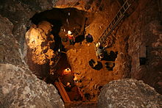
Excavations

Slide 11
Excavations
The greatest risk in an excavation is a cave-in.
Employees can be protected through sloping, shielding, and shoring the excavation.
A competent person is responsible to inspect the excavation.
Other excavation hazards include water accumulation, oxygen deficiency, toxic fumes, falls, and mobile equipment.

Slide 12
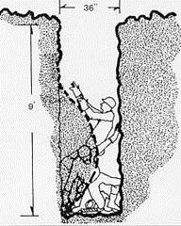
Excavations

Slide 13
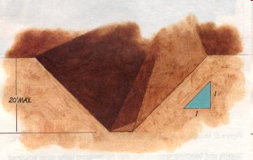
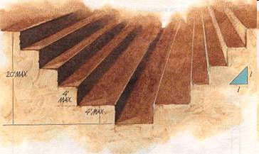
Excavations
Benching
Sloping

Slide 14
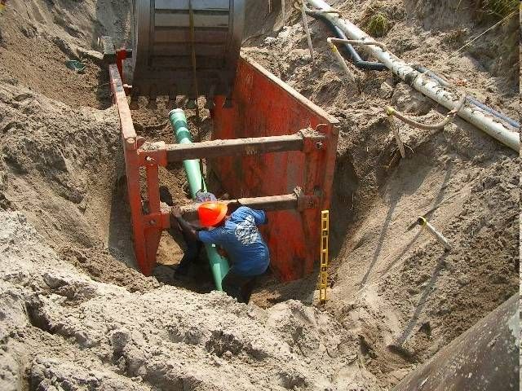
Excavations
Shielding

Slide 15
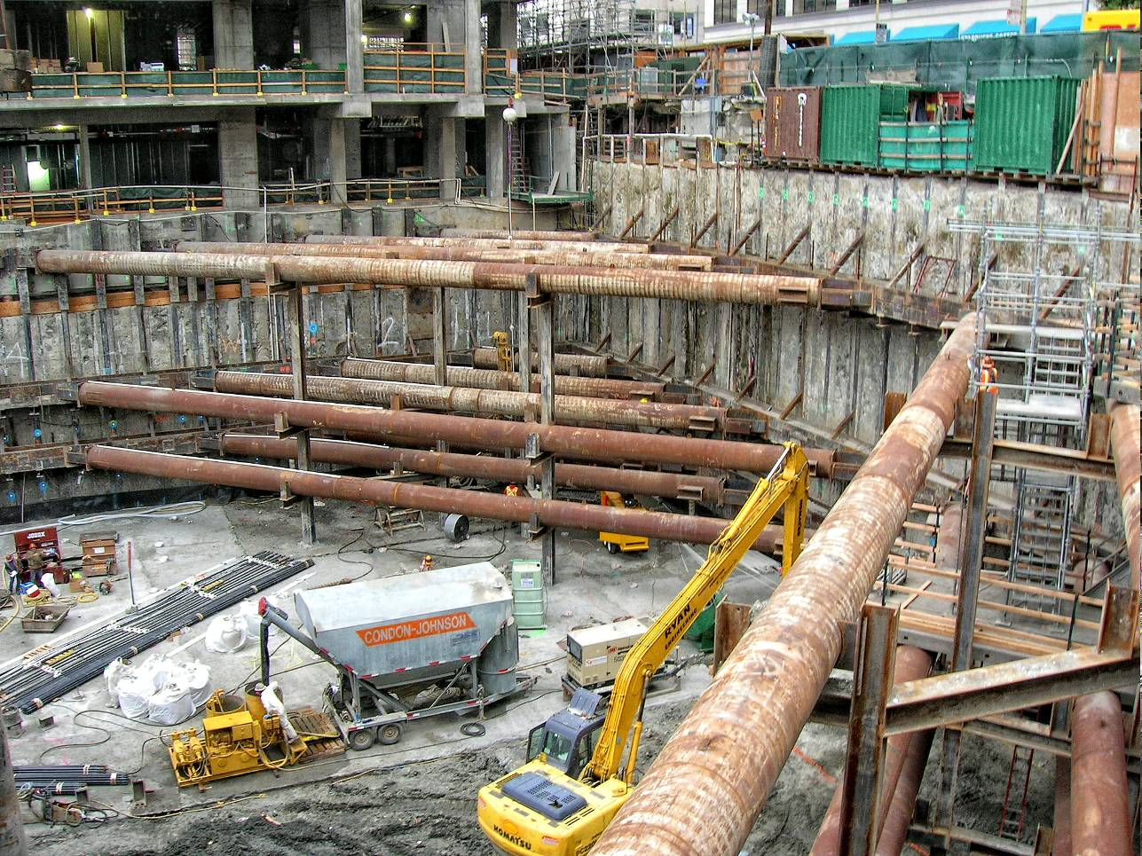
Excavations
Shoring

Slide 16
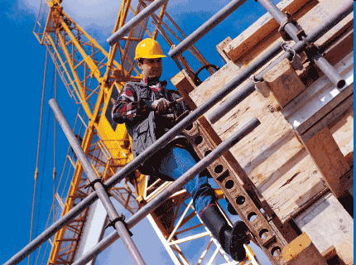
Scaffolds

Slide 17
Scaffolds
An elevated, temporary work platform
Three basic types:
Supported scaffolds -- platforms supported by rigid, load bearing members, such as poles, legs & frames
Suspended scaffolds -- platforms suspended by ropes or other non-rigid, overhead support
Aerial Lifts -- such as “boom trucks”

Slide 18
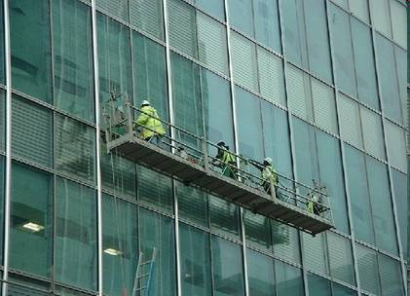
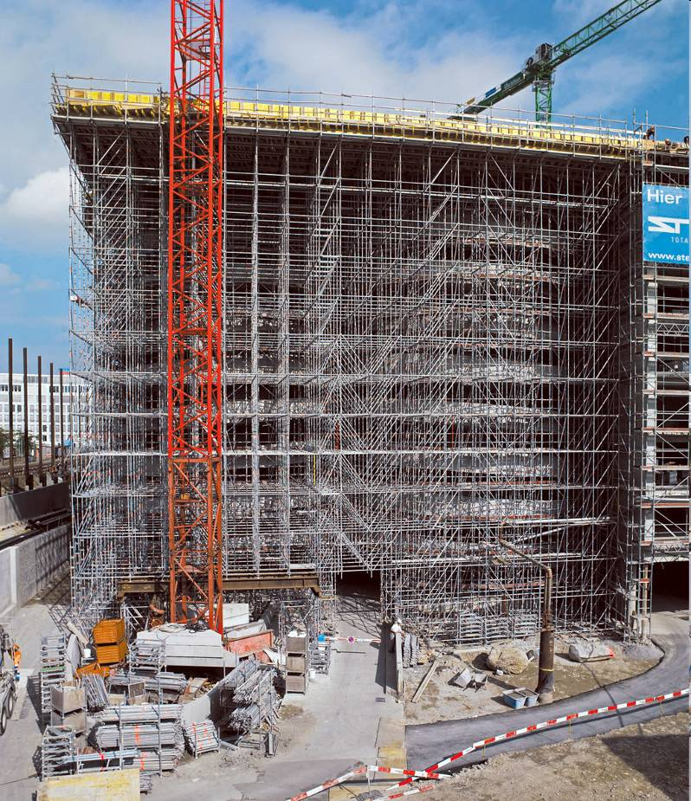
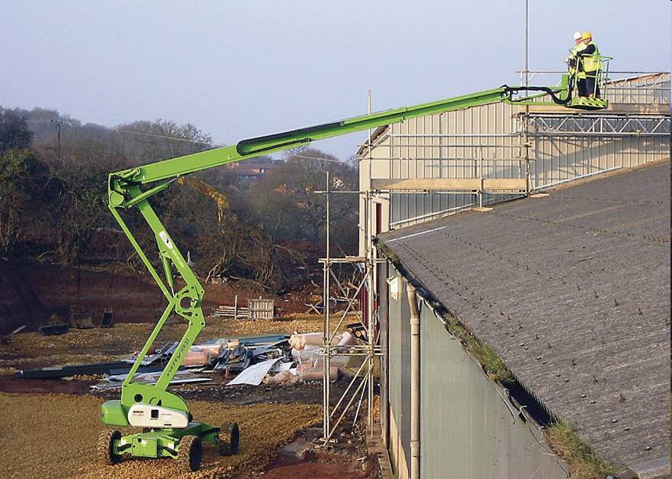
Scaffolds
Suspended scaffolds
Supported scaffolds
Aerial Lifts

Slide 19
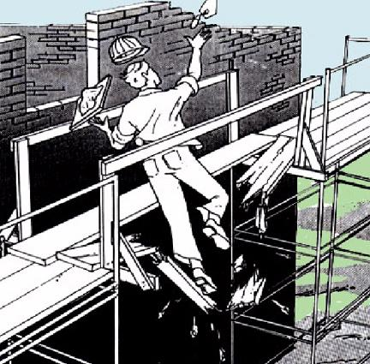
Scaffolds
Employees working on scaffolds are exposed to these hazards:
Falls from elevation – caused by slipping, unsafe access, and the lack of fall protection
Struck by falling tools / debris
Electrocution – from overhead power lines
Scaffold collapse - caused by instability or overloading

Slide 20
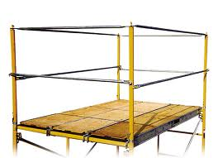
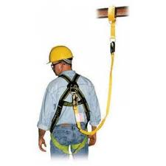
Scaffolds
Guardrails
Personal Fall Arrest Systems (PFAS)
Hardhats
Barricade area below
Clear distance from electric cables
Proper Scaffold design

Slide 21
Thank you for listening

