Slide 1
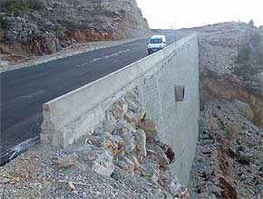
Cantilever retaining wall SESSION 2011
M. Azhar Saleem, PhD
April 2015

Slide 2
Retaining wall
A retaining wall is any constructed wall that restrains soil or other material at locations having an abrupt change in elevation.
Retaining wall has many uses such as:
A retaining wall for roadside embankments
A retaining wall can separate older roads from highways
A retaining wall helps keep river banks from eroding

Slide 3
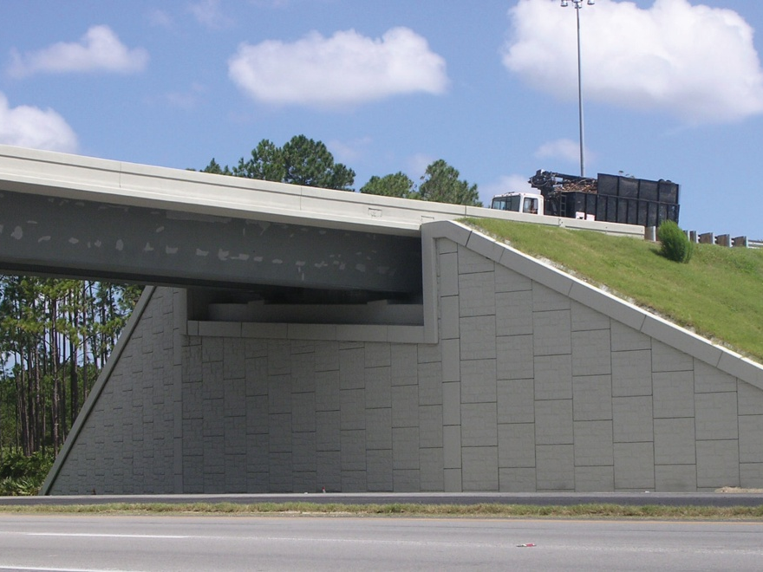
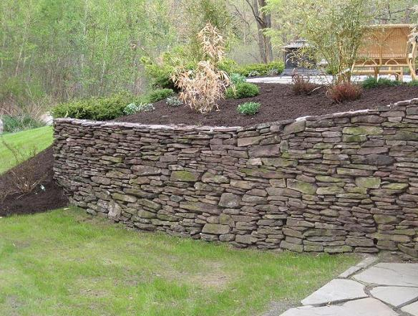
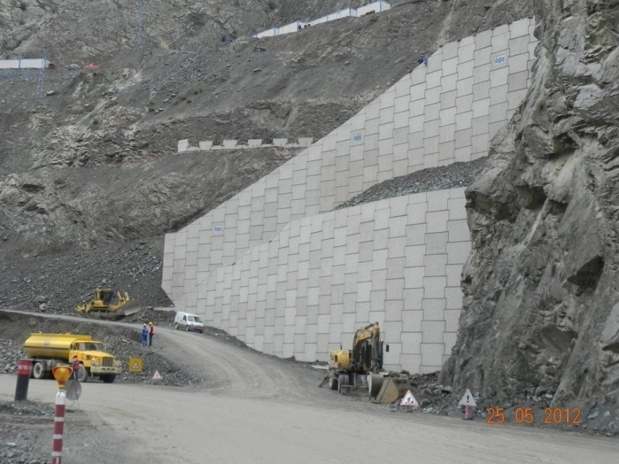
Examples Retaining Walls

Slide 4
Types Retaining wall
Gravity wall-Masonry or Plain concrete
Cantilever retaining wall-RCC
(Inverted T and L)
Counterfort retaining wall-RCC
Buttress wall-RCC

Slide 5
Types of Retaining wall
Backfill
Backfill
Gravity RW
T-Shaped RW
L-Shaped RW
Backfill
Counterfort
Buttress
Counterfort RW
Buttress RW

Slide 6
Retaining wall terminology

Slide 7
Failure Modes of Cantilever Retaining Walls

Slide 8
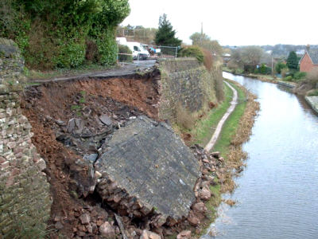
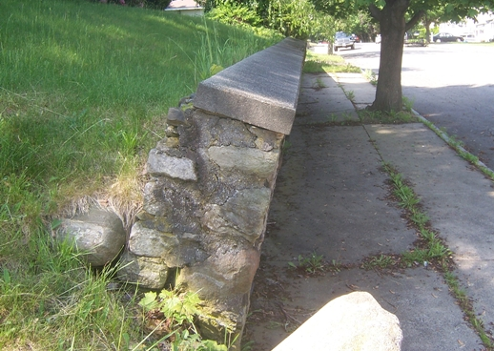
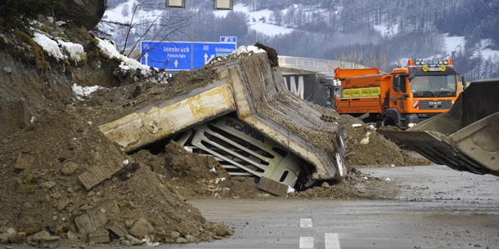
Examples Failure

Slide 9
Earth Pressure
Earth pressure is the pressure exerted by the retaining material on the retaining wall. This pressure tends to deflect the wall outward.
Types of earth pressure :
Active earth pressure or earth pressure (Pa) and
Passive earth pressure (Pp).
Active earth pressure tends to deflect the wall away from the backfill.
GL
P_{a}
Variation of Earth pressure

Slide 10
Factors Affecting Earth Pressure
Earth pressure depends on type of backfill, the height of wall and the soil conditions
Soil conditions: The different soil conditions are
Dry levelled back fill
Moist levelled backfill
Submerged levelled backfill
Levelled backfill with uniform surcharge
Backfill with sloping surface

Slide 11
Analysis for dry backfills
Maximum pressure at any height, p=C_{a}γh
Total pressure at any height from top, p_{a}=1/2[C_{a} γh]h = [C_{a} γh²]/2
Bending moment at any height
M=p_{a}xh/3= [C_{a} γh³]/6
Total pressure, P_{a}= [C_{a} γH²]/2
Total Bending moment at bottom,
M = [C_{a} γH³]/6
h
H
p_{a}
M
C_{a} γ H

Slide 12
Analysis for dry backfills
Where,
C_{a}= Coefficient of active earth pressure
= (1-sinΦ)/(1+sin Φ)=tan² Φ
= 1/C_{p,} coefficient of passive earth pressure
Φ = Angle of internal friction or angle of repose
γ =Unit weigh or density of backfill
If Φ = 30º, C_{a}=1/3 and C_{p}=3. Thus C_{a} is 9 times C_{p}

Slide 13
Coefficient of active earth pressure
θ = 0
θ

Slide 14
Concluded

