Slide 1
Channel Plan Forms/Pattern
Configuration(arrangement) of a channel in the plan view
Wide range of plan form types/shapes exist conditioned by:
1) Available flow energy
2) Sediment size and availability
3) Whether the reach operates as bedload, mixed load, or suspended load

Slide 2
Channel Plan Forms/Pattern
Straight Channel
Water moves parallel to the channel banks
Sinuosity varies from 1 – 1.05
Meandering (bending) Channel
Follow the sinuous path
Braided Channel
Channel flows in more than one sub-channels, because the natural topography does not match the hydraulic conditions of a river.

Slide 3
Sinuosity
The meander ratio or sinuosity index is the ratio of actual length, Lm, along a meandering river to the straight distance, S, between the end points (AB).
It is an indication of quantification of meandering.
For a straight river course this ratio is equal to unity. A ratio varying from 1 to 1.5 defines the river course as sinuous and from 1.5 to 4 as meandering.

Slide 4
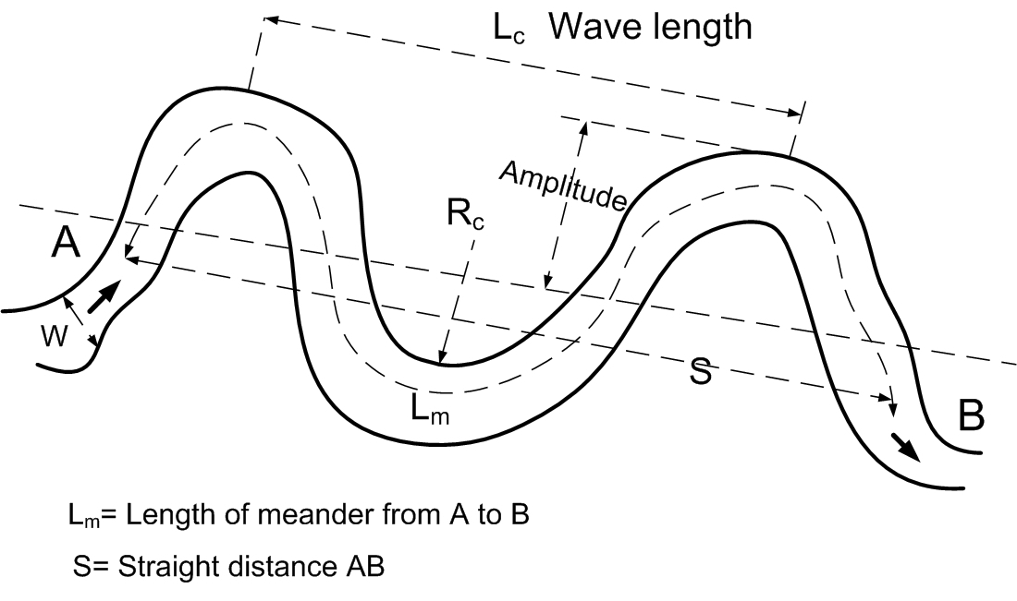
Geometric features of meander
Meander Belt
$$Sinuosity=\frac{Lm}{S}$$

Slide 5
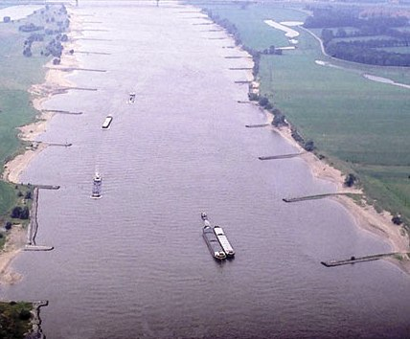
Straight Channel

Slide 6
Meandering Channel

Slide 7
Braided Channel

Slide 8
Braided Channel

Slide 9
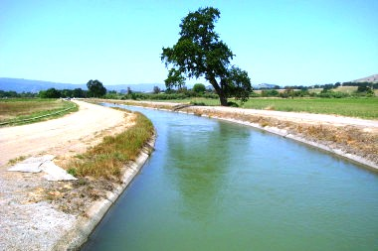
Earthen Channel Design

Slide 10
Alluvium
Alluvial soil:
The soil which is formed by continuous deposition of silt is known as alluvial soil.
The river carries heavy charge of silt in rainy season. When the river overflows its banks during the flood, the silt particles get deposited on the adjoining areas. This deposition of silt continues year after year.
This type of soil is found in deltaic region of a river.
This soil is permeable and soft and very fertile.
Non-alluvial soil
The soil which is formed by the disintegration of rock formation is known as non-alluvial soil.
It is found in the mountain regions of a river.
The soil is hard an impermeable in nature. This is not fertile

Slide 11
Efficiency of canal design
The efficiency of the canal design has a bearing on its working
The canal efficiency suffers from silting and scouring of the canal due to faulty design thus necessitating heavy maintenance or may be even remodeling
The other worse problems whose origin lies in faulty design are; weed growth infection, heavy seepage losses entitling development of water-logging (saturation of soil with water) alongside the canal.

Slide 12
Efficiency of canal design
Canal design practices also depend on the conditions, particularly the soil formation, sediment transport characteristics, operational needs and desired standards of maintenance
Usually irrigation canals are constructed in alluvial soils and the water supplies are essentially from river that carry silt
The sediment passed into the off-taking channel of low velocity, deposits in the canal bed resulting in silting up and consequently causing loss of discharge carrying capacity thus necessitating frequent silt clearing
On the other hand a high velocity in channel causes erosion/scouring, thereby, lowering Full Supply Level resulting in loss of command

Slide 13
Types of Canal Sections
There are two types of canals sections
Unlined channels, most of our main irrigation canals are unlined/earthen canals which cause seepage and result in losses and raising in the water table of the adjoining area.
Lined channels, lined with RC, PCC, Bricks, Stones etc, to minimize the seepage losses and increase the efficiency of the system.
Recently irrigation canals are built with lining

Slide 14
Factors affecting the Design of Canals
Main factors:
Water discharge, Q
Sediment Discharge, Qs
Sediment size, d
Slope of canal
Bed width
depth
velocity
Secondary factors:
Acceleration due to gravity, g
Shear stress
Viscosity
Temperature
Sediment density etc.

Slide 15
Design of irrigation canals
It is the process to obtain a cross-section, slope and geometry of channel/canal which should not have objectionable silting and scouring.
To Determine
(1) depth,
(2) bed width,
(3) side slope
(4) longitudinal slope of the channel so as to produce a non-silting and non-scouring velocity for the given discharge and sediment load.

Slide 16
Approaches used for Design of Earthen Canals
Empirical
Semi-empirical
Rational

Slide 17
Empirical Approaches
Empirical Approaches (Regime Theories):
These methods are based on those canals which were working reasonably well and they were not having any objectionable silting and scouring and having stable cross-sections.
These channels were fulfilling the requirements to carry designed water and silt discharge.
These theories are not dimensionally homogenous and do not follow any laws or theories.
The stable channel is said to be in state of regime if the flow is such that silting and scouring need no special attention

Slide 18
Concept of Channel in Regime
Channel in Regime (Stable Channel)
Lindley (1919): When an artificial channel is constructed in alluvium to carry silty water, its bed and banks would silt or scour until the depth, slope and width attain a state of balance, to which he designated as channel in regime.
Lane (1953) defined stable channel as
Which carries water
The banks and bed of which are not scoured objectionably by moving water and
In which objectionable deposit of sediment do not occur.
A channel in which neither silting nor scouring takes place is called stable channel or regime channel

Slide 19
Design of Earthen Channel
Kennedy Regime Theory (1895):
Executive Engineer UBDC(Upper bari doab canal)
Published his work in 1895.
He did pioneering research work for obtaining a stable non-silting, non-scouring irrigation canal system. On the basis of observations made at 20 different sites of Upper Bari Doab Canal system (mostly middle reach) in Punjab, Kennedy concluded that:
The flowing water is to counteract friction against the bed of channel resulting in generation of vertical eddies rising up gently to the water surface.
A velocity sufficient to generate these eddies keeps the sediment in suspension, thereby, avoiding silting up of channel (Non silting Non Scouring velocity)

Slide 20
Kennedy Regime Theory
Safe velocity against erosion for canals in Punjab soil is 1m/s corresponding to depth of not more than 3 m.
The amount of silt held in suspension is proportional to the upward acting force of vertical eddies and varies as bed width and some power of the velocity of the flow in the channel.
A regime channel is one which neither silts nor scours.
The Manning’s roughness coefficient (n) is 0.0225 for all irrigation channels

Slide 21
Kennedy Regime Theory
Kennedy presented the following relationship based on his research:
V_{c} = 0.55 D^{0.64} (S.I.)
V_{c} = 0.84 D^{0.64} (FPS)
When the same formula was applied in Sindh and Punjab canals other than UBDC, then the constant 0.84 was not found to be correct. Therefore a general formula was proposed as:
V_{c} = mKD^{N}

Slide 22
Kennedy Regime Theory
V_{c} = mKD^{N}
Where
Vc = Critical velocity i.e. non silting and non scouring velocity
m= critical velocity ratio = V/Vc, V is the velocity of channel being designed.
It depends on the nature and the charge (Parts/million) of the silt. Its value varies 1.1 – 1.2 for canals having coarser sediment than UBDC and 0.8 – 0.9 for finer sediments
N = Constant, and its value is 0.64
K = 0.84 (FPS) and 0.55 (SI)
In short:
V_{c} = m 0.55 D^{0.64} (S.I.)
V_{c} =m 0.84 D^{0.64} (FPS)

Slide 23
Kennedy Regime Theory
Drawbacks and Limitations of Kennedy's Theory:
Kennedy did not give any method of measurement of critical velocity ratio (CVR).
Kennedy's equation of non-silting and non-scouring velocity, Vc, is only the function of depth D. Shape, channel width, roughness of bed, side slope and longitudinal slope are not at all considered in assessing this velocity.
Assumption of first approximate depth to initiate the trial and error method is difficult. Some approximate method depending on designed discharge should have been provided to save computational time.
His regime velocity did not consider the sediment load as a variable.

Slide 24
Kennedy Regime Theory
Steps involved for the design of Earthen Canals:
Assume a suitable depth
Find out Vc using Kennedy’s approach
V_{c} = 0.55 D^{0.64}
Calculate Area of cross-section, A = Q/Vc
Calculate R (Hydraulic radius) and B (bottom width) assuming any reasonable side slope value (1V:1H, 1V:2H, 1V:1.5H etc)
Calculate velocity using chezy’s formula

Slide 25
Kennedy Regime Theory
Find Chezy’s C by Kutter’s Formula
(S.I. Units): (F.P.S UNITS):
n = Kutter’s Coefficient, 0.0225 (UBDC)
Compare Vc with V and keep on taking trials till Vc = V

Slide 26
Kennedy Regime Theory
Example: Design a channel as per Kennedys theory to carry a discharge of 60 cusecs with longitudinal slope 1ft/canal mile, n=0.0225 and m=1.
Solution: Assume depth,
D=2 ft
V=mx0.84xD^{0.64}
=1x0.84x2^{0.64}
=1.31 ft/sec
A=Q/V=60/1.31=45.8ft²
With side slopes 1V:0.5H
A=(B+0.5D)D=45.8
(B+1)*2=45
B=21.9ft
R=A/P=1.74ft
C=69.5
According to Chezy’s equation
V_{actual}=C(RS)^{1/2}
V_{actual}=69.5(1.74x1/5000)^{1/2}
V_{actual}=1.30ft/sec

Slide 27
Kennedy Regime Theory
Example problem:
Design the canal using Kennedy’s method for the following data:
Q = 80 m3/sec
S = 1:5500
Solution:

Slide 28
Example Problem
Q = 80 m³/sec S = 1:5500 = 0.00018 m/m m = 1 Assume D = 2.5 m V = 0.55 D^{0.64} = 0.989 m/sec A = 80.918 m² Side Slope = 1V:1.5H n = 0.0225
1
D
1.5
1.803
B

Slide 29
Example Problem
A = B D+ 1.5D²
B = 28.617 m
P = 32.223 m
R = A/ P = 2.511 m
Using Kutter’s Formula in S.I. Units
C = 52.479
V = C√RS = 1.121 m/sec
Keep on taking trials till Vc = V

Slide 30
Modification and improvements to kennedy’s theory
Lindleys depth bedwidth relationship (1919)
He performed experiments on the lower chenab canal and developed the following formula between the non-silting non-scouring velocity, V, bed width,B, and depth,D,
V=0.95D^{0.57}
V=0.59B^{0.355}
B=3.8D^{1.61}
F.W Woods Equation (1927)
He analysed Lindleys data and agreed with him that the stable channel carrying the sediment charge must have a fixed bed width, depth and slope. He developed the following equations
D=B^{0.434}
V=1.434log₁₀B
S=1/(2log₁₀Qx1000)

Slide 31
Design of Earthen Channel
Lacey’s Regime Theory (1930):
Developed relationship for determining regime slope and channel dimensions.
Water discharge, sediment grade and charge are constant
Sedimentation concentration is low (less than 100 PPM)
Regime theory postulates that dimensions of bed width, depth and slope of canal attain a state of equilibrium with time which is called regime state

Slide 32
Lacey’s Regime Theory
Lacey defined a regime channel as a stable channel transporting a minimum bed load.
According to him, a channel will be in regime if it carries a constant discharge and it flows uniformly in unlimited incoherent alluvium of the same character.
Incoherent alluvium is the loose granular material which can scour or deposit with the same ease.
The material may range from very fine sand to gravel, pebbles and boulders of small size.
According to Lacey, there is only one longitudinal slope at which the channel will carry a particular discharge with a particular silt grade.
Incoherent Alluvium: Soil composed of loose granular material, which can be scoured away with same ease with which it is deposited, is called incoherent alluvium.

Slide 33
Lacey’s Regime Theory
Lacey also differentiated regime between the initial and final regime conditions of channel.
The initial regime condition is attained shortly after it is put into operation after construction and the channel begins to adjust its bed slope either by silting or scouring although bed width is not altered.
Eventually continuous action of water overcomes the resistance of the banks and sets up a condition such that the channel adjusts its complete section, then final or true regime condition is attained.

Slide 34
Lacey’s Regime Theory
Based on his work, Lacey presented the following relationships:
Perimeter:
Lacey’s Silt factor:
Slope:
Velocity:
SI Units
d₅₀ in mm

Slide 35
Lacey’s Regime Theory
Based on his work, Lacey presented the following relationships:
Perimeter:
Slope:
Velocity:
FPS Units

Slide 36
Lacey’s Regime Theory
Drawbacks:
The concept of true regime is only theoretical and cannot be achieved practically.
The various equations are derived by considering the silt factor which is not constant all the time.
The concentration of silt is not taken into account.
The silt grade and silt charge are not clearly defined.

Slide 37
Lacey’s Regime Theory
Steps involved for the design of Earthen
Canals:
Given: Values of discharge Q, sand size d in mm, side slope zH:lV, (if not given assume 1/2H: 1V, 1H:1V, 1.5H:1V etc)
Estimate:
wetted perimeter as:
From the known sediment size, d₅₀, in mm, find Lacey’s silt factor

Slide 38
Lacey’s Regime Theory
Find out the slope of the channel by:
Solve the equation for velocity and determine the hydraulic radius, R,
Find out the area of cross-section (A) and wetted perimeter (P) in terms of depth of flow (D) and bed width (B)
Solve the equation for Area (A) and (P) simultaneously and develop a quadratic equation in terms of bed width (B) or depth of flow (D)

Slide 39
Lacey’s Regime Theory
Example Problems:
(1) Full supply discharge (Q) = 60 m³/sec
Channel slope (S) = 1 : 5200
(2) Full supply discharge (Q) = 80 m³/sec
Channel slope (S) = 1 : 5500
(3) Full supply discharge (Q) = 100 m³/sec
D₅₀= 0.5mm
assume 1/2H: 1V

Slide 40
Example Problem
Answers of Example Problem (1):
Perimeter (P) = 36.80 m
Lacey’s silt factor (f) = 1.15
D₅₀ = 0.43mm
Hydraulic Radius (R) = 1.60 m
Velocity (v) = 0.855 m/s
Depth of flow (D) = 1.80 m
Bed Width (B) = 32.8 m
D50 in mm

Slide 41
Example Problem
Answers of Example Problem (1):
Perimeter (P) = 42.48 m
Lacey’s silt factor (f) = 1.147
D₅₀ = 0.425mm
Hydraulic Radius (R) = 1.63 m
Velocity (v) = 0.863 m
Depth of flow (D) = 1.76m
Bed Width (B) = 38.5 m

Slide 42
Example Problem
Quadratic equation

Slide 43
Further Development in Regime Theory
Further development in regime theory are:
Lacey’s Shock Theory (1940)
Blench’s Method (1951)
Simons and Albertson Method (1957)
Shahid and Watts (1994)

Slide 44
Lacey’s Shock Theory (1940)

Slide 45
Lacey’s Shock Theory (1940)

Slide 46
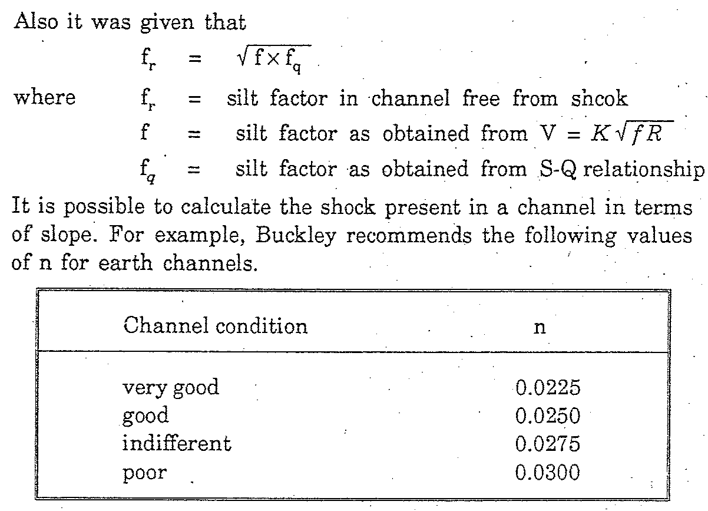
Lacey’s Shock Theory (1940)

Slide 47
Lacey’s Shock Theory (1940)

Slide 48
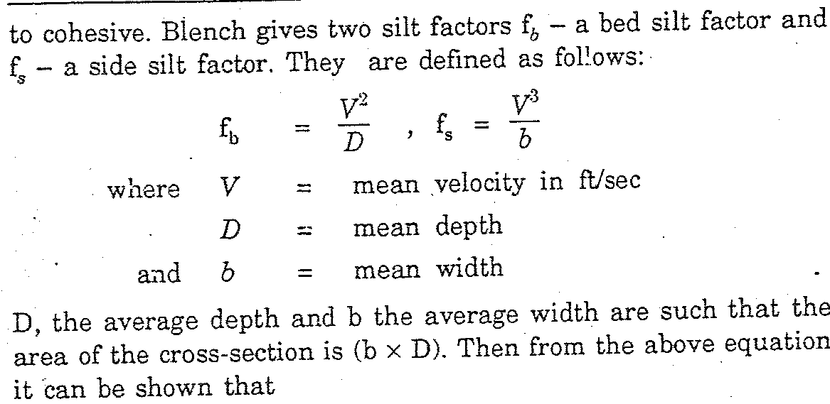
Blench’s Method (1951)

Slide 49
Blench’s Method (1951)
3

Slide 50
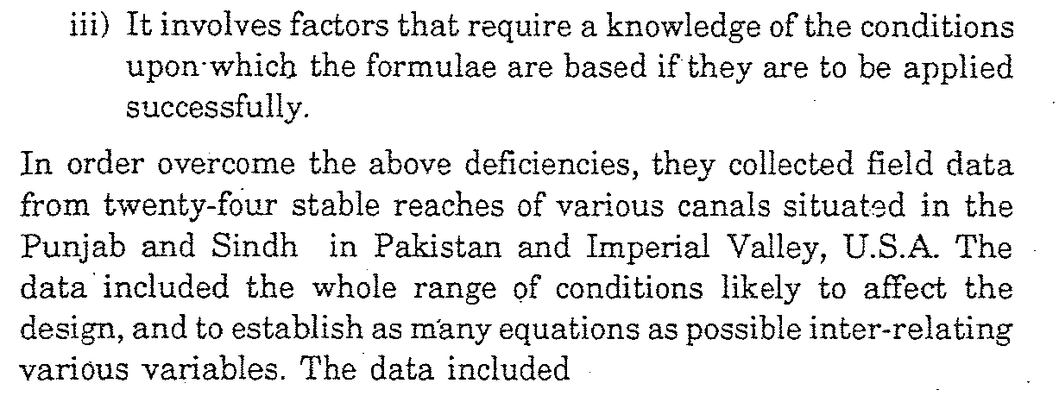
Simons and Albertson Method (1957)

Slide 51
Simons and Albertson Method (1957)

Slide 52
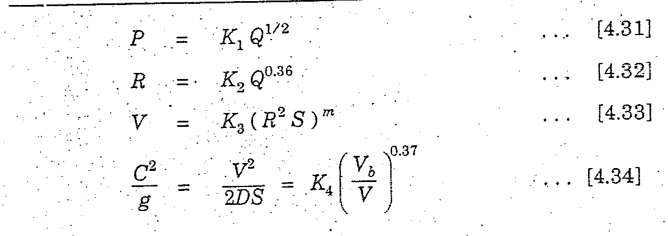
Simons and Albertson Method (1957)

Slide 53
Simons and Albertson Method (1957)

Slide 54
NUMERICAL
(1 +200 / 233)

Slide 55
NUMERICAL

Slide 56
Numerical

Slide 57
NUMERICAL
v² / gDS

Slide 58
NUMERICAL

Slide 59
Shahid and Watts (1994)
The authors proposed a new approach for the design of alluvial canal systems in Pakistan which was based on the analysis of ACOP (Alluvial Channel Observation Program) data observed for Punjab canals.
They suggested a modification in Lacey's regime equation to include the sediment concentration and sediment size in the slope equation.
The silt factor "f" in the regime equation was quantified by the following expression in relation to the total concentration of bed material load in ppm.

Slide 60
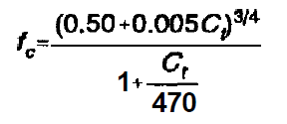
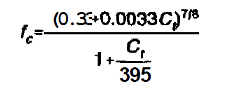
Shahid and Watts (1994)
For Indus River
For Jehlum River
For Chenab River
Channel Slope is given by

Slide 61
Rational Method
Design of unlined channels by rational method involves problem of sediment transport.
Canal sections will be stable if velocity, slope and cross section are such that all sediment entering in canal is swept away from the section, or if the clear water is flowing in the canal does not scour the cross-section.
Sediment load is divided into:
Bed Load
Suspended Load
Separate functions have been derived by various authors for both. These functions are empirical in nature, being based on laboratory experiments and field data.

Slide 62
Rational Method
Duboys Formula
Permissible Velocity Method
Tractive Force Method
Above formulae in combination with Manning and other formula are used to design channel by rational method
Ref. Irrigation and hydraulic Structures, Theory, Design and Practice By Dr Iqbal Ali

Slide 63
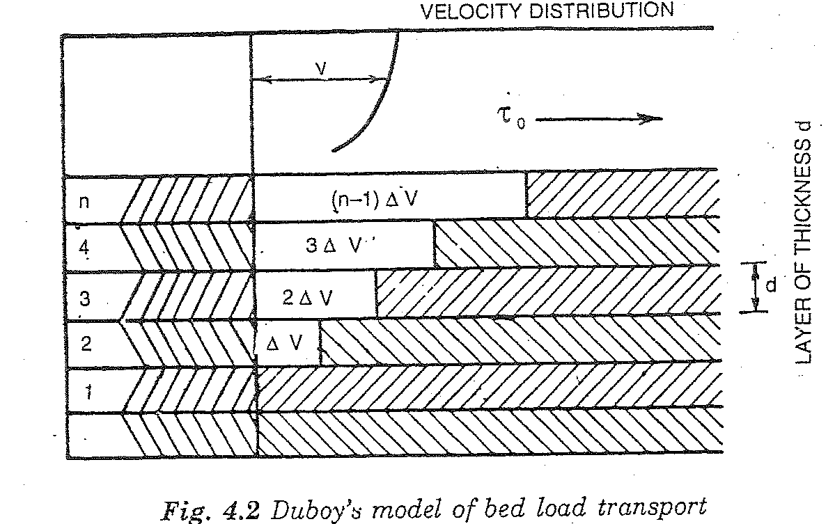
Rational Method
Bed Load Function-Duboys Formula
It is one of the oldest method in use.
The bed is assumed to move in layers of thickness, d, the same as that of particles, due to force exerted by the fluid.
The velocity of the layers is assumed to vary linearly by equal increments from zero to maximum.
Duboy’s model of bed load transport

Slide 64
Bed Load Function-Duboys Formula
Above eq. can be rewritten involving slope as
Using Chezy eq, Straub’s formula for Cs depth of flow,y, above eq can be written as
Now Using Manning's Equation
Ref. Irrigation and hydraulic Structures, Theory, Design and Practice By Dr Iqbal Ali
(Chapter 4)

Slide 65
Example
Design an unlined earthen channel to carry a discharge of 60 cfs with a bed load 100 PPM. Mean diameter of bed material is 0.25 mm
Solution

Slide 66
Example
Now using eq. below

Slide 67
PERMISSIBLE VELOCITY METHOD
Permissible Velocity Method
In permissible velocity method, channel size is selected such that mean flow velocity for design discharge under uniform flow conditions is less than permissible velocity.
Permissible Velocity
Permissible velocity is defined as the mean velocity at or below which bottom and sides of channels are not eroded.
Permissible velocity depends upon:
Type of soil
Size of particles
Depth of flow
Curvature of channel

Slide 68
PERMISSIBLE VELOCITY METHOD
Maximum permissible velocities for different materials are given in the table. The values listed in the table are for straight channels having flow depth of about 3 .50 ft.
These values should be reduced for sinuous channels as below:
Slightly sinuous channels = 5%
Moderately sinuous channels = 13%
Highly sinuous channels = 22%
For other flow depths, these velocities should be multiplied by correction factor to determine permissible flow velocity. Correction factor k for wide channels is:
k = y^{1/6}
where k = Correction factor y = Depth of flow

Slide 69
PERMISSIBLE VELOCITY METHOD

Slide 70
PERMISSIBLE VELOCITY METHOD
Procedure for design of channel by permissible velocity method is as follows:
Estimate n, Side slope (based on angle of repose) and Permissible velocity based on the given material from the table.
Area is found from continuity equation A = Q / V and hydraulic radius R from Manning equation.
Wetted perimeter is determined from P = A / R.
Using basic equation of area of trapezoidal section, y and b are determined.
Computed values are equated to expressions for P and A and resulting equations are solved to determine channel bed width and depth of flow.

Slide 71
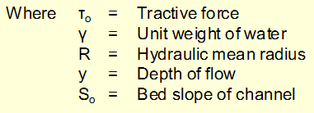
TRACTIVE FORCE METHOD
Tractive Force Method
Scour and erosion process can be viewed in rational way by considering forces acting on particles lying on channel bottom or sides. The channel is eroded if resultant of forces tending to move particles is greater than resultant of forces resisting motion. This concept is referred as tractive force approach.
Tractive Force
The force exerted by flowing water on bottom and sides of channel (force on the particles composing the perimeter of channel) is called tractive force. In uniform flow, this force is equal to component of weight acting in direction of flow and is given by

Slide 72
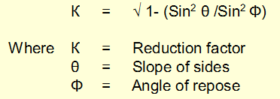
TRACTIVE FORCE METHOD
Critical Tractive Force
The force at which channel material begins to move from stationery condition is called critical tractive force. It is the permissible tractive force which will not cause serious erosion in the channel
Distribution of Tractive Force
Distribution of tractive force or shear stress over channel perimeter is not uniform. For trapezoidal channels, unit tractive force at channel bottom may be assumed equal to (γ y So) and at channel sides equal to 0.75 γ y So
Reduction Factor for Channel Sides
Reduction factor (tractive force ratio) for critical tractive force on channel sides is:
i.e K=Tractive force on side slope/Critical Tractive force

Slide 73
TRACTIVE FORCE METHOD
Effect of angle of repose should be considered only for coarse non cohesive materials and can be neglected for fine cohesive materials.
Critical shear stress for cohesive and non cohesive materials is given in the figures. These values are for straight channels and should be reduced for sinuous channels as below:
Slightly sinuous channels = 10%
Moderately sinuous channels = 25%
Highly sinuous channels = 40%

Slide 74
TRACTIVE FORCE METHOD

Slide 75
TRACTIVE FORCE METHOD
Design Procedure
Procedure for design of channel by tractive force method is as follows:
Determine n, angle of repose and Permissible (critical) shear stress based on given sediment size
Reduction factor, K, for channel sides is determined.
Unit tractive force on the side ( 0.75 γ y So) is equated to product of permissible shear stress (critical) and reduction factor to compute depth of flow.
Bed width is determined from Manning equation.

Slide 76
MISCELLANEOUS CONSIDERATIONS
Alignment of Irrigation Channels
Main and branch canals should be aligned along main ridges.
Distributaries should be aligned along secondary ridges.
Irrigation channels should not cross drainage system of area.
Obstacles such as roads, towns, railway lines, canals etc. should be avoided.
Direct irrigation should not be done from main and branch canals.
Main canal should be split into branch canals
Irrigation channels should be straight as far as possible
In case of curvature, suitable radius of curves should be provided. Radius of curve depends on discharge of canal but should be not less than10 to 15 times bed width of canal.

Slide 77
MISCELLANEOUS CONSIDERATIONS
Longitudinal Slope
Longitudinal slope is fixed as per Lacey equation. If slope of canal is flatter than grade of land, canal falls are provided at suitable intervals.
Side Slope
Side slope of canal should be so selected that they remain stable under all operating conditions. Side slope ranges from vertical to 1:3 for lined canals to 1:1/2 to 1:3 for unlined canals, depending on site conditions and angle of repose.

Slide 78
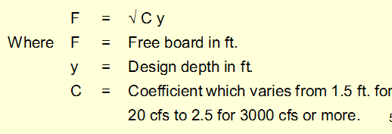
MISCELLANEOUS CONSIDERATIONS
Free Board
Free board is vertical distance between full supply level and top of canal banks. It depends on full supply depth and discharge of canal and generally ranges from 1 ft. to 4 ft. for small distributaries and main canals carrying 3000 cfs discharge. For canals carrying 10000 cfs or more discharge, it is 5.5 ft.
Following equation provides estimate for free board.

Slide 79
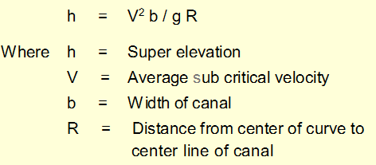
MISCELLANEOUS CONSIDERATIONS
Drainage behind Lining
In case of hydrostatic pressure behind lining, drainage of soil behind lining should be provided. Drainage may consists of filter blanket or transverse and longitudinal drains under the lining.
Super Elevation
Bed of canal is elevated on outer side as compared with inner side on curves to overcome effects of curvature, which is called super elevation. The effect of curvature is negligible if ratio of radius of curvature to distance to center of canal is greater than 3 times bed width of canal.
Super elevation can be calculated from the following equation.

Slide 80
MISCELLANEOUS CONSIDERATIONS
Berm Width
Berm is distance between edge of canal section and inner toe of canal bank. Berm width is usually kept between 2D to 4D, where D is full supply depth.

Slide 81
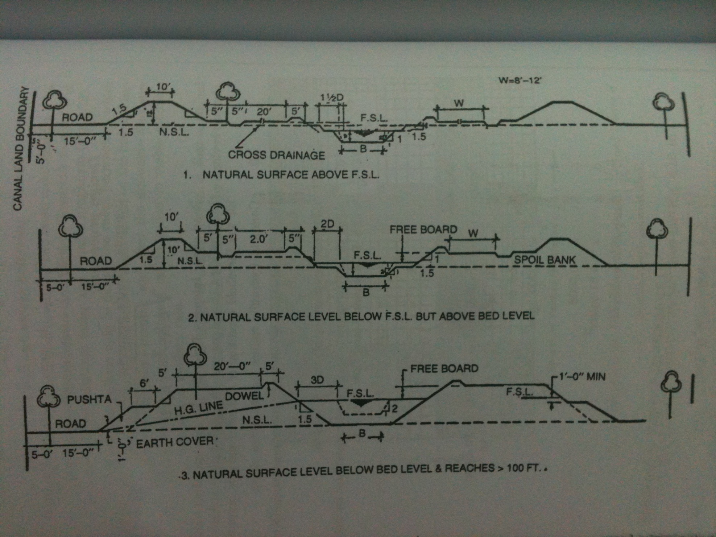
Typical Cross-sections of canal

Slide 82
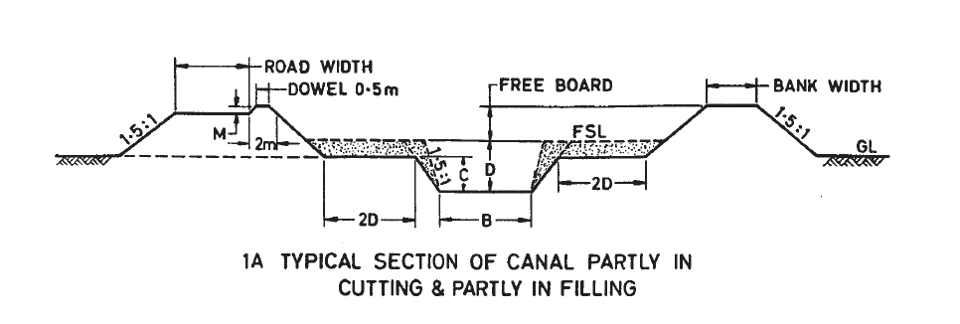
Typical Cross-sections of canal

Slide 83
Typical Cross-sections of canal

Slide 84
Canal Classification
Definitions
Permanent Canals: Permanent canals are those which are fed by a permanent source of supply such as ice fed rivers or reservoirs.
Perennial Canals: perennial canals are permanent canals which get continuous supplies from rivers throughout the year.
Non-Perennial Canals: Non-perennial canals are permanent canals which irrigate for a part of year, usually during the summer season and at the beginning and end of the of winter season.
Inundation Canals: Inundation canal is one which the supply depends upon the periodic rise of water level in the river from which it takes off.
Irrigation Canals: An irrigation canal carries water to the irrigation field.
Link Canals: Links canals are constructed for transporting the waters of the rivers to the canal systems. Qadirabad-Balloki Link Canal
Carrier Canals: A carrier canal in addition to supplying irrigation water, also carries water for another canal e.g. UCC
Feeder Canal: This feed two or more canals e.g. LCC

